Slide 1
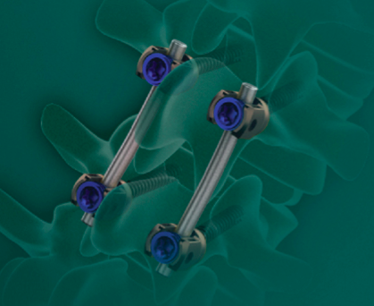

MAST® MIDLF™ Procedure with
Cortical Bone Screws
Ronnie I. Mimran, M.D.
Pacific Brain and Spine Medical Group
Danville, CA

Slide 2
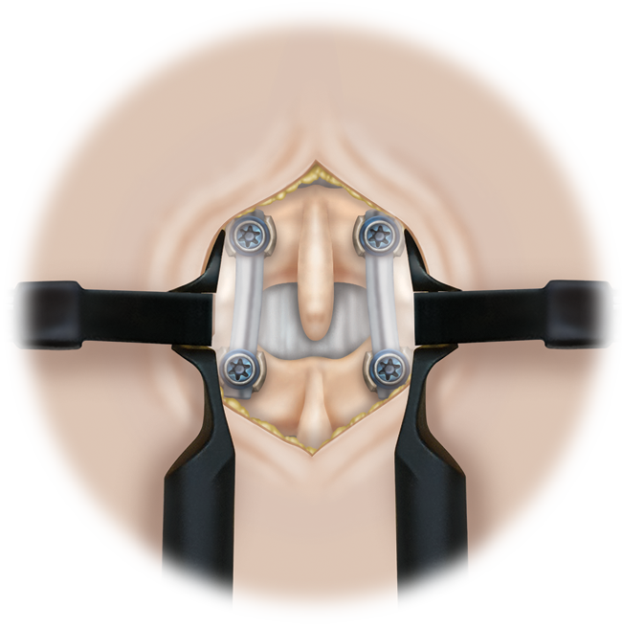
MAST® MIDLF™
Procedure
MAST® MIDLF™ Procedure
  Midline (laminectomy) anatomic approach
    Decompression
    Fusion
    Posterior fixation
  Medialized screw placement through stronger cortical bone
Notes:
Substantiation
Bruffey, J. D., P. D. Co., et al. (2011). Update in Minimally Invasive Spine (mis) Surgery: Clinical Examples of Anatomy, Indications, and Surgical Techniques, Center For Advanced Spinal Surgery of Southern Arizona.

Slide 3
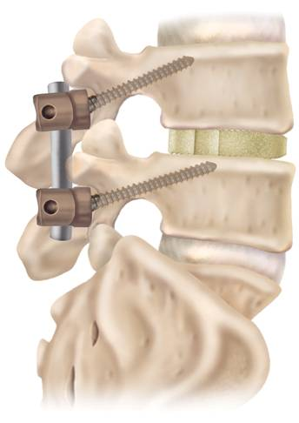
MAST® MIDLF™
Procedure
Considerations in:
  Osteoporotic Bone
  Revision Surgeries
  Large Patients
  Trauma (broken pedicles)
  Scoliosis
Notes:
Substantiation
Bruffey, J. D., P. D. Co., et al. (2011). Update in Minimally Invasive Spine (mis) Surgery: Clinical Examples of Anatomy, Indications, and Surgical Techniques, Center For Advanced Spinal Surgery of Southern Arizona.

Slide 4
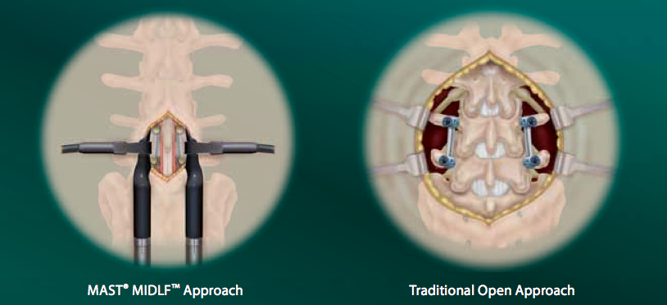
Cortical vs. Traditional Trajectory

Slide 5
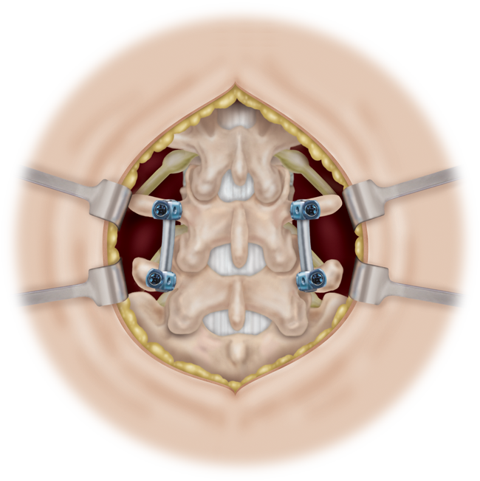
Traditional vs. Cortical Trajectory

Slide 6
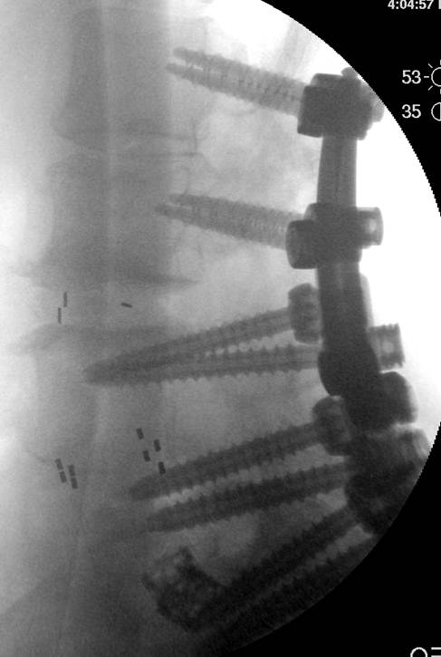
Considerations
Anatomical Landmarks
Exposure Time
Muscle Retraction
Quality of Bone
Hardware Removal
Rod Placement
Volume of Bone Graft
Closure Time
Associated risks include fracture, microfracture, resorption, damage, or penetration of spine bone

Slide 7
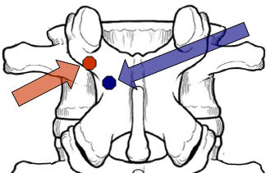
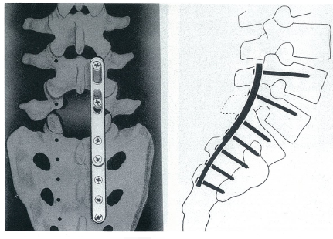
Technique Origin
1986 – Art Steffee coins the term “Force Nucleus” – convergence point of pedicle, pars/lamina, TP, SAP – an area of significant strength due to high cortical bone content
Roy-Camille’s “Straight-In” screw/plate construct used a similar starting point for its trajectory
Notes:
Steffee, A. D., R. S. Biscup, et al. (1986). "Segmental spine plates with pedicle screw fixation. A new internal fixation device for disorders of the lumbar and thoracolumbar spine." Clin Orthop Relat Res(203): 45-53.

Slide 8
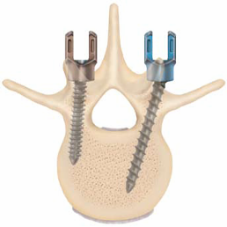
The Screw
Utilizes existing CD Horizon® LEGACY™ Spinal System Instrumentation
Tapping is essential
  Includes Cortical Taps matching thread pitch of the Screw
  Line-to-Line Tapping
Multiple Screw Diameters available
  4.0mm, 4.5mm, 5.0mm, and 5.5mm
  6.5mm and 7.5mm also available
Lengths range from 15mm to 30mm
  Common length 25-30mm
Associated risks include tissue or nerve damage caused by improper positioning and placement of implants
Cortical Trajectory
Traditional Trajectory

Slide 9
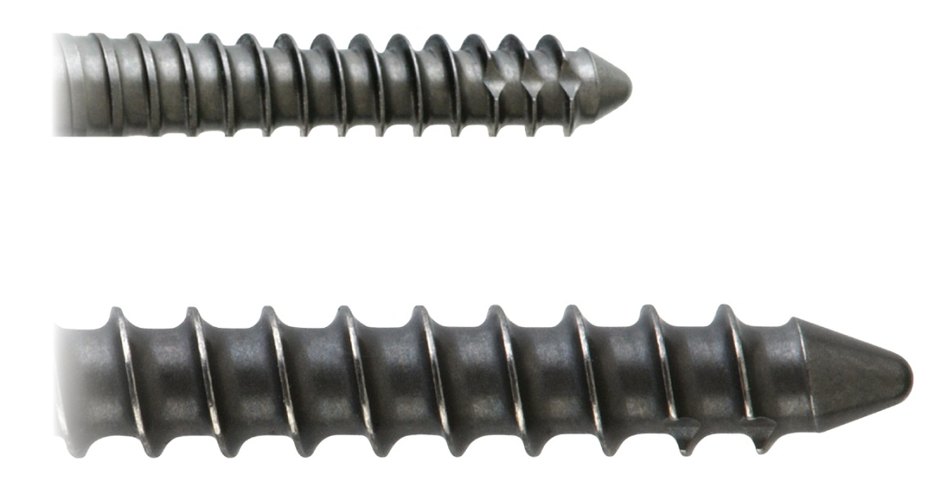
Thread Pattern
Cortical
Traditional

Slide 10
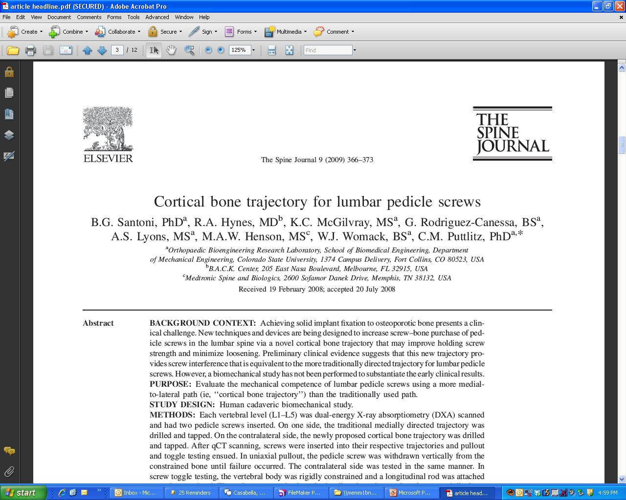
Notes:
Substantiation:
Santoni BG, et al. Cortical bone trajectory for lumber pedicle screws. Spine J. 2008 Sep 12.

Slide 11
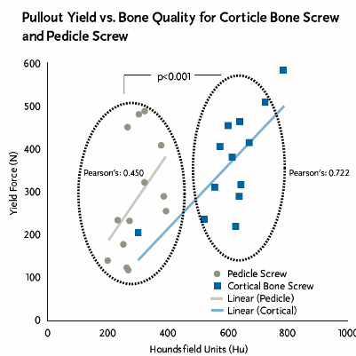
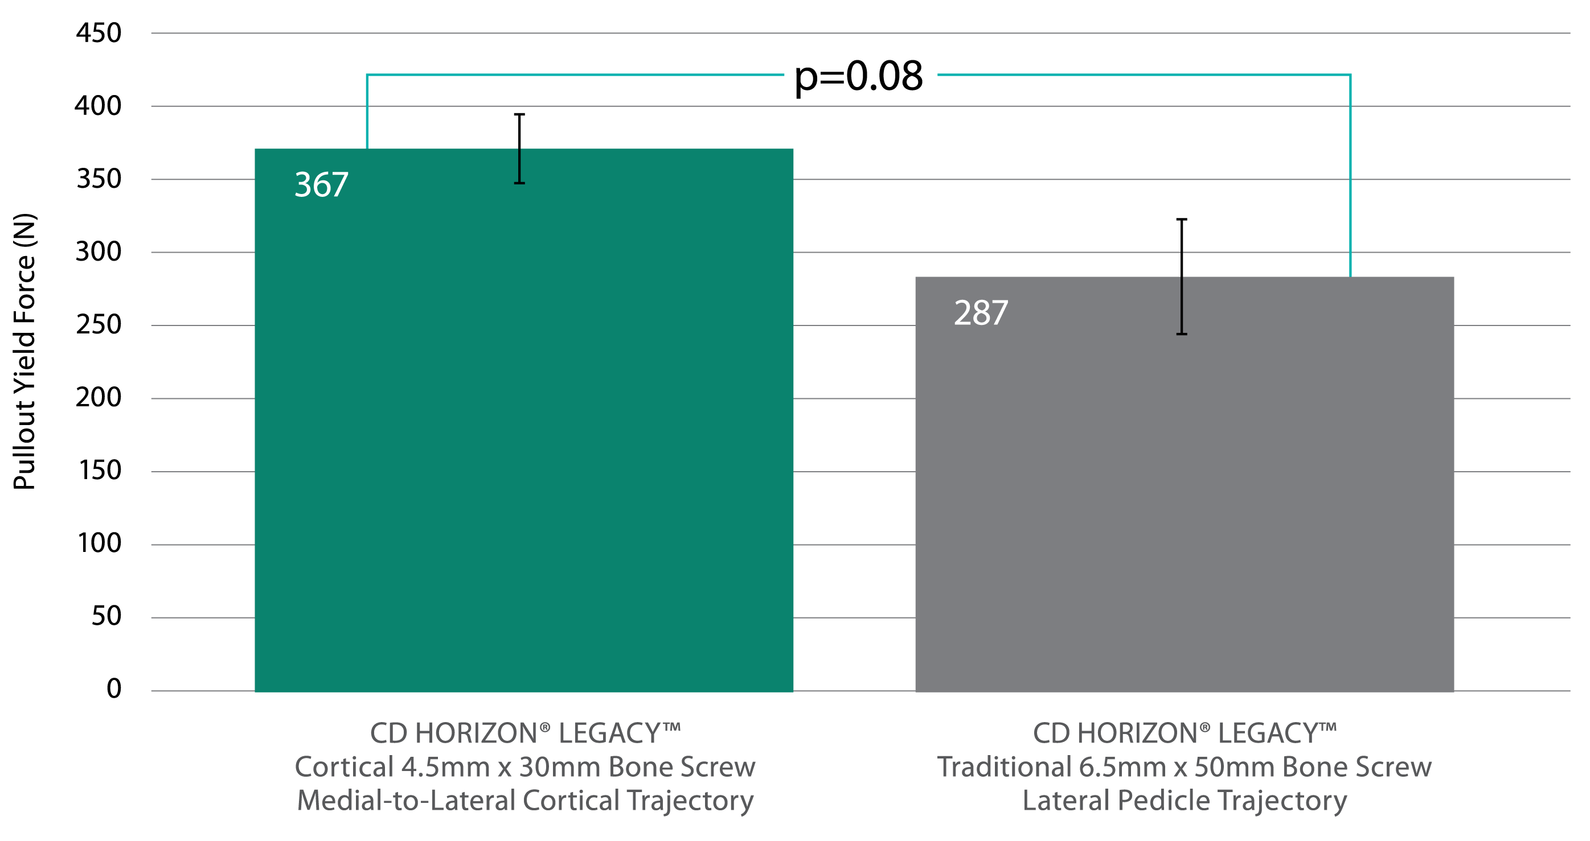
Pullout Strength and Bone Quality Results
Biomechanical (cadaveric) testing is not necessarily indicative of human outcomes. N = 5 cadavers
Biomechanical (cadaveric) testing is not necessarily indicative of human outcomes. N = 5 cadavers
PULLOUT TESTING
Biomechanical (cadaveric) testing is not necessarily indicative of human outcomes. N = 5 cadavers
Trend toward higher pullout strength
Traditional Screws = 6.5mm x 50mm
Cortical Screws = 4.5mm x 30mm
Cortical trajectory surrounded by higher density bone
Santoni BG, et al. Cortical bone trajectory for lumbar pedicle screws. Spine J. 2008 Sep 12.
Notes:
Santoni BG, et al. Cortical bone trajectory for lumbar pedicle screws. Spine J. 2008 Sep 12.
Biomechanical (cadaveric) testing is not indicative of human outcomes.

Slide 12
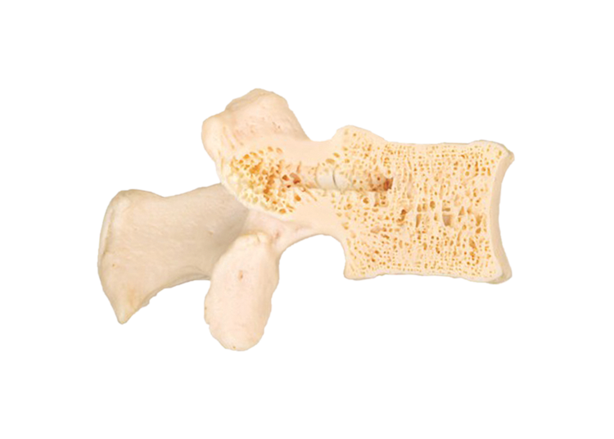
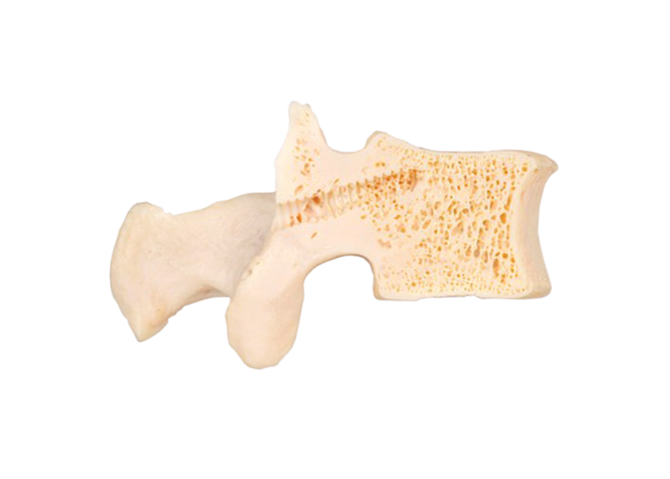
Trajectory Bone Quality Comparison
Circled area indicates trajectory surrounded by higher density cortical bone
Traditional Screw Trajectory
Cortical Bone Trajectory
Image based on lab created actual patient CT image with digitally imposed screw threads to illustrate bone density

Slide 13

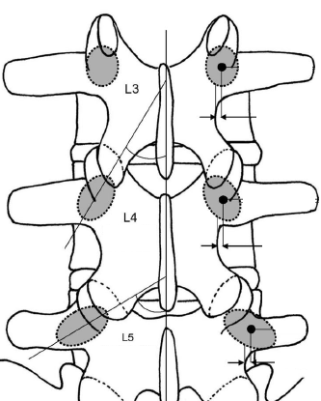
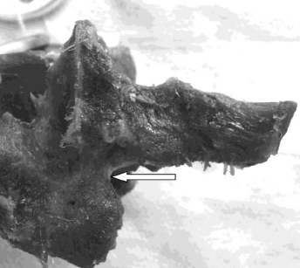
Cortical Fixation Bone Quality
“The MLP (mid-lateral pars) is a distinct anatomic area, which is routinely visualized during posterior exposure and consists of dense cortical bone which does not become arthritic or deformed in the setting of degenerative disease.”
L3
L4
L5
Su BW, Kim PD, Cha TD, Lee J, April EW, Weidenbaum M, Vaccaro AR. An anatomical study of the mid-lateral pars relative to the pedicle footprint in the lower lumbar spine. Spine (Phila Pa 1976). 2009 Jun 1;34(13):1355-1362.
Notes:
Substantiation:
Brian Su, Paul Kim, Thomas Cha, Joseph Lee, Ernest April, Mark Weidenbaum, and Alexander Vaccaro. An Anatomical Study of the Mid-Lateral Pars Relative to the Pedicle Footprint in the Lower Lumbar Spine. SPINE 34(13): 1355-1362, 2009.

Slide 14
Overview of the Technique
Drill Dependent
Drill is needed to Start
Finish with Drill or Gear Shift (Probe) Device
Orientation
Medial to Lateral, Away From the Neural Elements
Placement
Instrumentation Is Delivered More Centrally
Adjunct to Fusion
Anterior Column Support, e.g., TLIF or DLIF

Slide 15
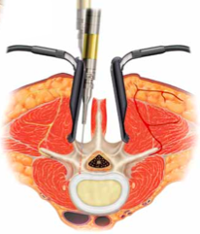
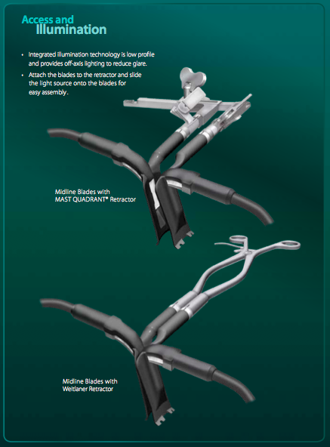
The Midline Access Retractor

Slide 16
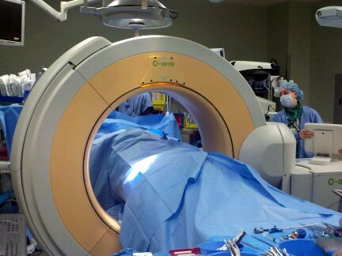
O-Arm Scan
Drape patient to remain sterile, run spin, and remove O-arm for consideration of space.
** TIP - O-Arm can be draped and remain in the sterile field. This may be very helpful in using the M2D feature of the O-Arm and eliminate the need for a C-Arm.
** TIP - With proper planning the scan can take place while the surgeon is scrubbing, thus eliminating any delays.

Slide 17
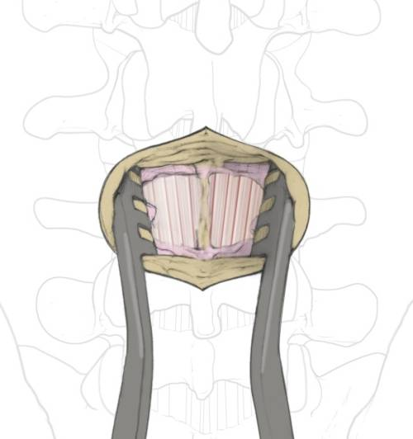
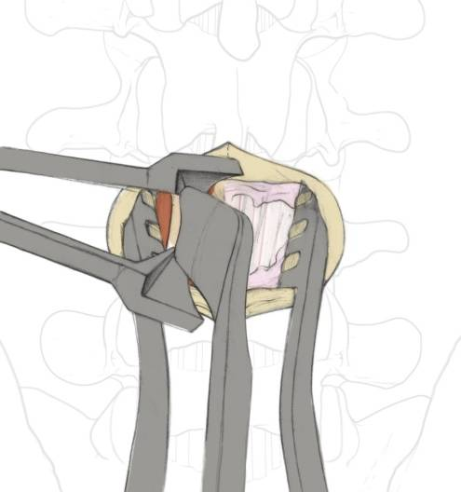
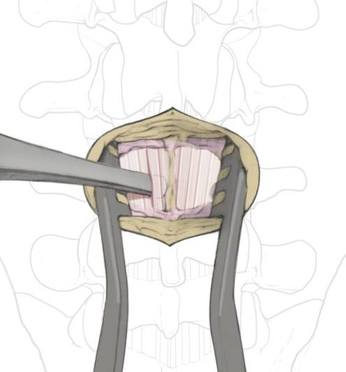
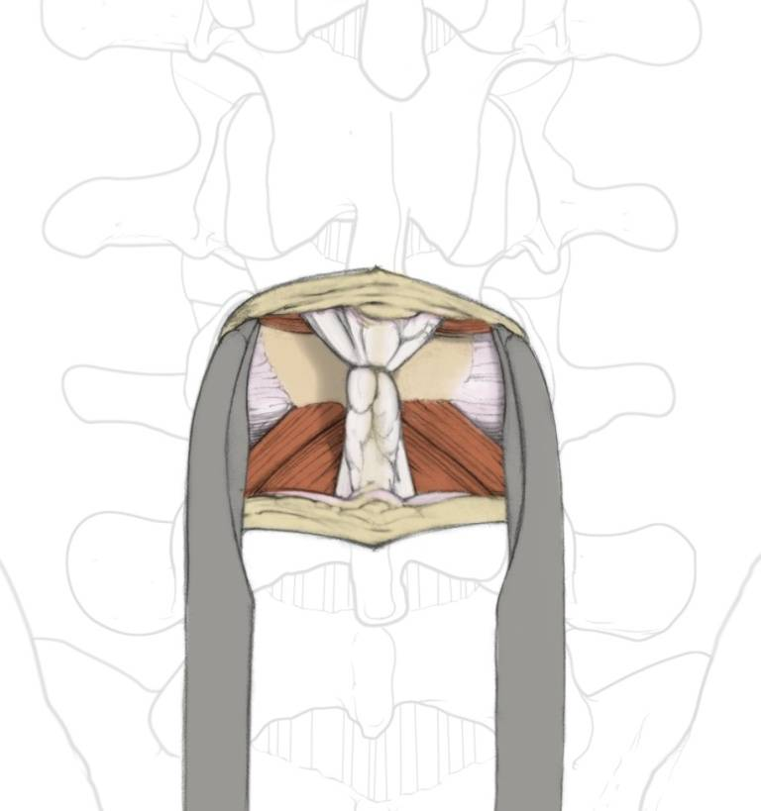
Midline Approach to Fusion
1
3
2
4
Notes:
Substantiation
Bruffey, J. D., P. D. Co., et al. (2011). Update in Minimally Invasive Spine (mis) Surgery: Clinical Examples of Anatomy, Indications, and Surgical Techniques, Center For Advanced Spinal Surgery of Southern Arizona.

Slide 18
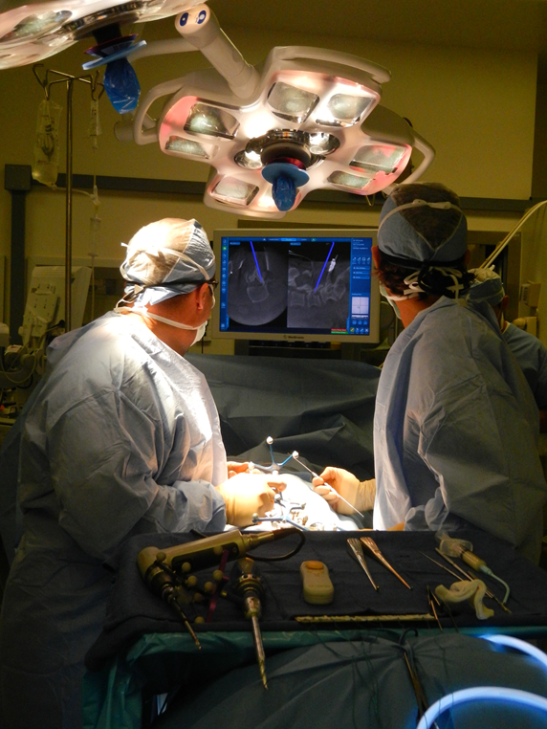
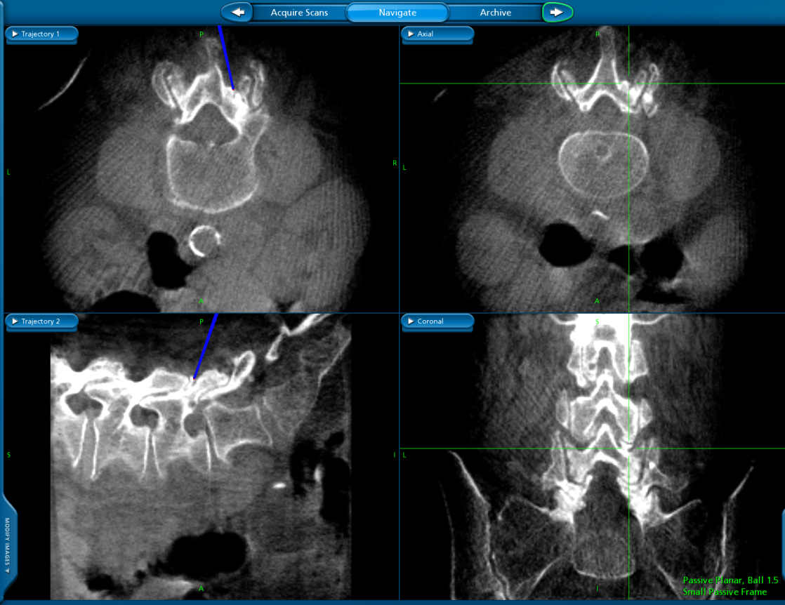
Planning and Navigation
Use Planar Probe to identify incision site and/or plan initial trajectory of screws

Slide 19
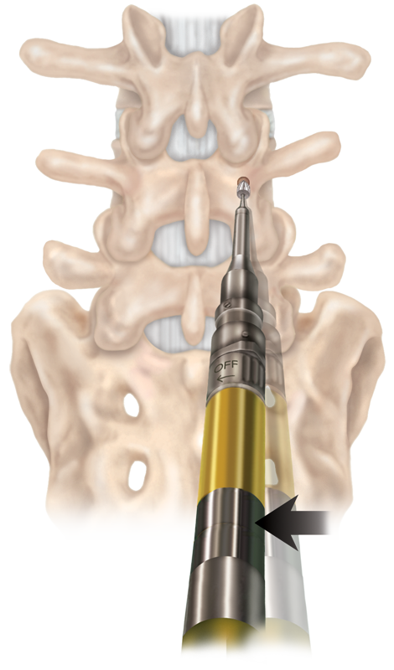
Approach and Starting Points
Midline Laminectomy exposure
Determine the starting point and use a Medtronic drill with an acorn tip or PowerEase drill. A two-hand drill technique is required. The starting point is pure cortical bone.
The drill is aimed at the starting point and laid down in a medial/lateral direction to make a 2 to 3mm sulcus

Slide 20
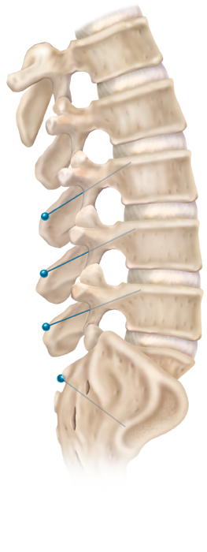
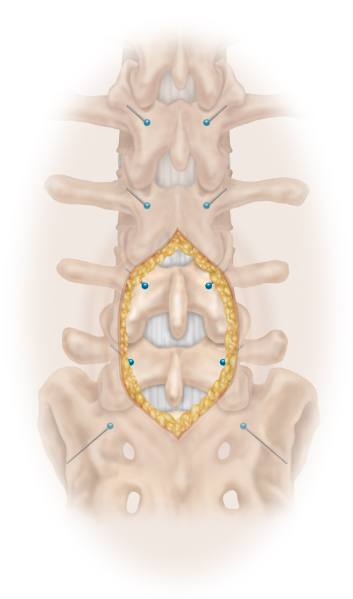
Typical Cortical Starting Points

Slide 21
Typical Cortical Starting Points
Orthogonal AP View
Draw a tangent line through medial border and inferior border
Where these lines intersect is the typical starting point for CBS
Drill to midpoint of pedicle then switch to lateral

Slide 22
Establishing a Trajectory
Rotate the drill handle to achieve a medial/lateral drill trajectory over
the top of the neuroforamen
  The central canal is medial, and the exiting nerve root is caudal
Drill should be advanced slowly through the 5 to 15mm of
cortical bone
  Slight tapping or “Pistoning”
  of the drill may be helpful
  A gearshift can be used in the cancellous bone of the pedicle

Slide 23
Fluoroscopic guide

Slide 24
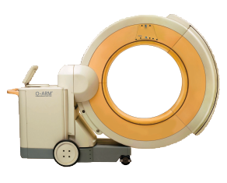
Intraoperative Imaging
O-ARM® Imaging System

Slide 25
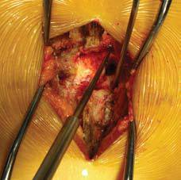
Tapping the Pilot Hole
Tapping is done with a very sharp cortical threaded tap due to the bone density
Perform line-to-line tapping the entire length. The threaded portion of the tap is 30mm
Drill and tap prior to performing bony decompression. Decompression should be performed so a minimum of
3mm of bone remains

Slide 26
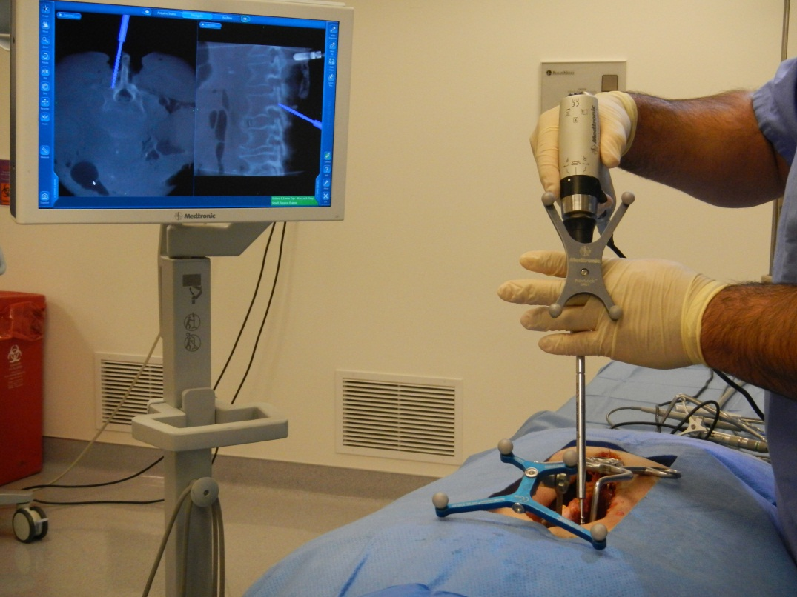
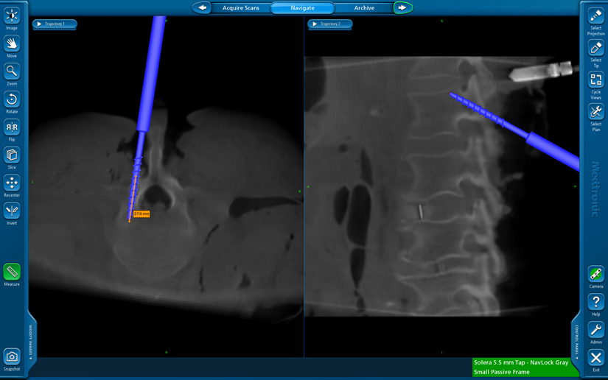
Tap the pilot holes
TIP: You may use a negative projection on the tap to measure the size of your desired screw. Then “save plan” to drop a virtual guidewire to more easily find your hole with the screw.

Slide 27
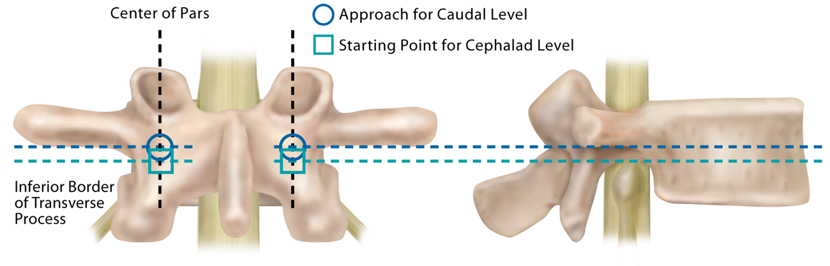
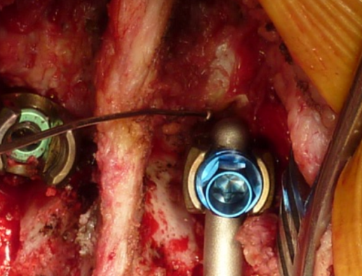
Cephalad vs. Caudal Starting Points
Recommended entry point at the most cephalad instrumented level is one to two millimeters inferior, relative to the starting point for the caudal levels.

Slide 28
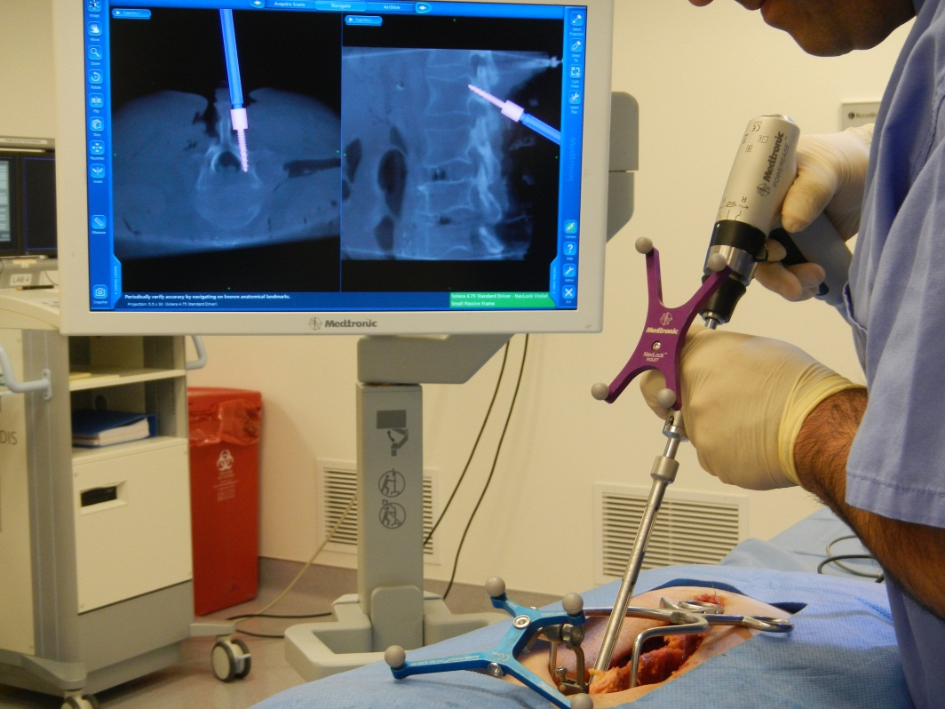
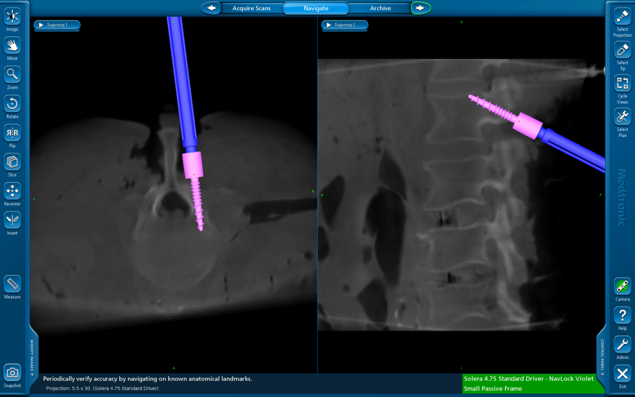
Place screws

Slide 29
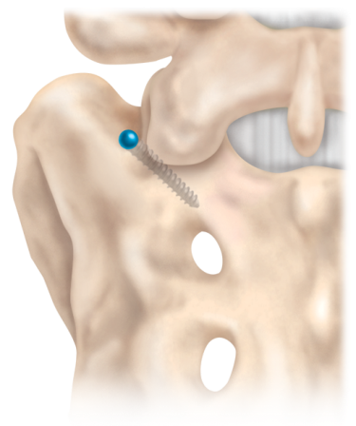
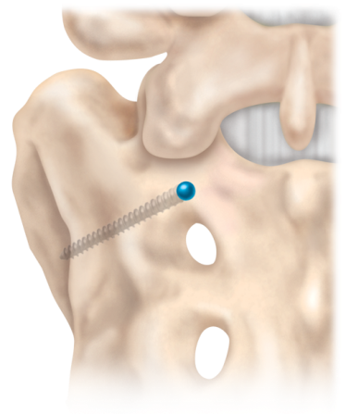
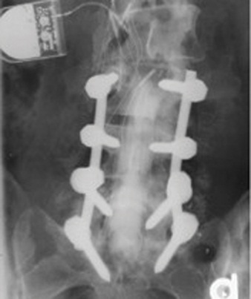
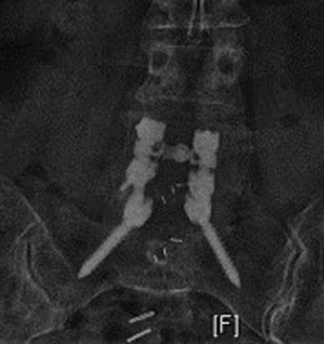
S1 Screw Placement Options
Traditional Pedicle Trajectory
Alar Trajectory

Slide 30
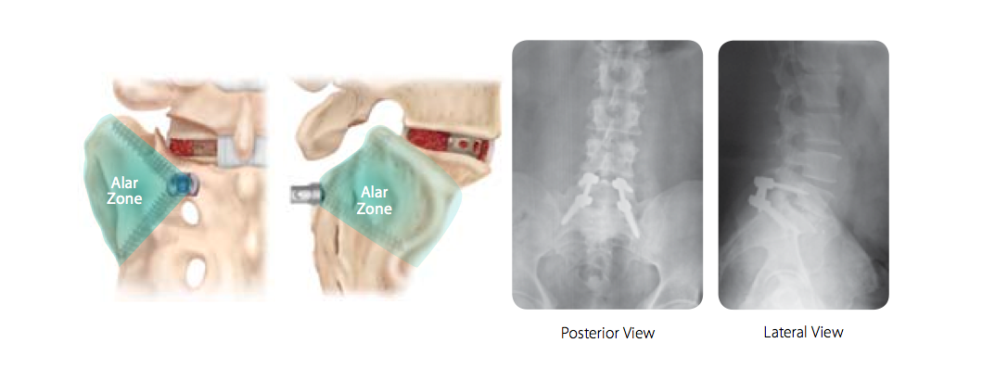

Slide 31
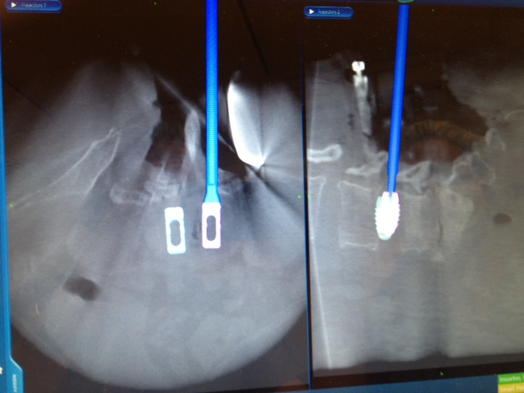
Decompression / Interbody
Tip – Use the Planar probe at any time during interbody work to confirm amount or location of disc prep
Tip - Tactile feel should determine appropriate graft height. AXIAL navigation image can confirm trajectory and depth of graft placement.

Slide 32
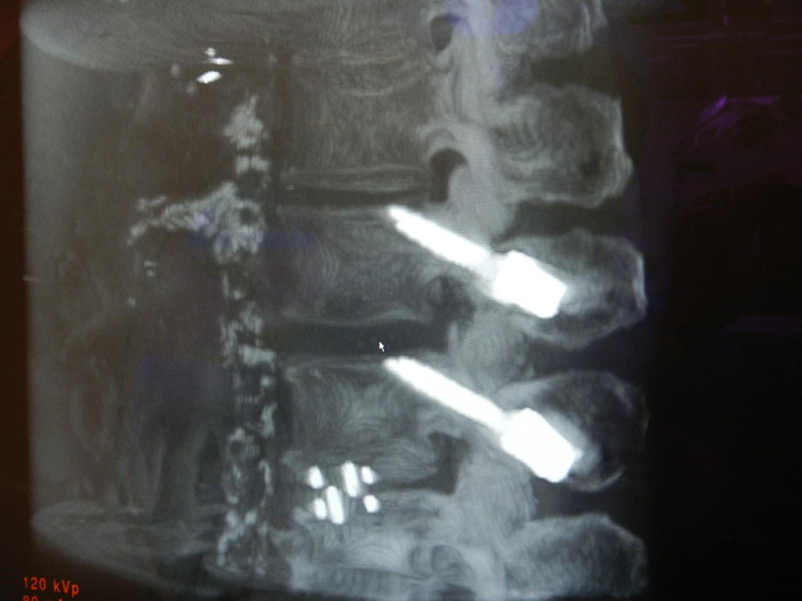
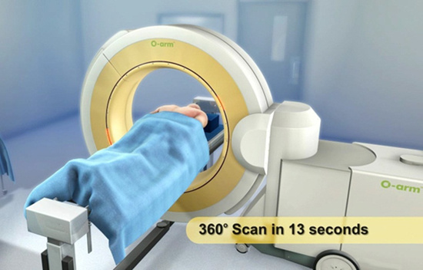
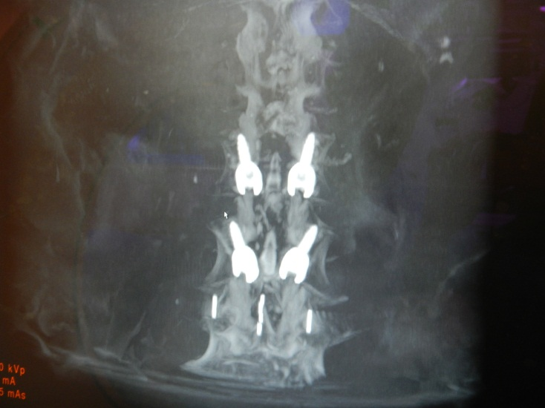
Acquire Post-Op Scan
Post-op O-arm scan can be used to confirm placement of screws, rods, and interbody graft.
Can also assess things like extent of decompression, reduction of deformity, and restoration of disc height.

Slide 33
Key Points
Proven technique
  True minimally invasive surgery using MAST® MIDLF™ Procedure platform
Case Considerations
  Osteoporotic Bone
  Revision Surgeries
  Large Patients
  Trauma (broken pedicles)
  Scoliosis
Biomechanical Data ⁽¹⁾
  Greater Density
Learning Curve
  Drill Technique
  O-ARM® imaging system or Fluoro recommended
Retrospective study, Lateral vs. Medial
  Paper in development
  ⁽¹⁾ Santoni BG, et al. Cortical bone trajectory for lumbar pedicle screws. Spine J. 2008 Sep 12.
Notes:
Substantiation
Bruffey, J. D., P. D. Co., et al. (2011). Update in Minimally Invasive Spine (mis) Surgery: Clinical Examples of Anatomy, Indications, and Surgical Techniques, Center For Advanced Spinal Surgery of Southern Arizona.

Slide 34
Summary of Indications
The CD HORIZON® Spinal System with or without SEXTANT® instrumentation is intended for posterior, non-cervical fixation as an adjunct to fusion for the following indications: degenerative disc disease (defined as back pain of discogenic origin with degeneration of the disc confirmed by history and radiographic studies); spondylolisthesis; trauma (i.e., fracture or dislocation); spinal stenosis; curvatures (i.e., scoliosis, kyphosis and/or lordosis); tumor; pseudarthrosis; and/or failed previous fusion.
Except for hooks, when used as an anterolateral thoracic/lumbar system, the CD HORIZON® Spinal System may also be used for the same indications as an adjunct to fusion.
CAPSTONE® Spinal System and CRESCENT® Spinal System are indicated for interbody fusion with autogenous bone graft in patients with Degenerative Disc Disease (DDD) at one or two levels from L2 to S1. These DDD patients may also have up to Grade 1 Spondylolisthesis or retrolisthesis at the involved levels. These patients should be skeletally mature and have had six months of non-operative treatment. These devices are intended to be used with supplemental fixation instrumentation, which has been cleared by the FDA for use in the lumbar spine.
Please see the package insert for the complete list of indications, warnings, precautions,
and other medical information.

