Slide 1
OLIF25™ Procedure
Surgical Technique
Ronnie Mimran, MD
Pacific Brain and Spine Medical Group
Danville, CA

Slide 2
Surgical Technique
Ronnie I. Mimran, MD
Danville, CA

Slide 3
DLIF Vs. Oblique Lateral Technique
Standard
Oblique
Pre-op planning (X-Rays)
Needle electrode setup
Patient positioning
Fluoroscopic localization
Incision at Midbody
Dissection to psoas
Neuromonitor (through psoas)
Dilation/Retractor placement
Fusion preparation (Laterally)
Trial/Distract – Implant
Closure
Pre-op planning (Axial MRI)
Needle electrode setup
Patient positioning
Fluoroscopic localization
Incision 5cm Anterior to Mid-Body
Dissection to psoas
Neuromonitor (Anterior to Psoas)
Dilation/Retractor placement
Fusion preparation (Orthogonally)
Trial/Distract – Implant (Orthogonally)
Closure

Slide 4
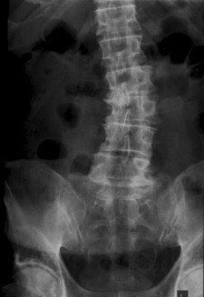
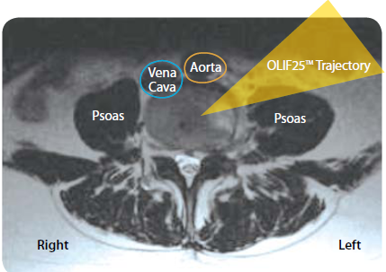
Pre-op Planning
Standard
Oblique
Check for unfavorable anatomy (X-Rays)
High iliac crest at L4-5
Long 11th and 12th ribs
Check for unfavorable anatomy (Axial MRI)
Kidneys
Irregular Vasculature
Notes:
Unfavorable anatomy
Evaluate the position of the iliac crest relative to L4-5 disc
General rule if above midline of L4 body, don’t try.
If below midline of L4 boday, can usually be reached by breaking the table
Long 11th or 12th rib
Will have to go either go intercostal or take part of rib
Concavity vs. Convexity
surgeons preference varies
Concave – Hit two levels through 1 skin incision
Convex- easier to do discetomy
Go in on side that appears easiest to access on x-rays (e.g., due to crest,)
Surgeon comfort
Correction can be equally good from either side; consider ease of access
Ultimately, whichever side lets you reach L4-L5 the easiest

Slide 5
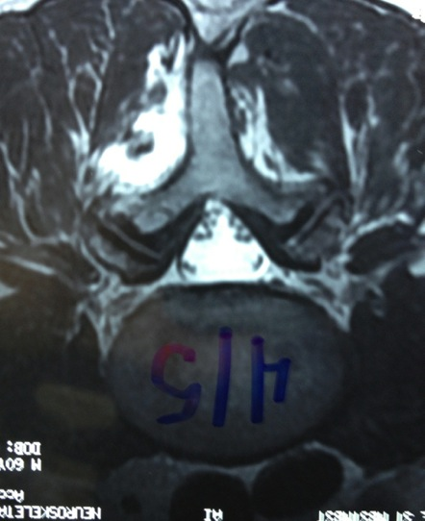
Pre-op Planning
Standard
Oblique
Vena Cava
Aorta
Vena Cava
Aorta
Oblique Access
Psoas
Standard Zone
Psoas
Psoas
Psoas
Right
Left
Right
Left

Slide 6
DLIF Vs. Oblique Positioning
Standard
Oblique
Put In Lateral Position with Right or Left Side Up
Axillary Roll and Pillows Between Arms and Legs
Break Bed at Patient’s Crest
Flex Both Hips and Knees
Surgeon Works at Anterior or Posterior Side of Patient
Put In Lateral Position ALWAYS Left Side Up
Axillary Roll and Pillows Between Arms and Legs
Do not have to break Patient on Bed
Patient Legs Can be Extended
Surgeon Works at Anterior Side of Patient

Slide 7
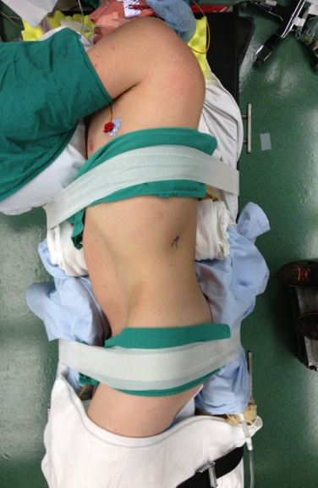
Standard
Oblique

Slide 8
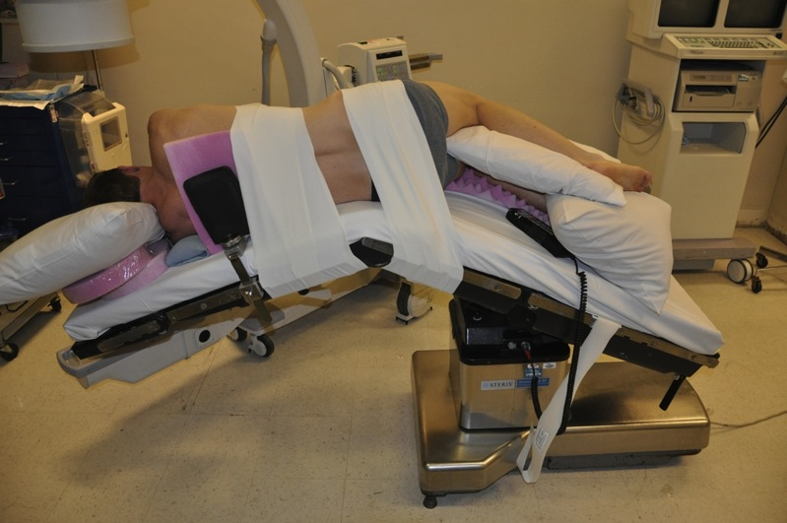
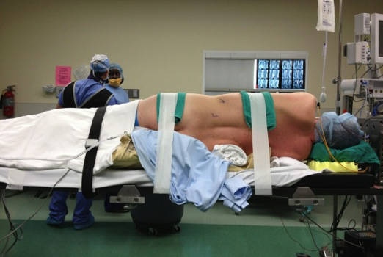
Tape Circumferential Around Bed
Oblique
C-Arm is Posterior
Surgeons Stand Anterior
Standard
C-Arm is Anterior or Posterior
Surgeons Stands Anterior or Posterior

Slide 9
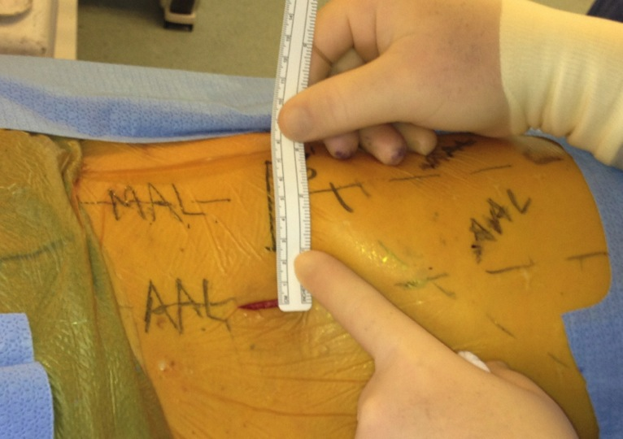
Patient Marking
Incision 5cm off of MAL
Standard
Oblique

Slide 10
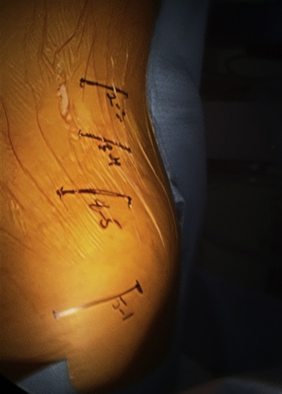
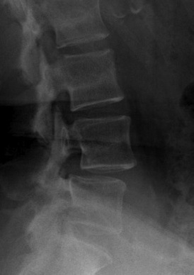
Skin Marking
Standard
Oblique
Ant
Post
Ant
Post

Slide 11
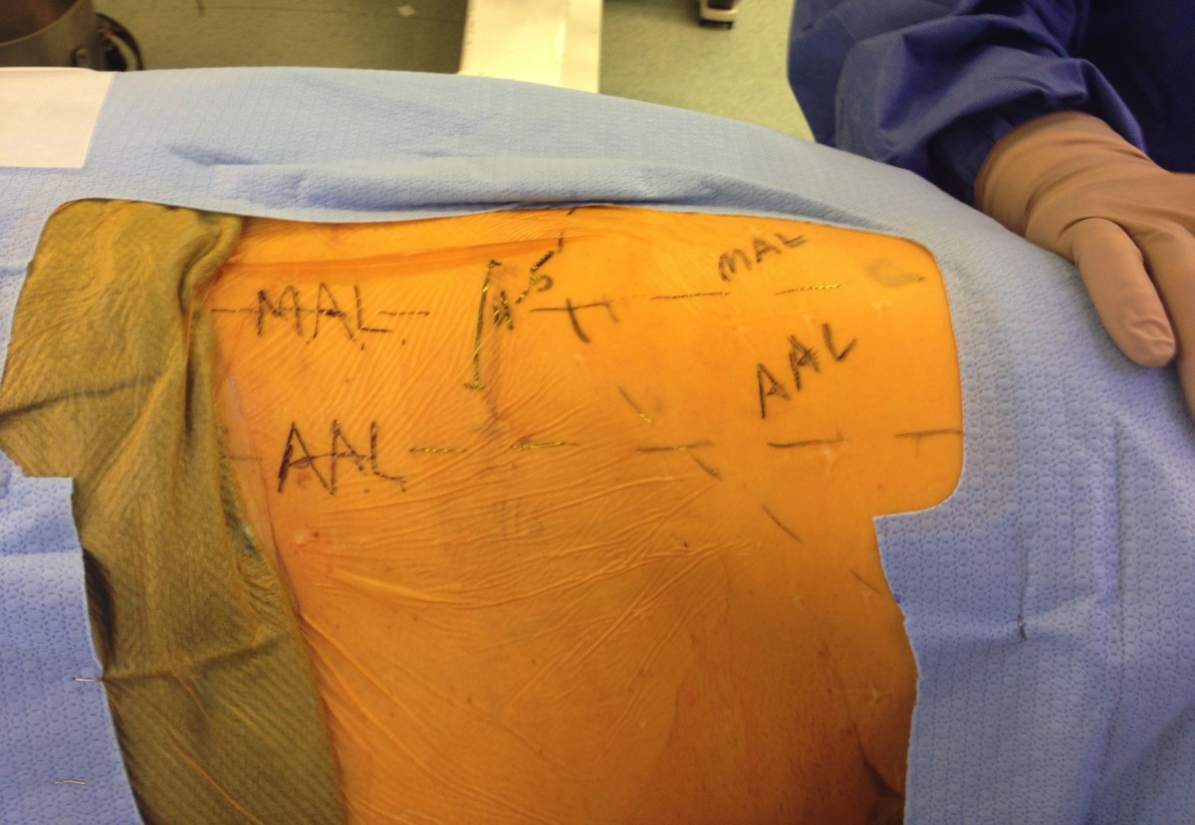
Incision Comparisons – Traditional Lateral ALIF
L4/L5
Traditional Lateral ALIF

Slide 12
Incision Comparisons - DLIF
L4/L5
DLIF Incision

Slide 13
Incision Comparisons – Roussouly OLIF
L4/L5
OLIF As Described by Roussouly

Slide 14
Incision Comparisons – Hynes OLIF
L4/L5
OLIF As Described by Hynes

Slide 15
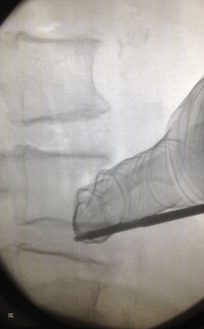
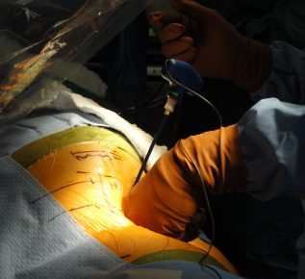
Dissection down to the disc space – use finger to protect peritoneal membrane

Slide 16
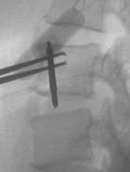
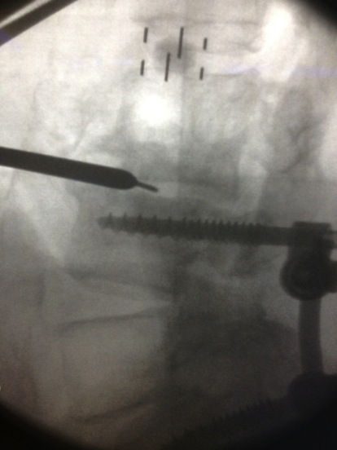
NIM® Probe
Standard
Oblique

Slide 17
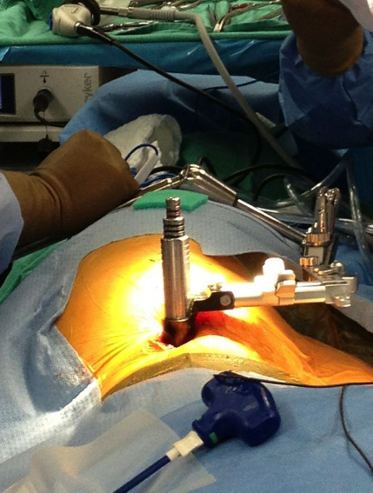
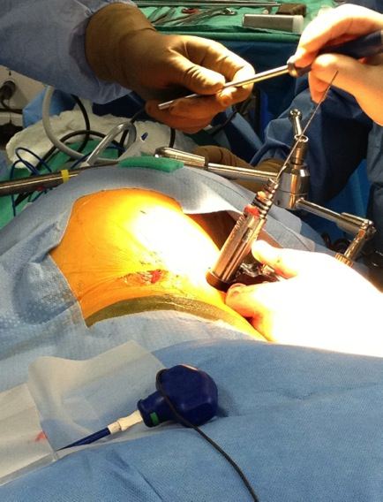
Dilation
Standard
Oblique

Slide 18
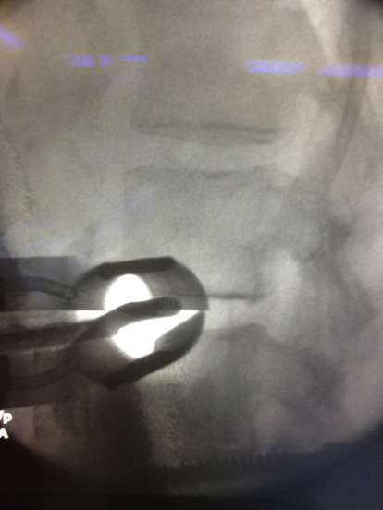
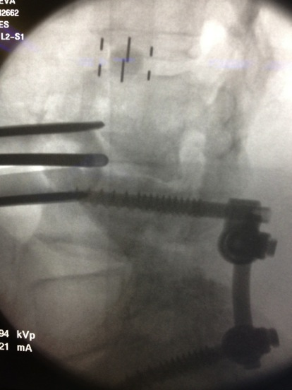
Retractor Placement
Standard
Oblique

Slide 19
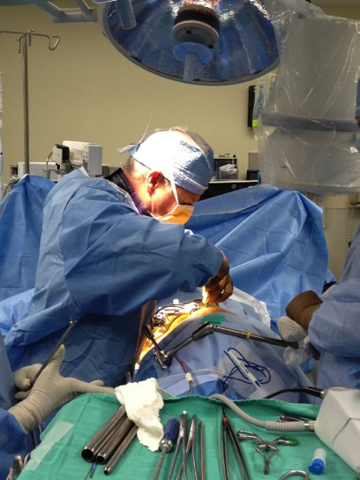
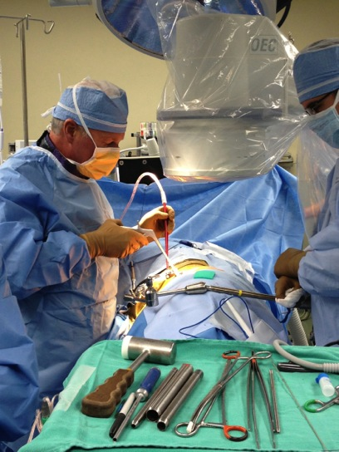
Working Position
Standard
Oblique
C-Arm Stationery
C-Arm Moves
Head Position
Head Position
Shoulder
Hands
Bending
Erect

Slide 20
SIGNATURE MOVE

Slide 21
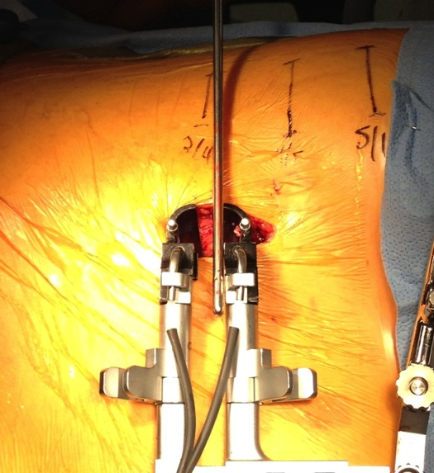
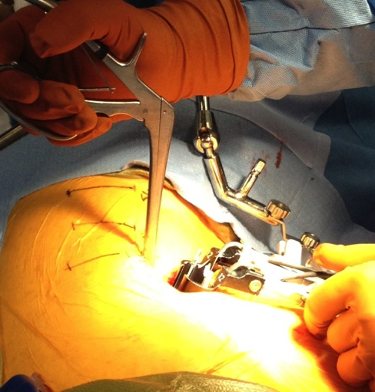
Orthogonal Maneuver
Proper Placement of Retractor Allows for rotation of:
Disc Prep Instruments (still able to get to contralateral side of disc space
Trials
Implant

Slide 22
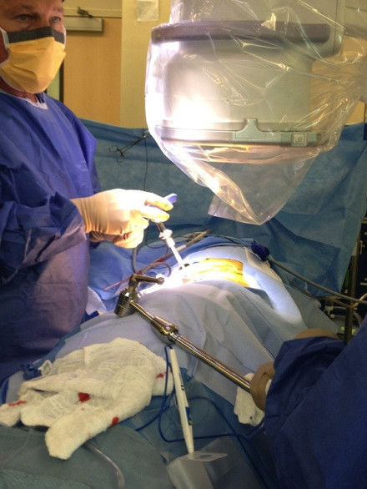
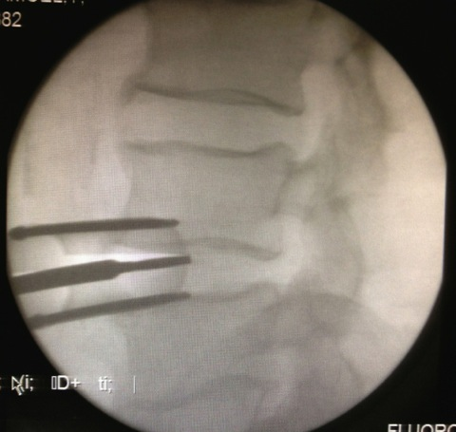
OM – Disc Prep

Slide 23
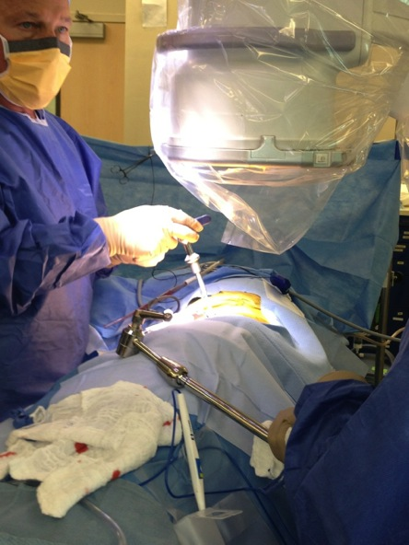
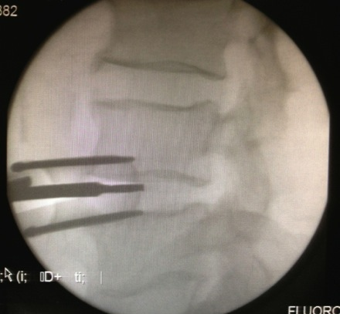
OM – Disc Prep

Slide 24
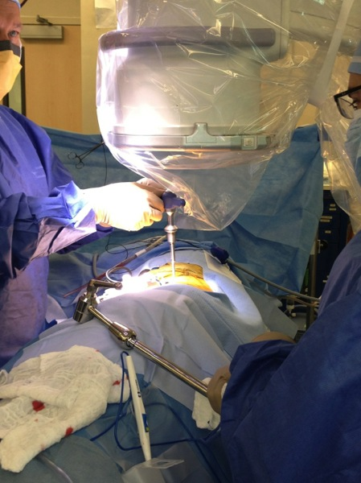
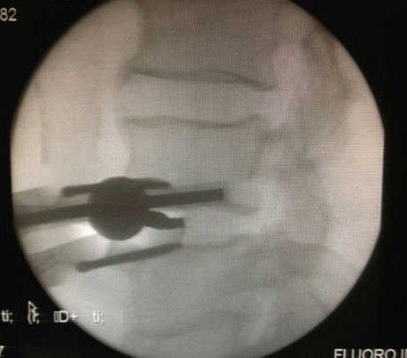
OM – Disc Prep

Slide 25
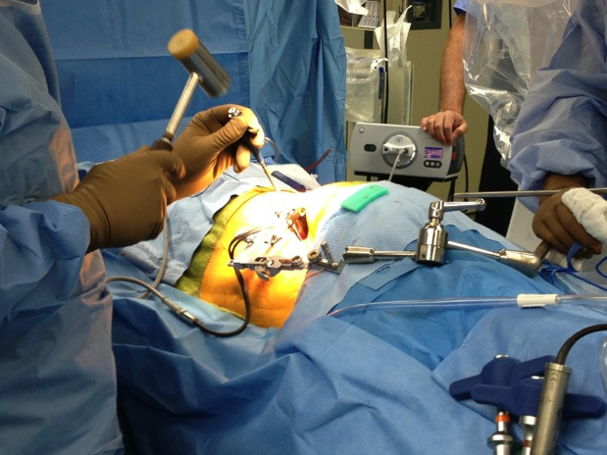
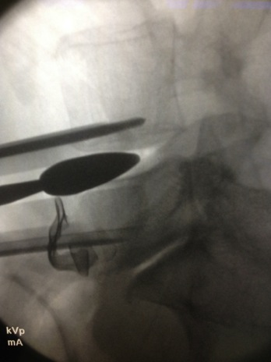
Distraction

Slide 26
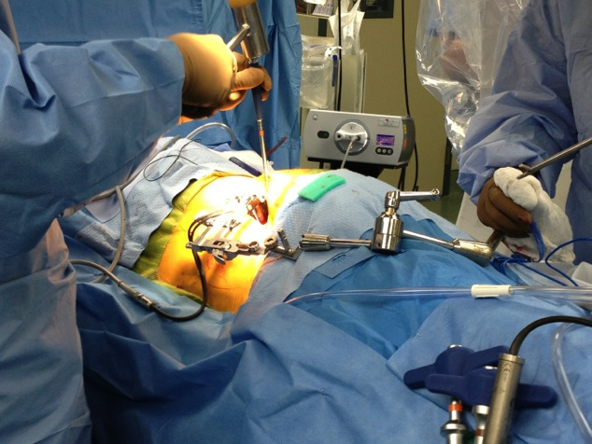
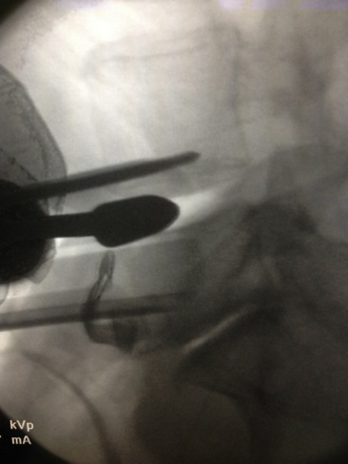
Distraction

Slide 27
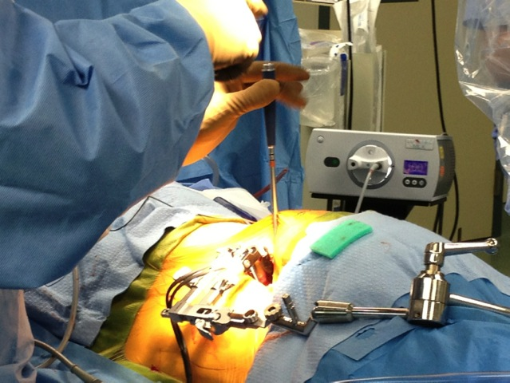
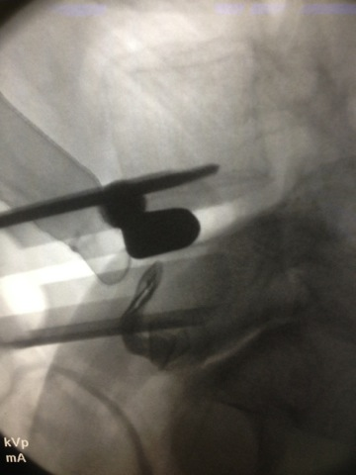
Distraction

Slide 28
CLYDESDALE ® Spinal System Indications
The CLYDESDALE® Spinal System is designed to be used with autogenous bone graft to facilitate interbody fusion and is intended for use with supplemental fixation systems cleared for use in the lumbar spine. The CLYDESDALE® Spinal System is used for patients diagnosed with degenerative disc disease (DDD) at one or two contiguous levels from L2 to S1. These DDD patients may also have up to Grade 1 Spondylolisthesis or retrolisthesis at the involved levels. DDD is defined as discogenic back pain with degeneration of the disc confirmed by history and radiographic studies. These patients should be skeletally mature and have had six months of non-operative treatment. These implants may be implanted via a minimally invasive lateral approach.

Slide 29
The surgical technique shown is for illustrative purposes only. The technique(s) actually employed in each case will always depend upon the medical judgment of the surgeon exercised before and during surgery as to the best mode of treatment for each patient.
Please see the package insert for the complete list of indications, warnings, precautions, and other important medical information.

