Slide 1
NEUROSURGERY Spine Conference
Stanford Hospital and Clinics
September 14, 2009

Slide 2
Case #1
HPI:
JF is a 40 yo M s/p bicycle vs. car accident without a helmet.
The car was travelling 10-15mph.
He was hit from the left side and thrown over the hood of the car and struck the pavement.
No LOC.
He was brought in by EMS c/o of 10/10 nonradiating neck and upper back pain on arrival to ER.
He c/o numbness/tingling on the left 1st and 2nd digits.
No weakness, bowel/bladder dysfunction, saddle anesthesia.

Slide 3
PMH:
Heart murmur
Angina
PSHx:
Repair of rt first finger from accident
Meds:
ASA, NTG prn
All:
NKDA
FHx:
HTN, diabetes
SHx:
Spent time in prison
Smokes 5-6 cigarettes/day
Denies alcohol/illicit drugs
ROS:
constipation

Slide 4
Physical Examination:
VSS
Laying supine with a rigid neck brace in moderate distress
GCS 15, OX3
CN II-XII intact
Strength 5/5
Sensation intact
Rectal tone normal
DTR 1+
No clonus/Hoffman’s sign
Skin abrasions/soft tissue hematoma over the left temporo-parietal region

Slide 5
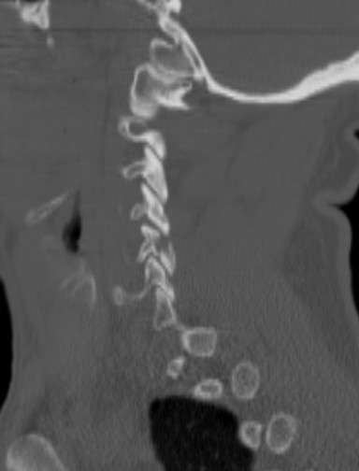
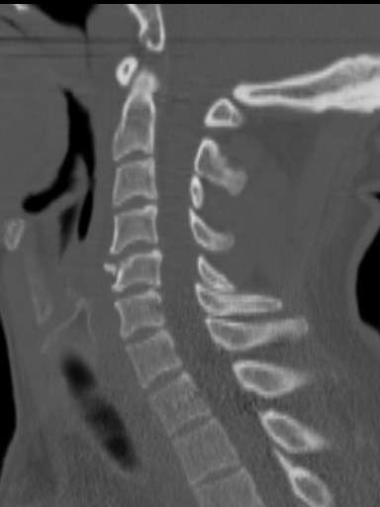
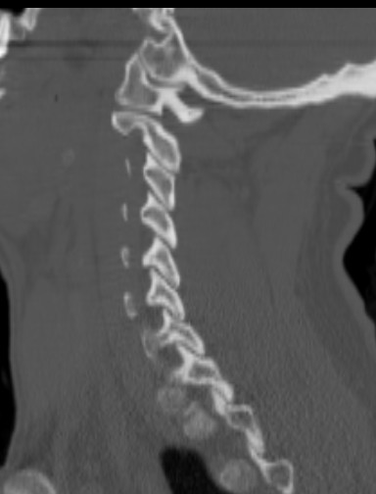
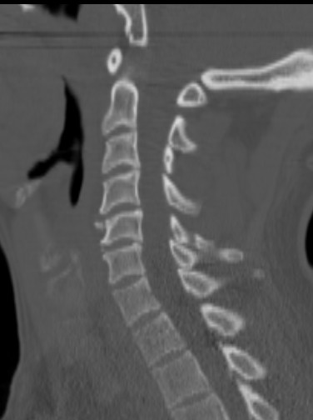
CT C-spine

Slide 6
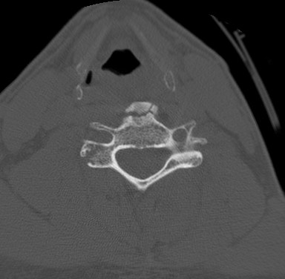
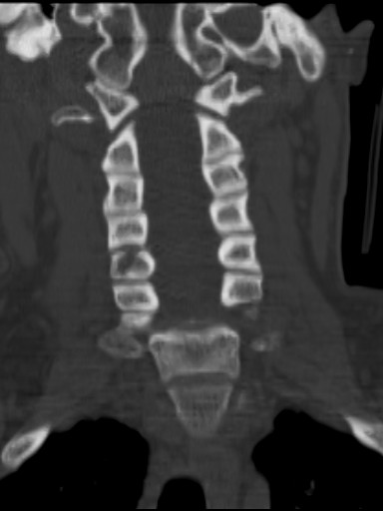
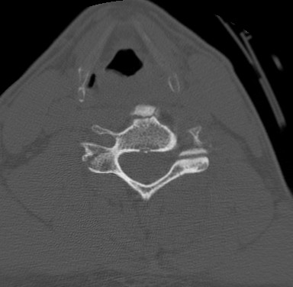

Slide 7
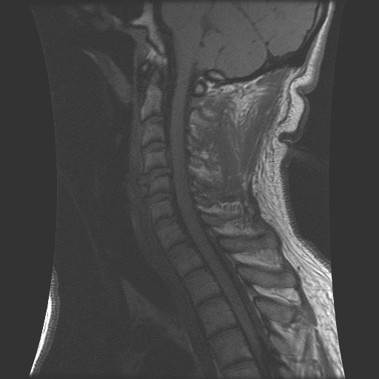
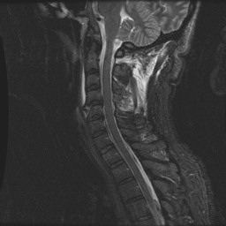
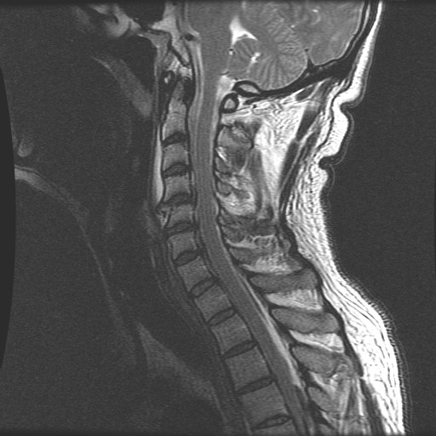
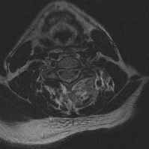
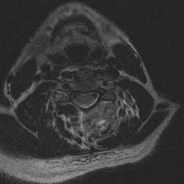
MRI C-spine

Slide 8
diagnosis: Tear drop fracture
Results from hyperflexion or axial loading with the neck flexed
Complete disruption of all ligaments, facet joints and intervertebral discs
Posterior displacement of the inferior margin of the fractured vertebral body
Often causes quadriplegia or anterior cord syndrome
Radiographically can find a small chip of bone at the anterior inferior edge of VB involved

Slide 9
Tear drop fracture vs. avulsion fracture
Small chip of bone off anterior inferior VB due to hyperflexion with axial loading
Retrolisthesis of involved VB
Fracture of VB and/or posterior elements
Prevertebral soft tissue swelling
unstable
Small chip of bone off anterior inferior VB pulled off by traction of the ALL in hyperextension
No malalignment of VB
No fracture of VB or posterior elements
No prevertebral soft tissue swelling
stable

Slide 10
Treatment Plan:
Cervical Traction?
Collar?
Halo vest?
Anterior Decompression and Fusion alone?
Posterior Decompression and Fusion alone?
Combined Ant/Post?
How many levels?

Slide 11
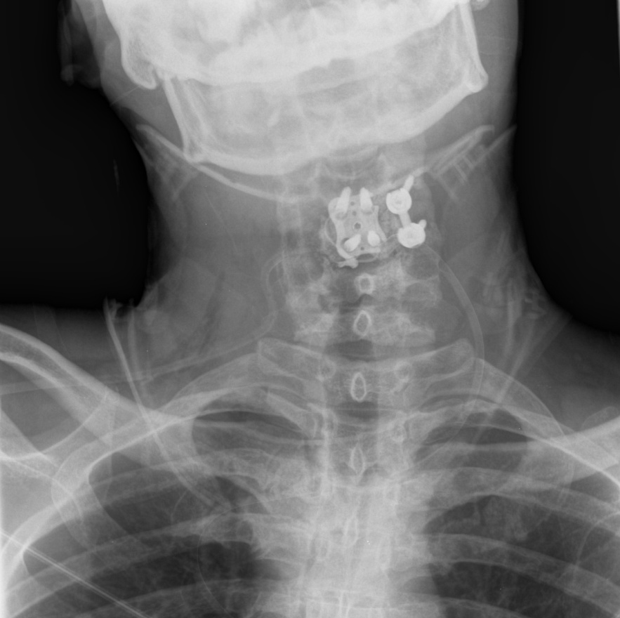
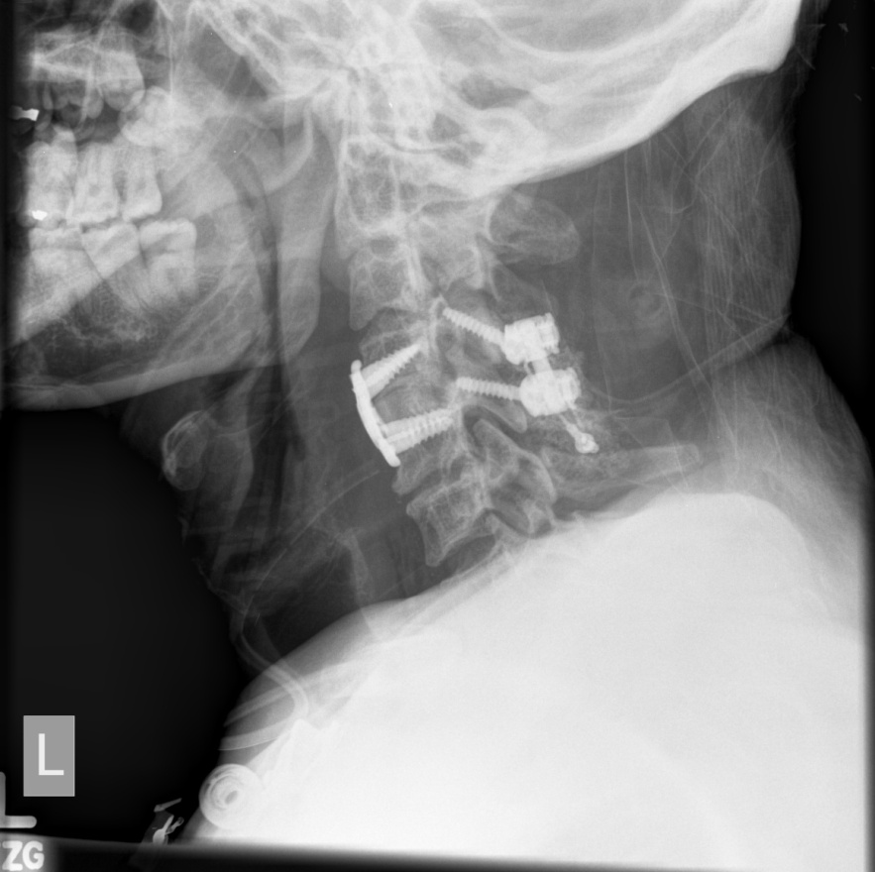
C4-5 ACDF; L C4-5 posterior fusion with interspinous wiring

Slide 12
Case #2
HPI:
GT is a 47 yo male s/p fall off a bridge 4-5 feet from his mountain bike and hitting his head/neck against some rocks.
He was wearing a helmet.
+ LOC.
Immediately after arousing, the pt had LUE paralysis and LLE paresis.
He was c/o left arm pain and allodynia.

Slide 13
PMH:
none
PSHx:
none
All:
NKDA
Meds:
none
FHx:
N/C
SHx:
Denies tobacco use; drinks 2 glasses of wine/wk
ROS:
As per HPI, o/w negative

Slide 14
Physical Examination:
VSS
GCS 15, OX3
CN II-XII intact
Strength 5/5 RUE, RLE; 0/5 LUE, 4/5 LLE
LUE allodynia, all others intact sensation
Rectal tone normal
DTR 3+ RUE, RLE, LLE; O LUE
+ Bilat Babinski; Clonus RLE

Slide 15
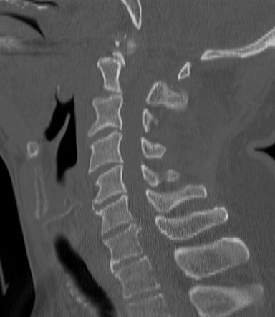
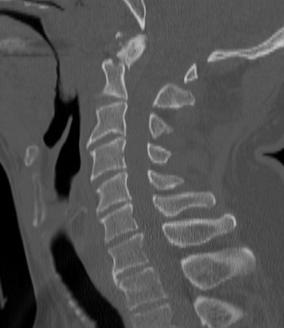
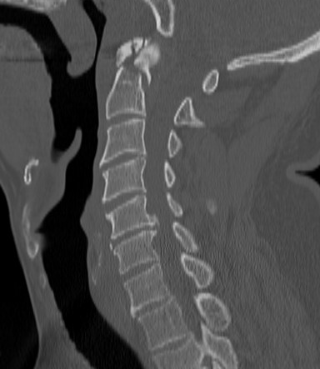
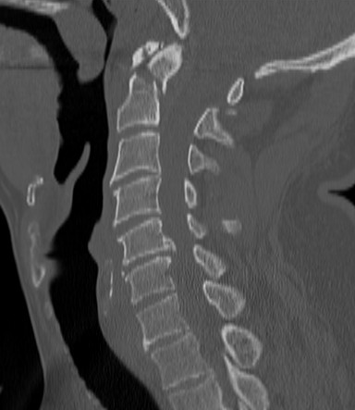
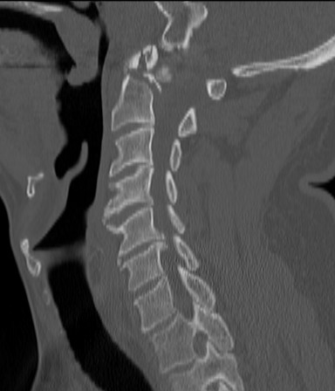
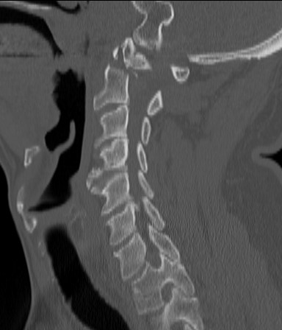
CT C-spine

Slide 16
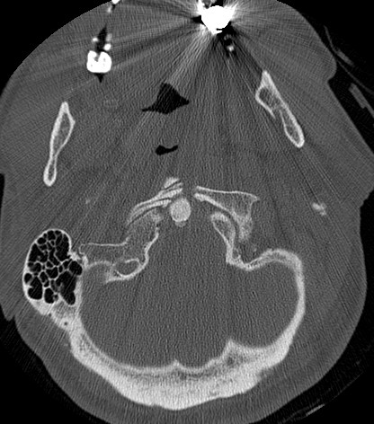
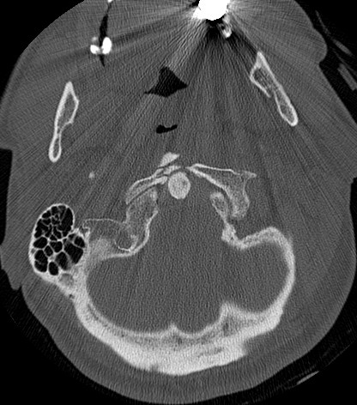
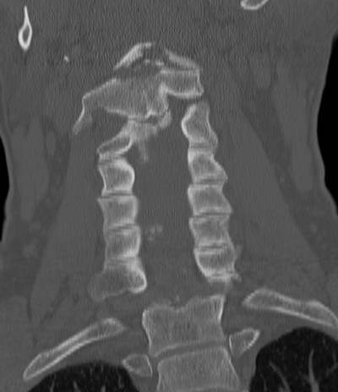
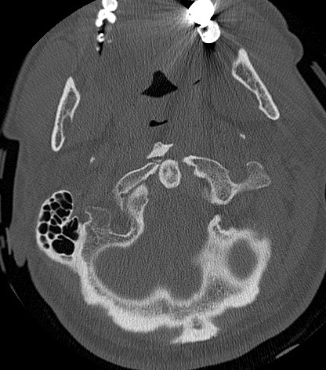
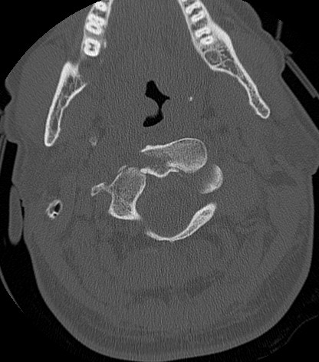

Slide 17
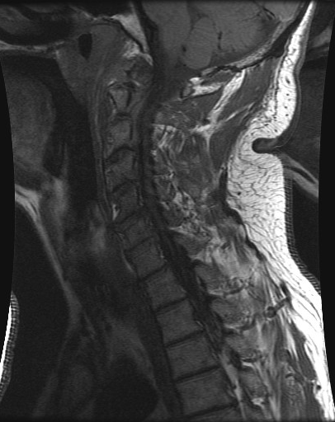
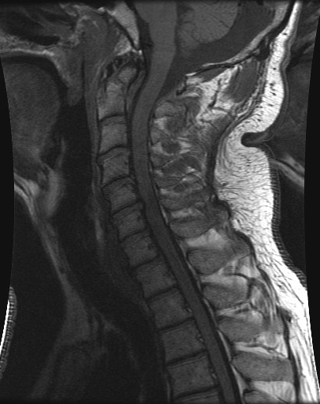
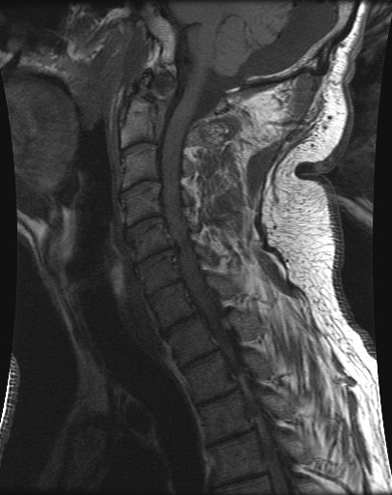
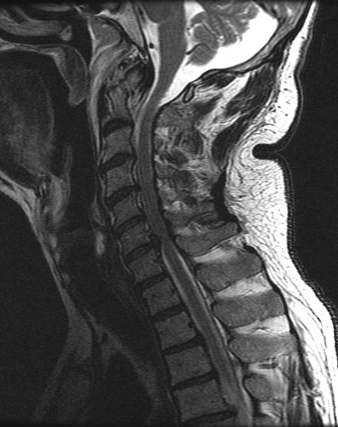
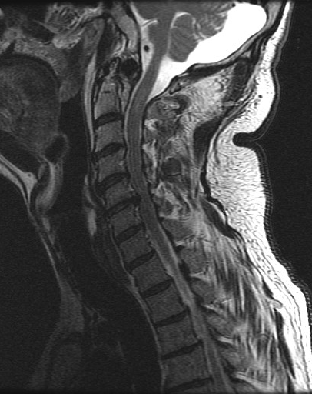
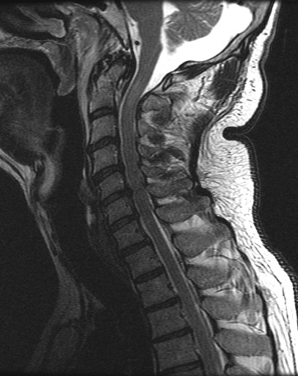
MRI C-spine

Slide 18
diagnosis: Dens fracture type IIA

Slide 19
Treatment Plan:
Steroids?
Cervical Traction?
Collar?
Halo vest?
Anterior Decompression and Fusion alone?
Posterior Decompression and Fusion alone?
Combined Ant/Post?
How many levels?

Slide 20
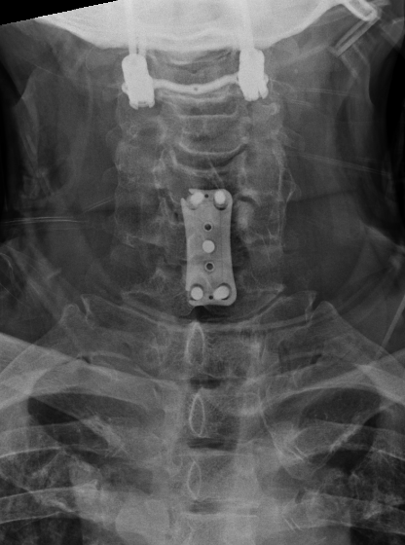
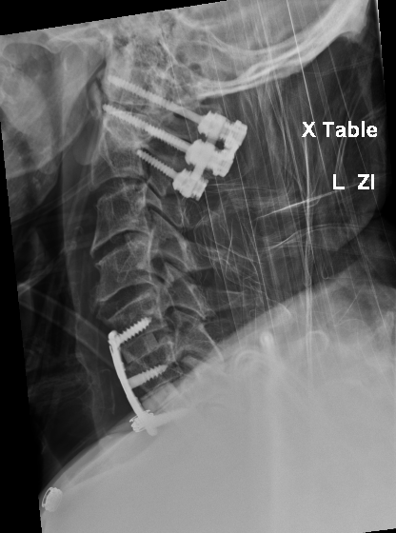
Posterior C1-C2 Fusion; C5-6, C6-7 ACDF

Slide 21
Case #3
HPI:
RJ is an 85 yo male s/p fall from 8-ft ladder while filling a water tank, and landed on his head against some rocks.
+ LOC.

Slide 22
PMH:
HTN, BPH, CAD, HC, L retinal blindness
PSHx:
Angioplasty, Atherectomy, Appy
All:
NKDA
Meds:
Terazocin, Hyzaar, Simvastatin, ASA, Xalatin eye gtt
FHx:
N/C
SHx:
Denies tobacco use; occ ETOH
ROS:
As per HPI, o/w negative

Slide 23
Physical Examination:
VSS
GCS 14, OX2 (name, place)
CN II-XII intact, except L pupil does not react
Strength 5/5
Sensation intact
Rectal tone normal
DTR 1+ R knee, all others 0/4
+ Bilat Babinski
No Clonus

Slide 24
CT C-spine

Slide 25
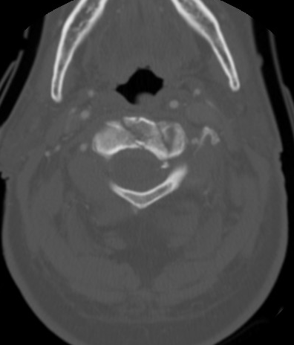
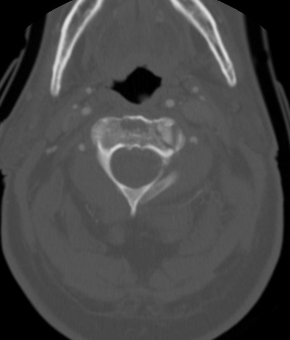
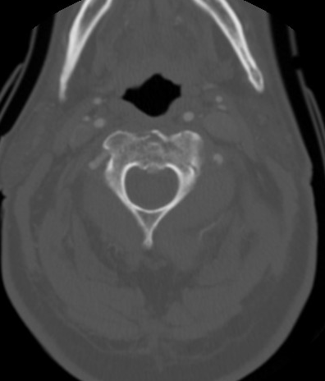
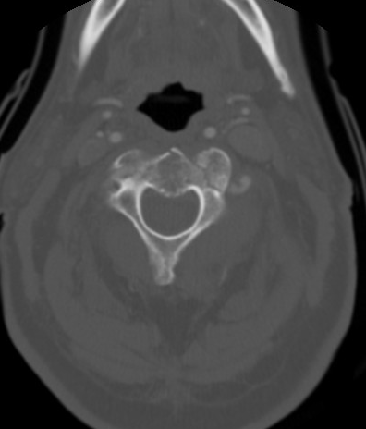

Slide 26
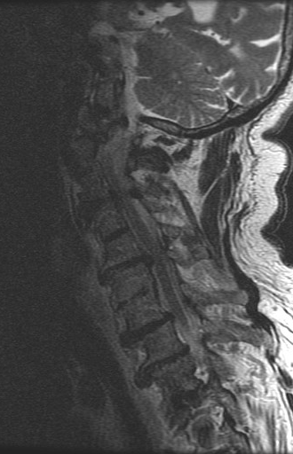
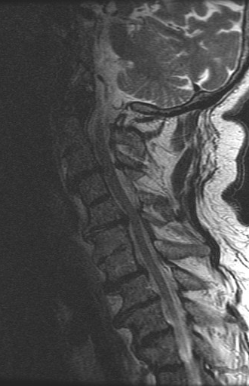
MRI C-spine

Slide 27
diagnosis: Dens fracture type III

Slide 28
Treatment Plan:
Steroids?
Cervical Traction?
Collar?
Halo vest?
Anterior Decompression and Fusion alone?
Posterior Decompression and Fusion alone?
Combined Ant/Post?
How many levels?

Slide 29
Conservative management with aspen collar with close follow-up

Slide 30
Anderson and D’alonzo classification of odontoid fracture
Type I
Fracture through the tip above transverse ligament
Rare
Unstable
Type II
Fracture through the base of the neck
Most common
unstable
Type IIA
Like type II but with large bone chips at fracture site
unstable
Type III
Fracture through body of C2
May involve superior articulating surface
stable

Slide 31
treatment
Type I usually treated with surgery
Isolated type II fractures in adults > 50 yo should be stabilized with surgery
Early surgery is recommended for all type IIA
Type I,II, III may initially be managed with rigid collar
Consider surgical fixation for type II and III if displacement > 5mm or inability to maintain alignment with rigid collar
In type II, 30% nonunion rate with collar
Displacement > 4mm increases nonunion
70% nonunion in displacement > 6mm
Surgical options:
Odontoid screw
C1-C2 arthrodesis: wiring, Harm’s technique, transarticular screw

