Slide 1
NEUROSURGERY Spine Conference
Stanford Hospital and Clinics
January 11, 2010

Slide 2
Case #1
HPI: JO is a 76 yo F w/ h/o urinary retention and incontinence with 3d onset mid-thoracic BP with sudden BLE numbness
PMH: Urinary retention, osteoporosis
PSH: Urethral Dilation, varicose vein stripping
Meds: Vesicare, Reclast
ALL: NKDA
FHx: CAD
SHx: Married, homemaker living in Bishop, CA. Denies tob/ETOH
ROS: o/w neg

Slide 3
Physical Examination:
VSS
GCS 15, OX3
CN II-XII intact
Motor Strength 5/5
Sensation intact, no Saddle Anesthesia
Rectal tone normal
DTR normal
No clonus or babinski sign

Slide 4
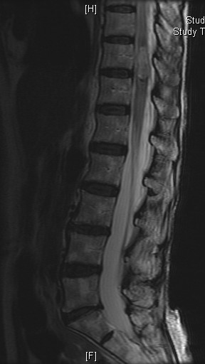
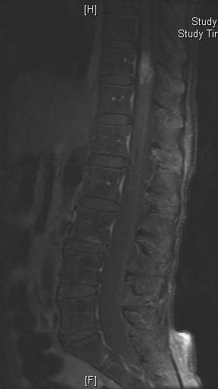
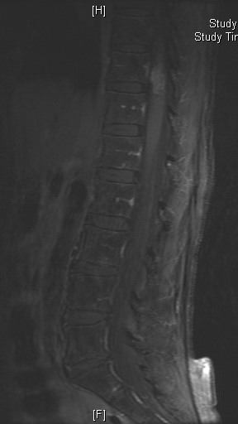
MRI L-spine

Slide 5
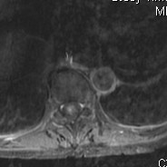
MRI L-spine

Slide 6
Diagnosis:
Intramedullary Spinal Tumor:
Ependymoma
Most common intramedullary tumor in adults (60%)
Cellular type - usually cervical, peak age 43, female, circumscribed, cystic, or hemorrhagic
Myxopapillary type – occurs in the conus or filum, peak age 28, male, may metastasize to lymph nodes, bone, or lung
iso-T1; hyper-T2; enhances
Astrocytoma
Most common intramedullary tumor in children, cervical, peak age 21, low grade, frequently causes cyst/syrinx
Fibrillary type
Can cause scoliosis
Enhances
Hemangioblastoma
50% thoracic 40% cervical, peak age 30, associated with VHL
Cystic with vascular nodule and have dilated feeding vessels
Others – oligodendrocytoma, ganglioglioma, schwanomma, met

Slide 7
Case #2
HPI: 58 yo F w/ 6-7 mo h/o RLE pain, numbness and weakness
PMH: bilat acoustic neuromas, lumbosacral plexus schwanommas
ALL: Codeine
Meds: Darvocet; Ramipril
PSHx: T&A; Craniotomy for tumor, removal of PN schwanomma
SHx: no tob; 6 cans of beers each week
FHx: N/C
ROS: bilat loss of hearing; difficulty walking; joint stiffness, muscle pain, leg pain

Slide 8
Physical Examination:
VSS
GCS 15, OX3
Deaf bilaterally and only communicates through written words
Facial Asymmetry
Left foot drop; weak R eversion
Motor Strength L: IP 4; Q 4+; H 4+; TA 0; G 0
R: IP 4; Q 4+; H 4+; TA 4; G 4-
Decreased sharp sensation RLE diffusely
DTR: 1+ bilaterally

Slide 9
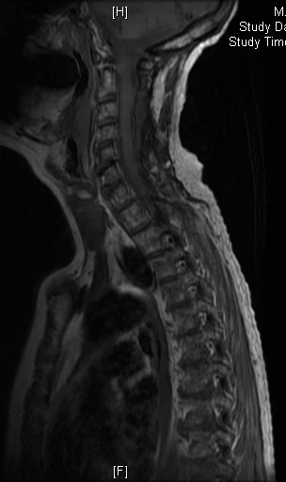
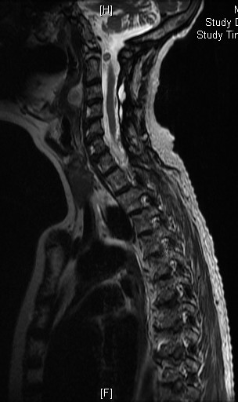
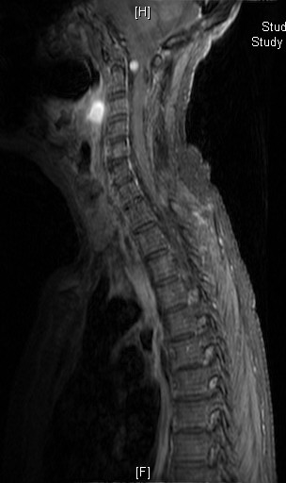
MRI -spine

Slide 11
MRI -spine

Slide 12
MRI -spine

Slide 13
MRI -spine

Slide 14
MRI -spine

Slide 15
MRI -spine

Slide 16
Diagnosis:
Intradural Extramedullary Tumor
Nerve Sheath Tumor
Most common spinal tumor (30%)
Schwanommas are more common than neurofibromas
Meningioma
25% of spinal tumors, peak age 40-60, female
Usually in the thoracic spine, can be multiple
Paraganglioma
Rare, usually in the cauda equina, from accessory organs of the PNS
Encapsulated, hemorrhagic and enhancing
Epidermoid
Dermoid
Neurenteric Cyst
Ventral to the cord
Arachnoid Cyst
Usually dorsal to the cord
Met – lung, breast, melanoma, lymphoma

Slide 17
Epidural Lesions:
Met
Breast, lung, prostate
In children: Ewing’s sarcoma, neuroblastoma
Usually in the lower thoracic and lumbar spine
Lytic-lung; blastic-breast, prostate

Slide 18
J Neurosurg Spine. 2009 Nov;11(5):591-9.
Factors associated with progression-free survival and long-term neurological outcome after resection of intramedullary spinal cord tumors: analysis of 101 consecutive cases.
Garcés-Ambrossi GL, McGirt MJ, Mehta VA, Sciubba DM, Witham TF, Bydon A, Wolinksy JP, Jallo GI, Gokaslan ZL.
Department of Neurosurgery, Johns Hopkins School of Medicine, Baltimore, MD, USA.
authors retrospectively reviewed 101 consecutive cases of IMSCT resection in adults and children at a single institution
Neurological function and MR images were evaluated preoperatively, at discharge, 1 month after surgery, and every 6 months thereafter
Pathological type included ependymoma in 51 cases, hemangioblastoma in 15, pilocytic astrocytoma in 16, WHO Grade II astrocytoma in 10, and malignant astrocytoma in 9
For all tumors, the intraoperative finding of a clear tumor plane of resection carries positive prognostic significance across all pathological types
The incidence of acute perioperative neurological decline increases with patient age but will improve to baseline in nearly half of patients within 1 month
A GTR should progression-free survival for astrocytoma

