Slide 1
case 1
79F with CAD, dementia, one week post colostomy for perf diverticulitis, open abdominal wound.
Transferred for management of spine fracture.

Slide 2
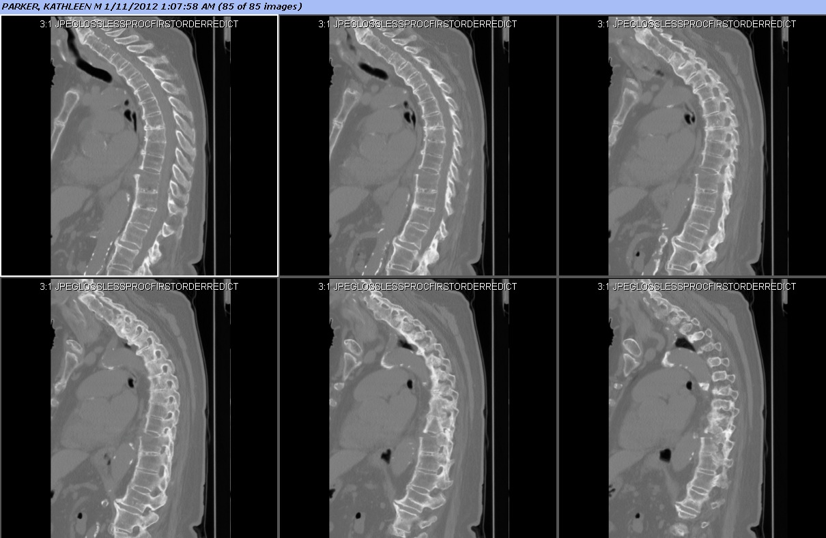
Fell in January. Back pain, no new deficits.
CT showed T10 bony chance fracture. Spine surgeon recommended brace only.

Slide 3
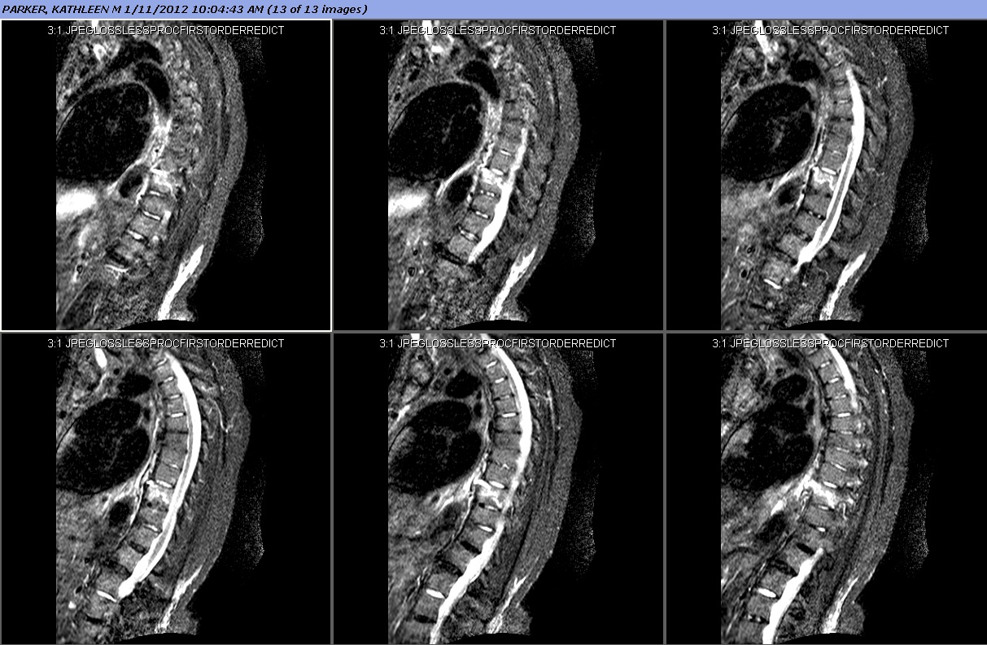
MRI STIR

Slide 4
Follow up scans showed progression of fracture deformity
Baseline weakness, no new deficits. Back pain reasonably controlled with meds and TLSO.

Slide 5
Transferred for “concern for osteo”
WBC, CRP, VS all normal on arrival

Slide 6
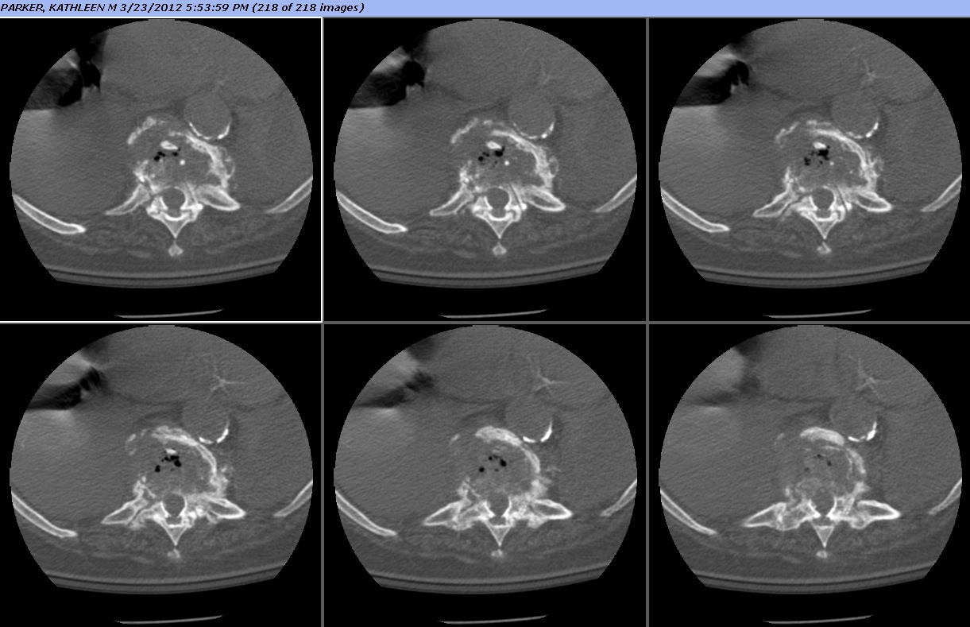

Slide 7
Intraop: No obvious infection. Cultures taken → negative.
T5-L2 fusion and instrumentation

Slide 8
Diffuse Idiopathic Skeletal Hyperostosis (DISH)
Enthesopathy – reaction at sites of tendinous insertions (entheses)
Flowing calcifications and ossifications along the anterolateral aspect of at least 4 contiguous vertebral bodies, with or without osteophytes
Preservation of disk height in the involved areas and an absence of excessive disk disease
Absence of bony ankylosis of facet joints and absence of sacroiliac erosion, sclerosis, or bony fusion, although narrowing and sclerosis of facet joints are acceptable

Slide 9
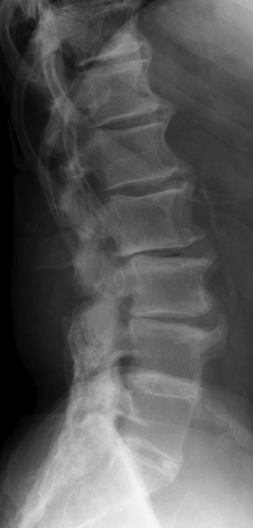
“Flowing calcifications”
< 4 consecutive VB
Disc height preserved
Notes:
Flowing calcifications and ossifications along the anterolateral aspect of at least 4 contiguous vertebral bodies, with or without osteophytes

Slide 10
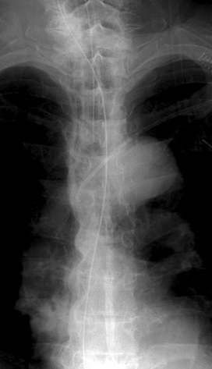
Predominantly right-sided ossification

Slide 11
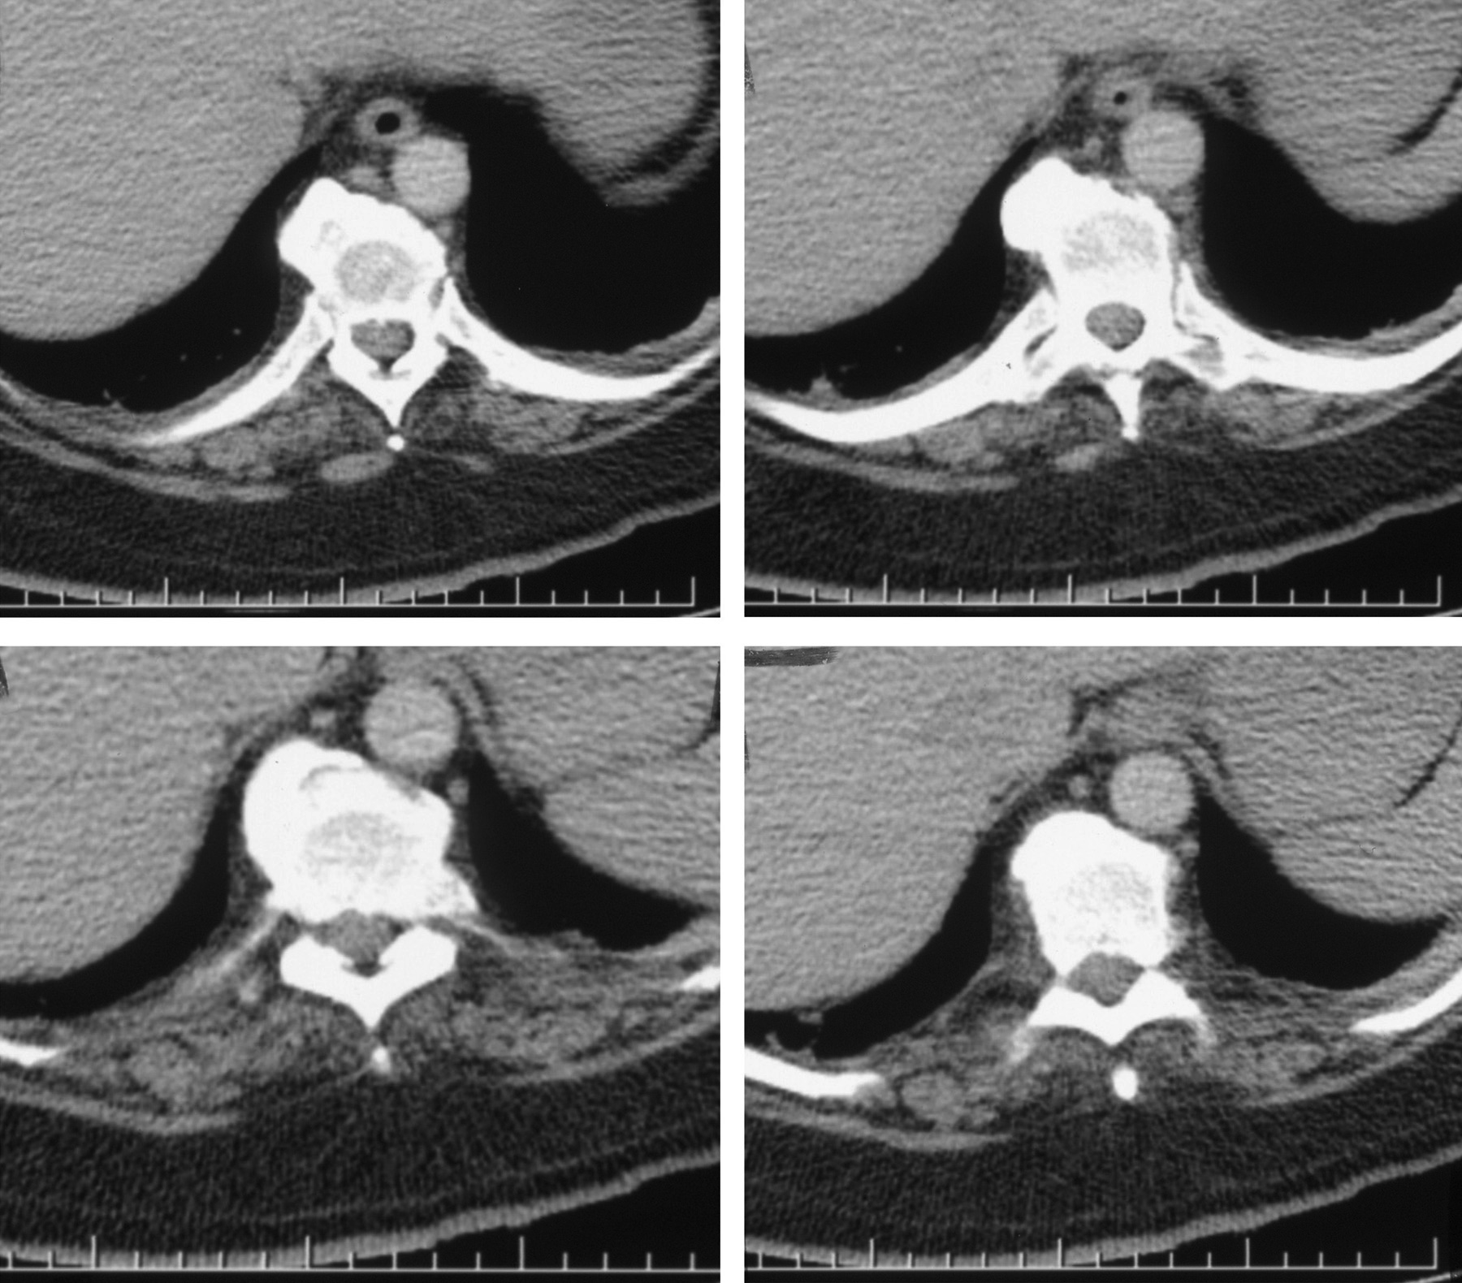
Large syndesmophytes

Slide 12
Discussion points
Ankylosing disorders can present with spine trauma. The same fracture pattern can be more unstable in an anklosed spine.
Late diagnosis leads to high morbidity (>80% in some series)
Long construct fusion with instrumentation may be needed
Distinguish DISH radiographically from ankylosing spondylitis and degenerative arthropathy
Notes:
Would anyone have done a corpectomy?

Slide 13
Case 2
63F with known NSCLC, CRF, new spine mets on CT.
Presents with severe back pain when walking and left thigh burning pain.

Slide 14
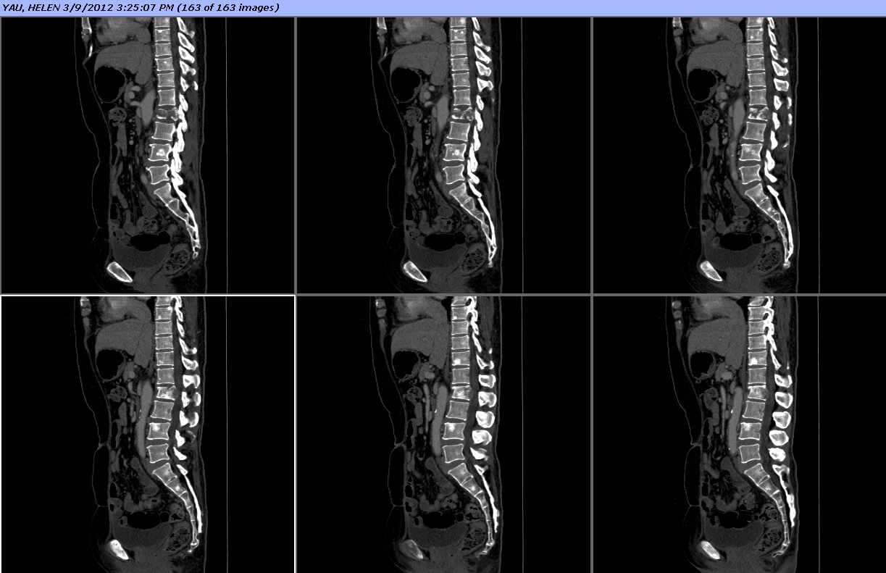
CT: Multiple vertebral mets. Pathologic burst fracture at L2 with mild retropulsion.

Slide 15
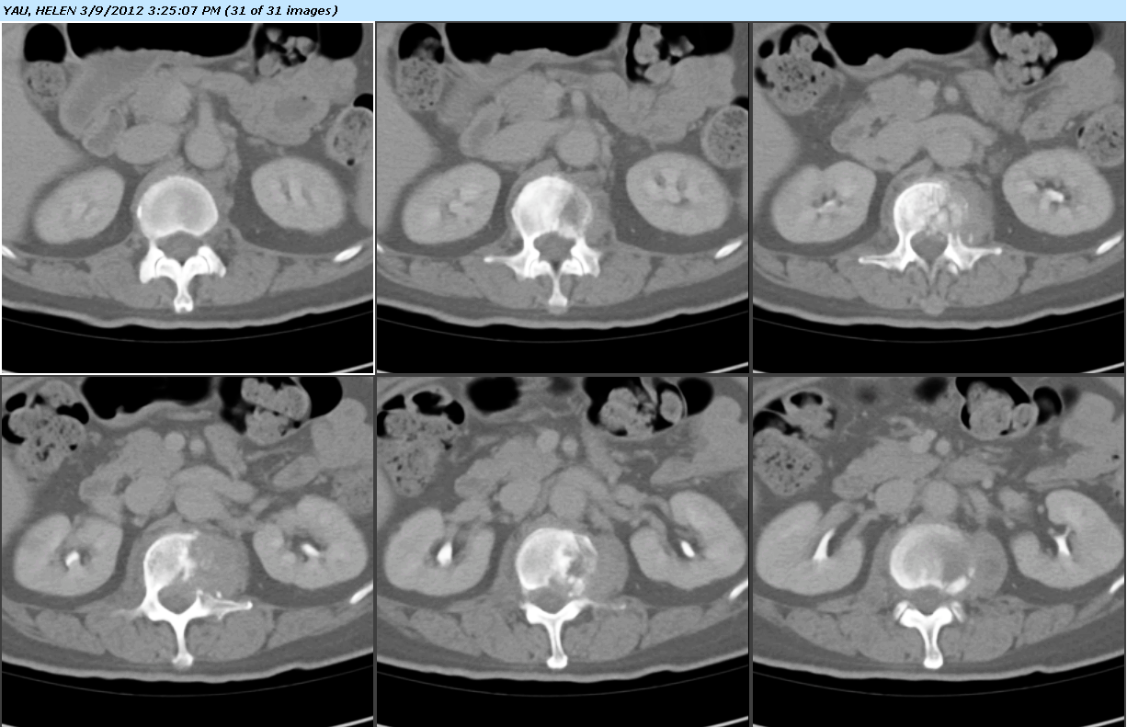
Axial CT: lytic lesion, replacing half of L2

Slide 16
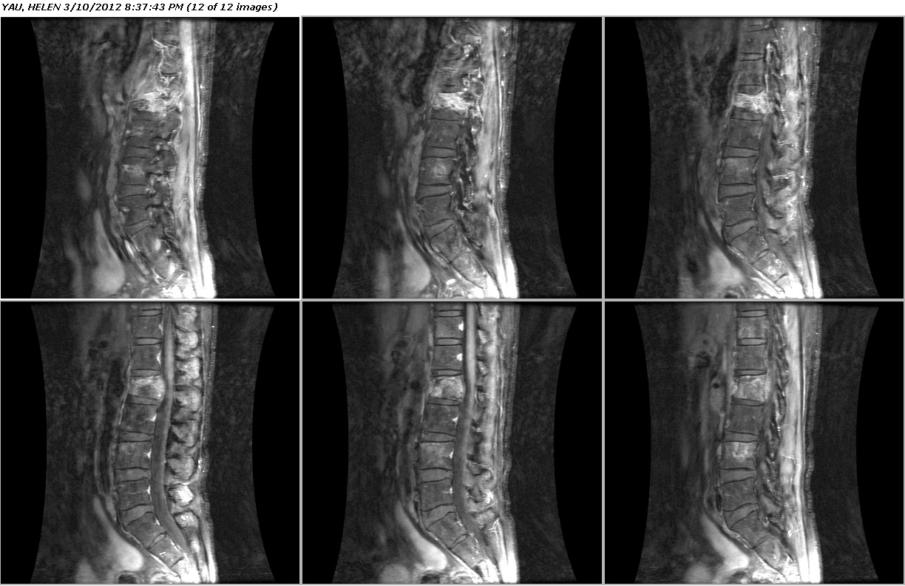
Sagittal T1+C

Slide 17
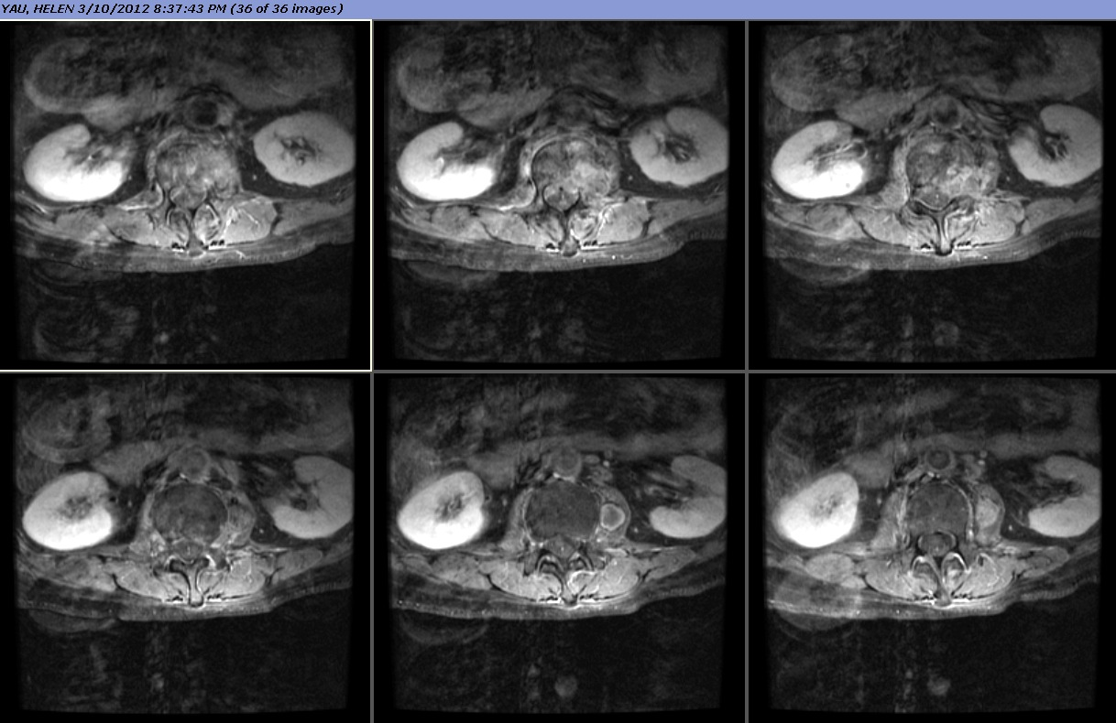
Axial T1+C: Left psoas mass at L2

Slide 18
Goals of surgery
Stabilize spine
Alleviate back pain

Slide 19
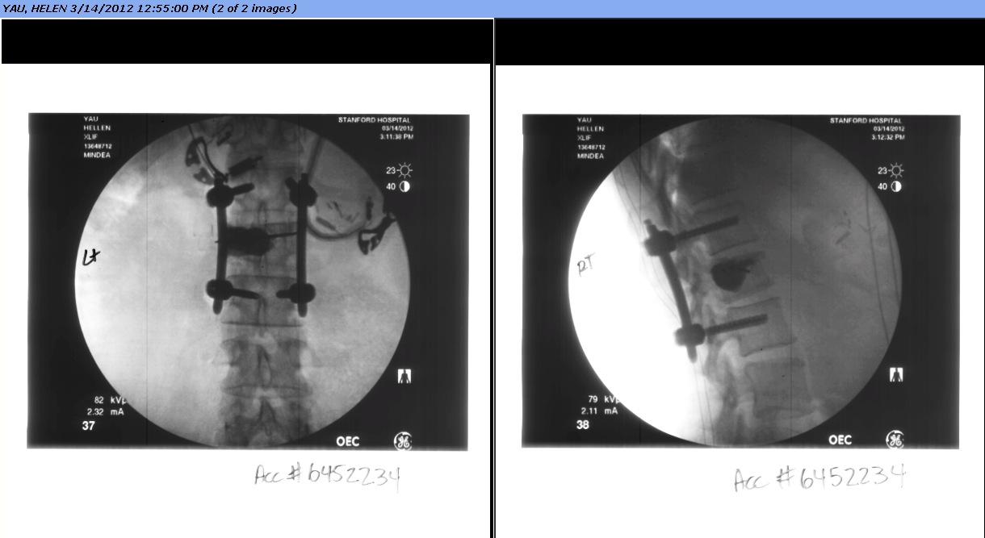
Surgery
1. Left lateral approach, L2 partial corpectomy, PMMA cement
2. Posterior percutaneous instrumentation and arthrodesis (Viper2)
IOM - SSEP, MEP

Slide 21
Result
Back pain much improved, leg pain slightly improved.
Home with outpatient PT
Chemo XRT to follow

