Slide 1
NEUROSURGERY Spine Conference
Stanford Hospital and Clinics
October 26, 2009

Slide 2
Case #1
HPI:
CO is a 66 yo F w/ a 30 year history of back and neck pain, developed rapid worsening of LBP radiating to the RLE over the last 2 weeks
She was unable to get up off the couch this am due to the severe LBP
Her husband recently underwent CABG and has been lifting things for him
Pain is worse with sitting, standing, and walking, and better when lying down and when she walks hunched over
Upon arrival to an OSH ED, she reported groin and bladder pain, and was only able only able to urinate small amounts. Foley was placed which showed urinary retention.
No bowel incontinence.
No leg weakness or numbness.
She has seen a chiropractor for her back pain in the past and reports no prior MRI of her back or back surgery.

Slide 3
PMH:
HTN
PSHx:
Hysterectomy 1990s, Left arm lipoma 2008, spontaneous pneumothorax with surgery 1990s, carpal tunnel release
Meds:
Bystolic 10 mg daily, Benazepril 40 mg daily, Amlodipine 10 mg daily
All:
Aspirin, Sulfa (Sulfonamide Antibiotics) , Codeine
FHx:
HTN, Diabetes
SHx:
Retired dental assistant
Denies smoking tob
Drinks 1 alcoholic beverage per wk
ROS:
As per HPI

Slide 4
Physical Examination:
VSS
GCS 15, OX3
CN II-XII intact
Tender to palpation at L4/5 midline
Strength 4+/5 on RLE limited by pain, o/w 5/5
Sensation intact
Rectal tone normal
DTR normal
No clonus

Slide 5
MRI L-spine

Slide 6
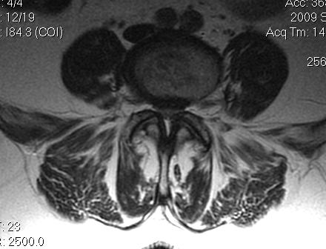
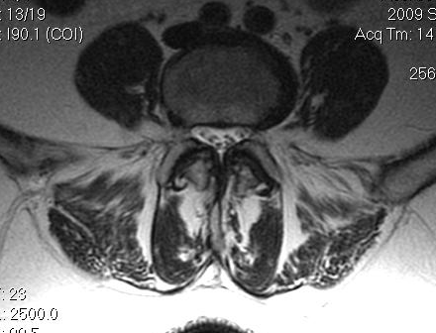
MRI L-spine

Slide 7
Diagnosis: Cauda Equina
Treatment ?

Slide 8
Case #2
HPI:
NW is a 24 yo male who is a police officer w/ a 3 yr h/o LBP.
The pain radiates to the inner aspect of both legs but worse on the left leg and radiates all the way to the bottom of his foot in what appears to be the S1 distribution.
No weakness except limitation of movement due to the pain.
Reports buttock numbness.
He has difficulty emptying his bladder over the last 24hrs
He denies bowel incontinence/difficulty.

Slide 9
PMH:
depression
PSHx:
none
All:
NKDA
Meds:
Lyrica, trazodone, minocycline, Cymbalta
FHx:
N/C
ROS:
As per HPI, o/w negative

Slide 10
Physical Examination:
VSS
GCS 15, OX3
CN II-XII intact
Strength 5/5
Numbness in the saddle distribution
Weak rectal tone
DTR: 3+ knee jerk bilaterally
Cerebellar nl

Slide 11
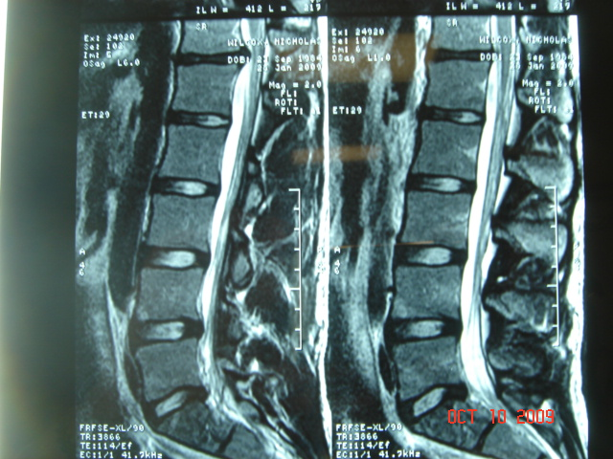
MRI L-spine

Slide 12
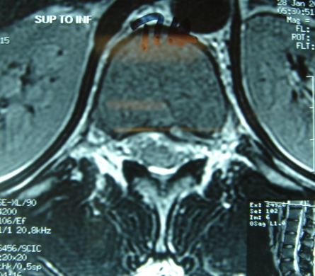

Slide 13
Diagnosis: Conus Medullaris Syndrome
Treatment ?

Slide 14
Conus medullaris
Cauda equina syndrome
L1–L2 vertebral level
Injury to Sacral Cord (S1–S5) nerve roots
Causes: L1 fracture, Tumors, gliomas, Vascular injury, Spina bifida, tethering of the cord
Resultant Signs and Symptoms:
Pain is rare and usually bilateral
Normal motor function of lower extremities unless S1–S2 motor involvement and usually symmetric
Saddle distribution sensory loss (touch is spared); Symmetric abnormalities
Areflexic ankle jerk
Early bowel, bladder, sexual dysfunction
Areflexic bowel and bladder
If it is a high conus lesion, bulbocavernosus reflex may be present
EMG: Normal EMG (except for external sphincter or S1, S2 involvement)
L2–sacrum vertebral level
Injury to Lumbosacral Nerves
Causes: L2 or below fracture, Sacral fractures, Fracture of pelvic ring, Can be associated with spondylosis
Resultant Signs and Symptoms:
Pain is a prominent symptom and can be severe and radicular
Flaccid paralysis of lower extremities of involved Lumbosacral nerve roots; usually asymmetric with atrophy
Sensory loss in root distribution; Abnormalities predominate on one side (asymmetric)
Areflexic knee and ankle jerk
High cauda equina lesions (lumbar roots) Spare bowel and bladder
Lower lesions (S3–S5) can involve late bowel and bladder and sexual dysfunction
Bulbocavernosus reflex is absent (in low cauda equina [sacral] lesions)
EMG: show multiple root level involvement Px: Good

Slide 15
Cauda Equina Syndrome
Urinary Retention is the most consistent finding
Check PVR
Cystometrogram shows hypotonic bladder with decreased sensation and increased capacity
Late manifestation is overflow B/B incontinence
Saddle anesthesia is the most common sensory deficit
Once total perianal anesthesia develops, there is permanent bladder paralysis
Sexual dysfunction is a late finding

Slide 16
Timing of Surgery
Controversial and point of contention in numerous lawsuits
Perform within 24hrs is desirable

Slide 17
Surgical Options
Transcanal Approach
Standard open laminectomy
Microlaminoforaminotomy and microdiscectomy
Smaller incision, shorter hospital stay, lower EBL
Intradiscal Procedures
less efficacious, theoretical advantage is less epidural scarring
Remove disc material from the center to reduce intradiscal pressure to decompress the herniated portion from the nerve root
Chemonucleolysis
Chymopapain injected intradiscally; 44-63% success rate
Risk of anaphylaxis
Automated Percutaneous Lumbar Discectomy
Utilizes a nucleotome; 37% success rate
Risk of cauda equina with improper nucleotome placement
Percutaneous Endoscopic Discectomy
Intradiscal Endothermal Therapy
Intradiscal Electrothermal Anulotomy
23-60% success rate
Laser Disc Decompression
Insertion of a needle into the disc and introduction of laser fiberoptic cable to allow a laser to burn a hole in the center of the disc

Slide 18
Case #3
HPI:
LC is a 34 yo male w/an 8 day h/o progressive back pain
Pt has a h/o occasional LBP after activity which responds to ibuprofen. However, this pain was not responsive.
He went to an OSH ER and was prescribed analgesics and but no imaging was obtained
LBP acutely progressed over the next 24 hrs and moved to his include his upper back and neck.
The pt first noticed RLE weakness in the evening which progressed overnight to include RUE.
Pt also noted numbness and tingling in his LUE/LLE.
Patient also has become bowel and bladder incontinent over the past 24hrs.
He returned to the ER the next day and MRI of the spine.
He reports not history of immunocompromise, IV drug use, or immunosupressive therapy.

Slide 19
PMH:
obesity
PSHx:
none
All:
NKDA
Meds:
oxycontin
FHx:
N/C
SHx:
Works as a parking attendant
Denies tobacco/ETOH use
Uses marijuana once a week
ROS:
As per HPI

Slide 20
Physical Examination:
Temp: 98.6 °F; VSS
General Appearance: Anxious, diaphoretic
AAOX3
CNII-XII: intact
Oral thrush present
Strength:
Delt Bi Tri WE FDP IO
Right 4+ 4+ 3 1 1 1
Left 5 5 5 5 5 5
IP Q H TA G
Right 1 1 1 1 1
Left 5 5 5 5 5
Pinprick sensation diminished up to the left medial thigh. Proprioception intact in all four extremities.
no Babinski, no Clonus, no hoffmans
Rectal tone absent

Slide 21
MRI Spine

Slide 22
MRI Spine

Slide 23
Diagnosis: Complete vs. Incomplete Spinal Cord Injury Brown-Sequard Syndrome
Treatment ?

Slide 24
Spinal Cord Injury
Complete
incomplete
No preservation of motor or sensory function more than 3 segments below the level of injury
3% will develop recovery within 24hrs
Any residual motor or sensory function more than 3 segments below the level of injury
Sensation or voluntary movement in Les
Sacral sparing

Slide 25
ASIA Impairment Scale
Classes:
A = Complete: no motor or sensory preserved in sacral segments S4-5
B = Incomplete: sensory but no motor below neurological level
C = Incomplete: motor function preserved below neurologic level with more than half of key muscles have strength < 3
D = Incomplete: motor function preserved below neurologic level with more than half of key muscles have strength >/= 3
E = Normal: motor and sensory function normal

Slide 26
Incomplete Spinal Cord Injuries:
Central Cord Syndrome
Disproportionate UE weakness more than LE
Most common
Hyperextension Injury
Timing of surgery: early is contraindicated in the absence of spinal instability unless the pt is improving then deteriorates
Anterior Cord Syndrome
Anterior Spinal Artery Syndrome
Cord infarction in the territory supplied by anterior spinal artery
Paraplegia/Quadriplegia
Dissociated sensory loss: loss of P/T, preserved two-point discrimination
Surgery only if there is compression from bone fragment
Worst prognosis

Slide 27
Brown-Sequard Syndrome
Spinal cord hemisection
Causes: penetrating trauma, radiation myelopathy, spinal epidural hematoma, cervical disc herniation, tumor, AVM, cervical spondylosis
Contralateral dissociated sensory loss
Ipsilateral loss of posterior column function, motor paralysis
Best prognosis; 90% of pts will regain ambulation and anal and sphincter control
Posterior Cord Syndrome
Relatively rare
Pain and paresthesia in the neck, upper arms and torso
Mild paresis of the UEs

