Slide 1
Introduction to Adult Spinal Deformity Surgery: Evaluation and Planning
Matt Neal, MD
Wed AM Conference
1/28/15

Slide 2
Outline
Types of deformity
Background on deformity classification schemes
Unique characteristics of adult degenerative spinal deformity
General principles and definitions
Specific considerations for
  Sagittal plane deformity correction
  Coronal plane deformity correction
  Axial plane deformity correction
  Spinopelvic balance
Indications for adult deformity surgery
Preoperative workup and planning

Slide 3
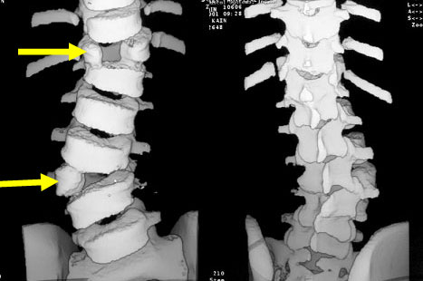
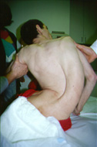
Types of Deformity
Congenital
Idiopathic (80%)
  Infantile (0-2 yo)
  Juvenile (3-9 yo)
  Adolescent (10-17 yo)
  Adult (>18 yo)
Neuromuscular (CP, DMD, SMA etc)
Degenerative
Traumatic / infectious
Iatrogenic
Syndromic (ED, Marfans, PW, Down S etc)

Slide 4
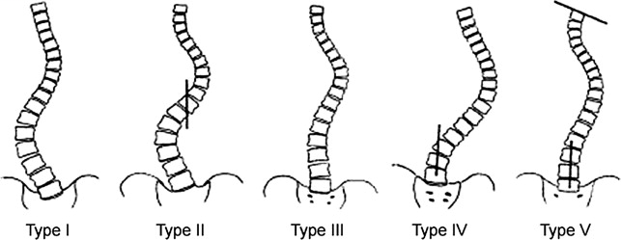
Classification
King-Moe Classification System for AIS
Introduced in 1980s
Concurrent with Harrington rod instrumentation
Only accounted for coronal deformity
Not comprehensive, poor intraobserver validity, reliability, and reproducibility

Slide 5
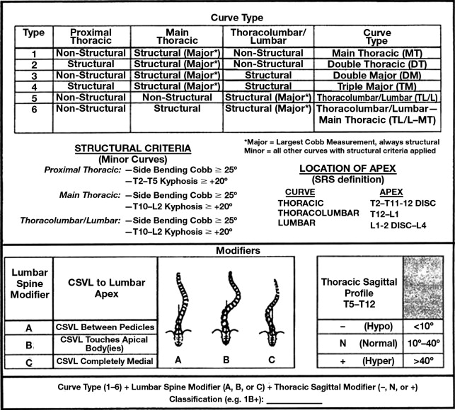
Classification
Lenke Classification for AIS
comprehensive
provide two-dimensional analysis with increased emphasis on sagittal modifiers
treatment based, advocating selective arthrodesis only of the structural curves

Slide 6
Problems with Prior Classification Schemes for ASD
Rooted in pediatric deformity, particularly AIS
ID “structural curves” in immature spine that are likely to progress
Provide guidance on levels to fuse in flexible/immature spine

Slide 7
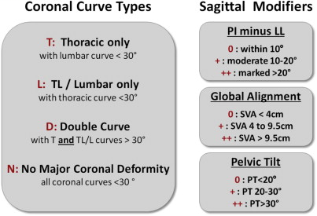
Classification
SRS-Schwab Classification for ASD
Relieving pain and disability are primary goals of ASD
Sagittal and spinopelvic alignment are most critical considerations for ASD
good intraobserver validity, reliability, and reproducibility

Slide 8
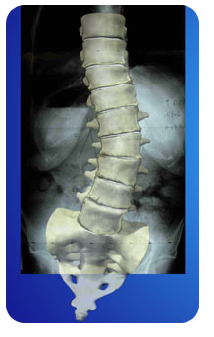
Degenerative Scoliosis Unique Characteristics
Stenosis, rigid (requiring osteotomies to correct), spondylolisthesis, rotary subluxation, lumbar hypolordosis, poor bone quality
Presents differently: back and leg pain, claudication with functional debility
Rare to extend beyond 60ᵒ (10ᵒ defined as scoliosis)
Usually lumbar, T/L curve
Often fractional lumbosacral curve present (L4 to sacrum)

Slide 9
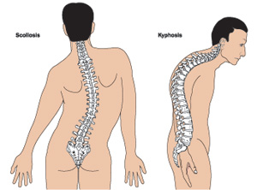
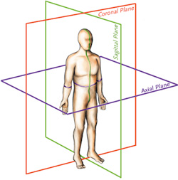
General Principles and Definitions
Scoliosis is a coronal deformity (10 degrees) and deformity encompasses imbalance in all planes

Slide 10
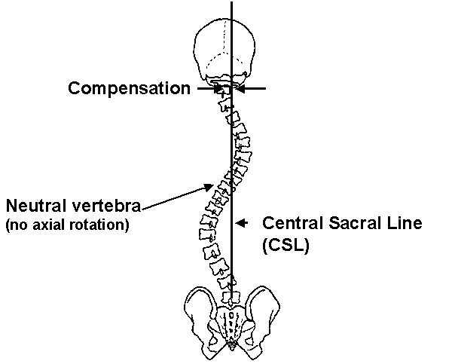
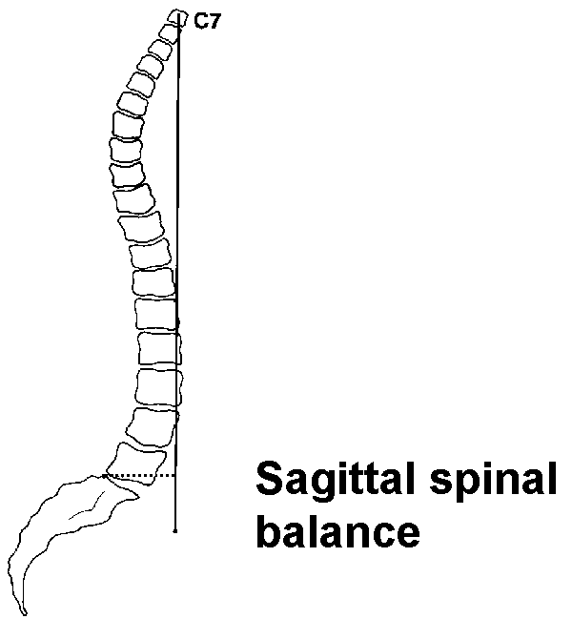
General Principles and Definitions
Central Sacral Vertebral Line (CSVL) and
C7 Plumb Line (C7PL)

Slide 11
General Principles and Definitions
Neutral vertebra – First vertebra where pedicles are symmetrical (no rotation)
Stable vertebra – First vertebra bisected by CSVL
End vertebra – Vertebrae with endplates maximally tilted from horizontal plane; used to calculate Cobb angles in coronal and sagittal planes
Cobb angles – Measurement between end vertebrae

Slide 12
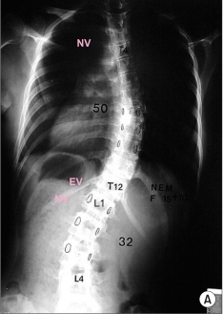
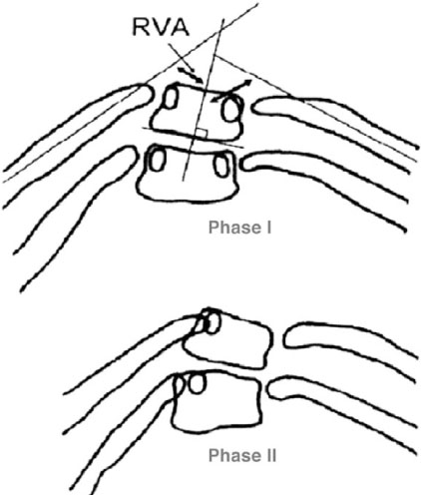
General Principles and Definitions
Neutral Vertebra

Slide 13
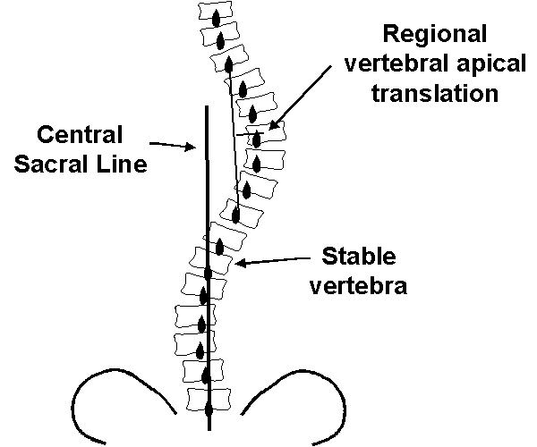
General Principles and Definitions
Stable Vertebra

Slide 14
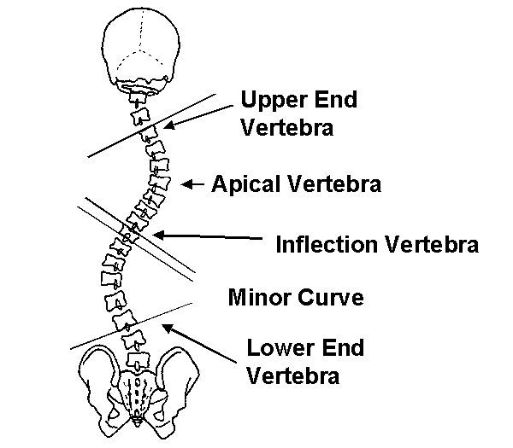
General Principles and Definitions
End Vertebra / Cobb Angles

Slide 16
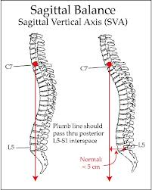
Sagittal plane deformity correction
Most important parameter
Plumb line center of C7 > 2.5 cm anterior to posterior / superior aspect of sacrum is positive imbalance (5 cm acceptable > 70 yo)
<2.5 cm abnormal

Slide 17
Sagittal plane deformity correction
Cervical: 40 +/- 9ᵒ
  (-) measurement
  Measured Inferior C2 through inferior C7
Thoracic: 20-50ᵒ (mean 36ᵒ)
  (+) measurement
  Measured from superior endplate of T2 or T4 to inferior endplate of T12
Lumbar: 31-79ᵒ (mean 44ᵒ)
  (-) measurement
  Measured from superior endplate of L1 to inferior endplate of L5
  2/3 lordosis at L4/S1; measure LL from inferior endplate T12 to superior endplate S1
T10 – L2 should be neutral of slightly lordotic

Slide 18
Sagittal plane deformity correction
Techniques for correction
Lordotic interbody grafts with compression of pedicle screws prior to final tightening of set screws
SPO originally described in ankylosing spondylitis (anterior column lengthening and posterior column shortening)
Polysegmental wedge osteotomies (SPO when able, PSO when necessary)
PSOs (for flat back syndrome or completely rigid kyphotic deformity)

Slide 19
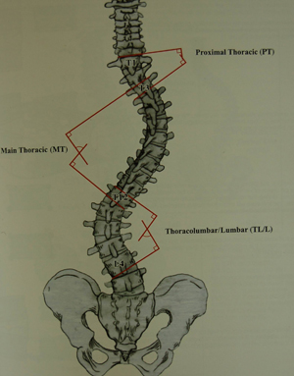
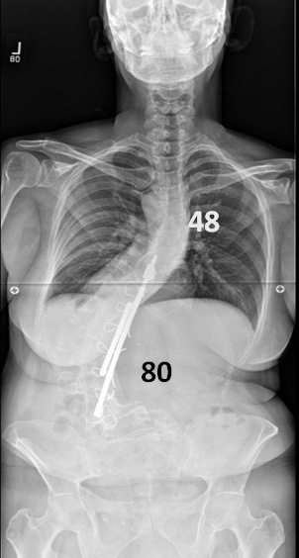
Coronal plane deformity correction
Deviation to left is negative, right is positive

Slide 20
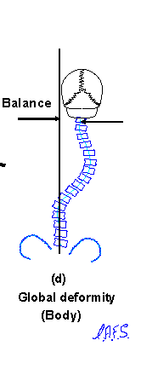
Coronal plane deformity correction
Determine difference between center of C7 and CSVL
Maybe > 4 cm become symptomatic?

Slide 21
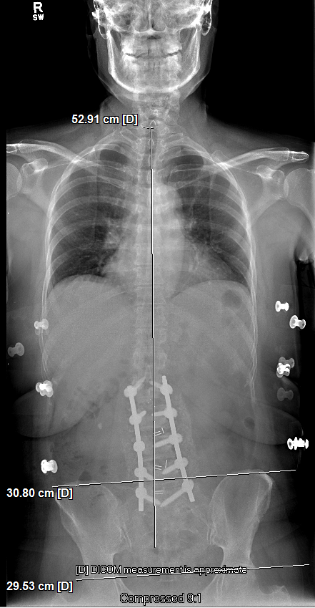
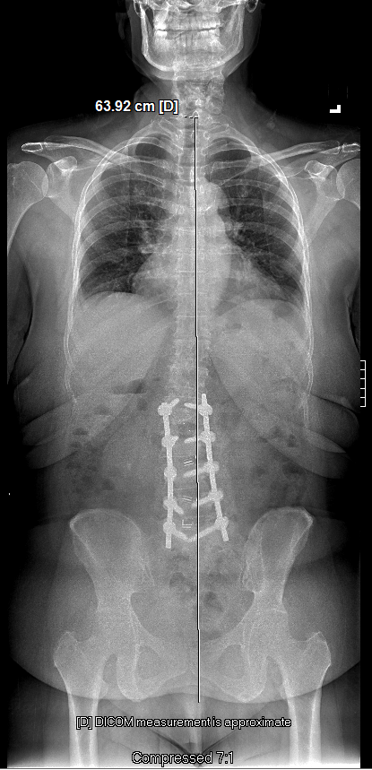
Pelvic Obliquity

Slide 22
Coronal plane deformity correction
Techniques for correction
Unilateral TLIF or PLIF
Pedicle screw fixation with rod correction
Can do in situ bending at end to get a little correction
Assymetrical PSO
VCR

Slide 23
Axial plane deformity correction
Most difficult to correct, but fortunately of most limited clinical benefit
Usually get a little derotation with rod insertion in rigid adult deformity
Beware of superior mesenteric artery syndrome
Using fixed or uniaxial screws helps with derotation

Slide 24
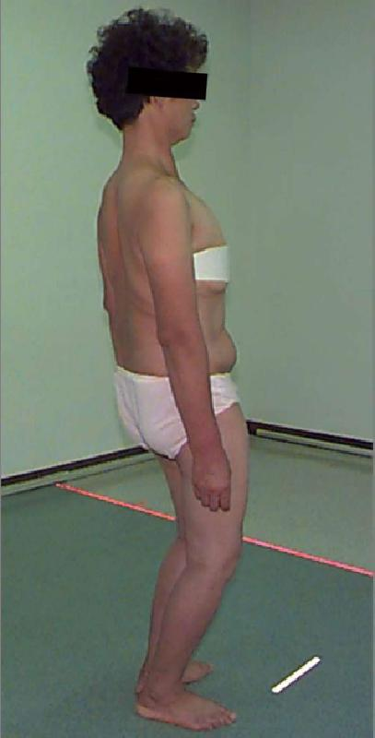
Spinopelvic parameters
Can compensate for sagittal imbalance with pelvic retroversion, hip extension (mild), hip/knee flexion (severe), cervical hyperlordosis, thoracic hypokyphosis

Slide 25
Spinopelvic parameters
3 Important measurements
Pelvic Incidence (PI)
Pelvic Tilt (PT)
Sacral slope (SS)
PI = PT + SS

Slide 26
Spinopelvic parameters
Pelvic incidence
PI morphological parameter after skeletal maturity
Mean PI = 52ᵒ
PI: 40-60ᵒ (48-53ᵒ)
Must see pelvic heads to measure
LL = PI +/- 10ᵒ

Slide 27
Spinopelvic parameters
Pelvic tilt and sacral slope
PT compensatory mechanism
  Have to see pelvic heads to measure
  Increases with retroversion
  Want < 20ᵒ (12-15ᵒ)
Sacral slope
  Decreases during retroversion
PI = PT + SS

Slide 28
Indications for surgery with ASD
Degenerative scoliosis curve progression with back, leg pain or functional debilitation (40ᵒ?)
Kyphosis (including Scheuermann’s kyphosis) or sagittal imbalance with neurological decline or intractable pain (70ᵒ?)

Slide 29
Preoperative planning
Combine patient evaluation with radiographic evaluation and develop specific surgical plan if appropriate

Slide 30
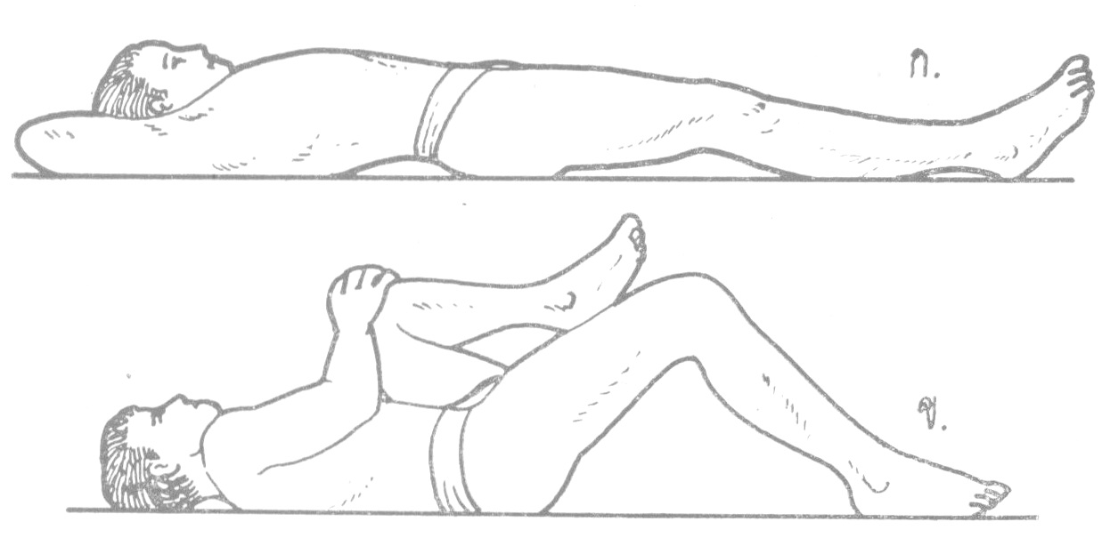
Preoperative planning for ASD
Patient evaluation
Consider patient’s medical status (remember all deformity surgery is elective)
Identify aspects of deformity contributing to patients’ symptoms (may be focal problem that does not require treatment of entire deformity)
Consider likelihood of progression
Evaluate results of prior decompression and fusion
Look for hip flexor contractures

Slide 31
Preoperative planning
Radiographic evaluation
1. Upright AP and lateral 36 inch scoliosis xrays
2. MRI to evaluate symptoms
3. Measure sagittal parameters (SVA, TK, LL, PI), coronal parameters (deviation from CSVL, Cobb angle of curve(s) )
4. Does the patient have pelvic obliquity?

Slide 32
Preoperative planning
Manage patient expectations
Appearance
Pain
Function

Slide 33
Preoperative planning
Initial considerations for construct
1. How much correction do you need in three planes?
  Goal is balance in all 3 planes + spinopelvic balance (LL = PI +/- 10ᵒ)
  Sagittal balance is most important (some guesswork)
2. Where are you going to get this correction and with what techniques?
  (Interbody fusion, SPO, PSO, VCR, facetectomies and “bring spine to the rod”)
3. Where do you need interbody fusions to augment arthrodesis?
4. Where do you need neural decompression?
5. What levels do you need to include in your construct?
  Want to include unstable segments
  Should you extend inferiorly to L5, S1, or Ilium?
  How far superiorly to extend?
    Want to reach stable vertebra in coronal plane
    Want to extend far enough to restore sagittal balance
    Do not want to stop at T/L junction or apex of thoracic kyphosis

Slide 34
Preoperative planning
Other considerations
Types of screws to use and where (reduction, fixed angle, polyaxial tulip heads)
Rod placement technique
Material and size of rods (add 3rd or 4th rod)
Use of crosslink
Type of arthrodesis material
Whether to use hooks or screws at top of construct
Role for anterior release?
Intraoperative risk reduction techniques (neuromonitoring, cell saver)

