Slide 1
When Screw Fixation is not an option
Michael S. Chang, MD
Clinical Faculty, BGSMC Orthopaedic Residency
Sonoran Spine Center
February 16, 2013

Slide 2
Disclosures
Consultant
Globus
Integra
Speaker’s Bureau
Medtronic
DePuy Synthes
Stryker

Slide 3
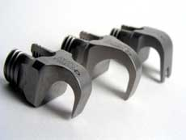
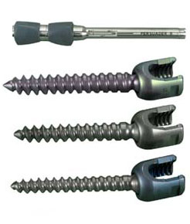
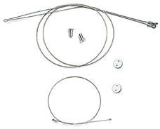
Instrumentation
Fixation options:
Pedicle screws
Hooks
Sublaminar wires

Slide 4
Pedicle Screws
Advantages
Strongest biomechanically
Greatest pullout strength
84% stronger then hooks
Three column fixation
Segmental
Rotational
Does not encroach upon the canal

Slide 5
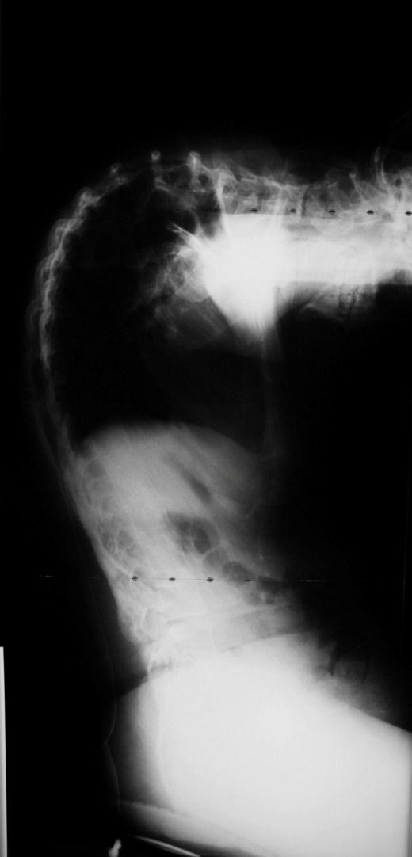
Case Presentation # 1
19 F c CP
Chin on Chest Deformity
Pelvic Obliquity
Previous fusion

Slide 6
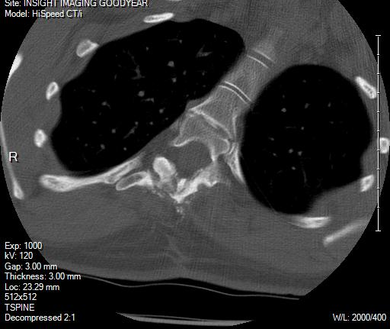
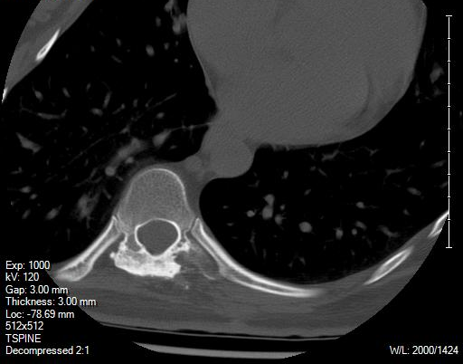
Plan?
Fusion Mass
Dysplastic Pedicles
Significant Deformity

Slide 7
Pedicle Screws
Disadvantage
Limited direct visualization
Requires complete understanding of thoracic vertebra/pedicle anatomy
Exacerbated by
Fusion Mass
Dysplastic Pedicles
Extracted instrumentation

Slide 8
Solution
Fusion mass hooks
Excellent fixation with minimal risk
Multi-level SPOs
C5-Pelvis revision fixation

Slide 9
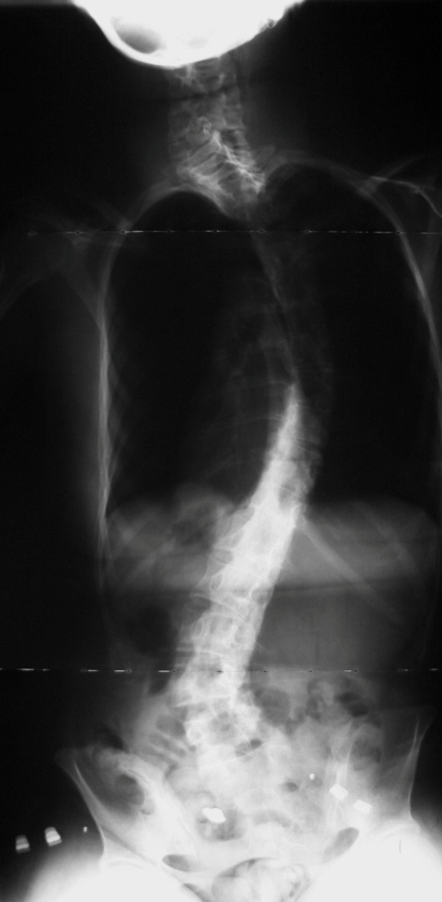
Case 1

Slide 10
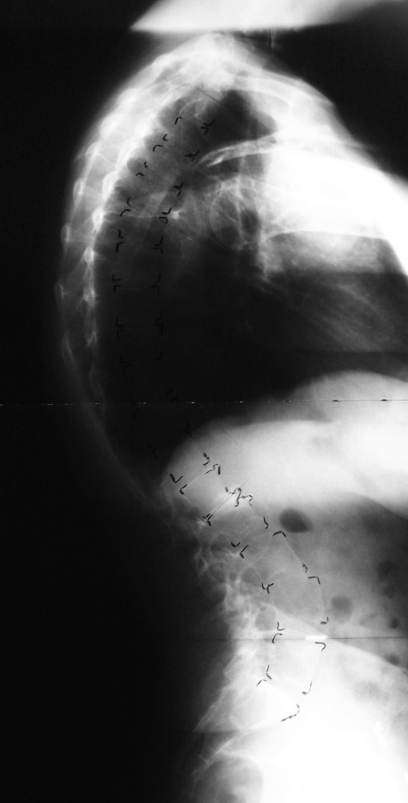
Case Presentation # 2
64 F
Adult Idiopathic Scoliosis
Osteoporosis
Treatment?

Slide 11
Case Presentation # 2
64 F
Adult Idiopathic Scoliosis
Osteoporosis
Most Common Complication?

Slide 12
Proximal Junctional Kyphosis

Slide 13
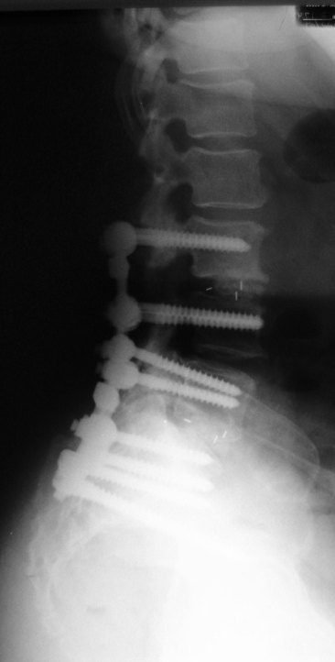
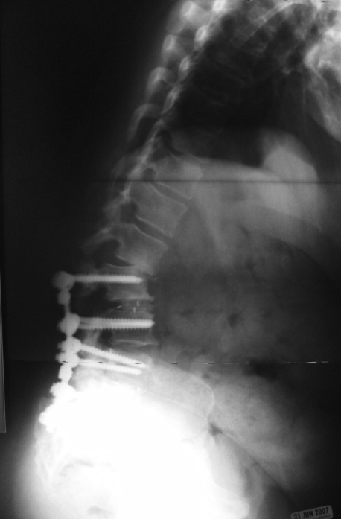
Junctional Pathology
Problems
Degeneration
Kyphosis
Fracture
Arise because of stress riser of fusion vs. adjacent segments
Decreasing construct stiffness leads to decreased instrumentation strain and hypermobility at junction
Durani et al: Spine. 2012
Cahill et al: Spine 2011
4 weeks post
12 weeks post

Slide 14
Case Presentation # 2
64 F
Adult Idiopathic Scoliosis
Osteoporosis
How do we avoid PJK?

Slide 15
Screws vs. Hooks
Junctional issues are less common in constructs with hooks compared with screws
Adults
2.4% (Hybrid) vs. 14% (Screw) revision rate in osteoporotic patients (Ondra)
Pediatric
0% (Hooks only), 2.3% (Hybrid), 8.1%(screw), 5.6% (Hooks at top level only)
Harms Study Group: Spine. 2010

Slide 16
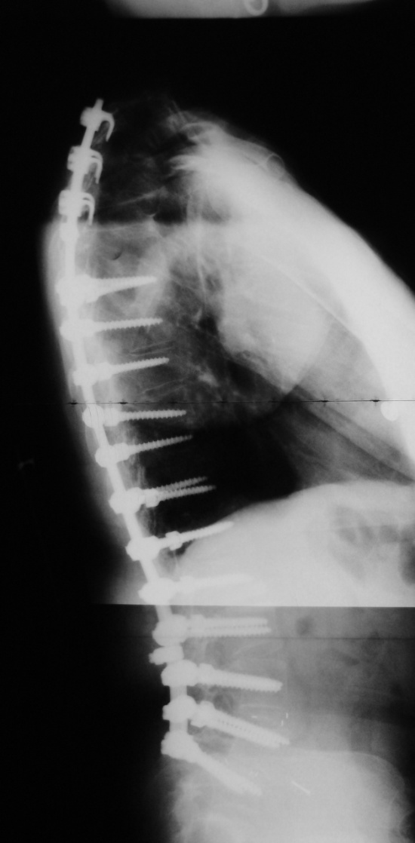
Case 2

Slide 17
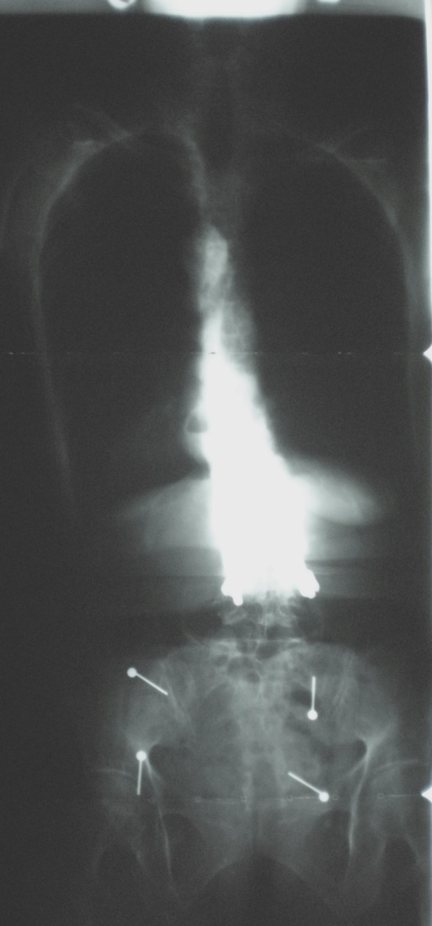
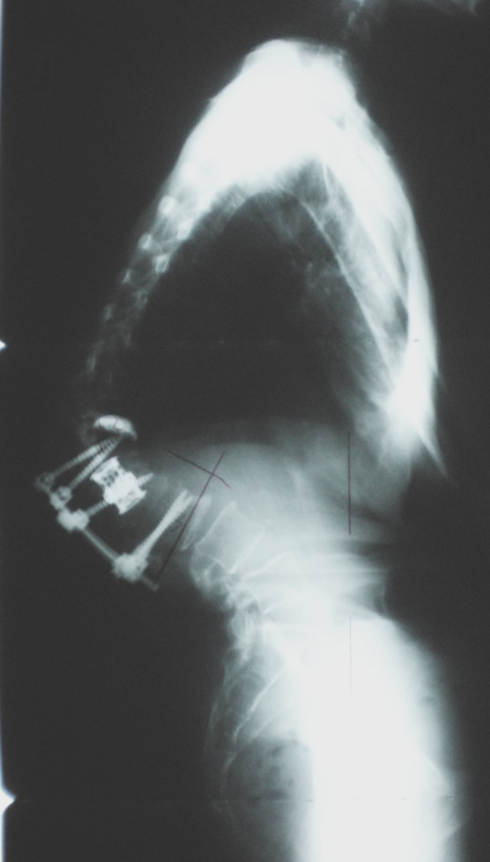
Case Presentation # 3
82 F c/o Imbalance, LBP
2009 L2 compression Fx, treated with A/PSF
Neurologically intact
T-score: -3.5 bone stock
80 lbs

Slide 18
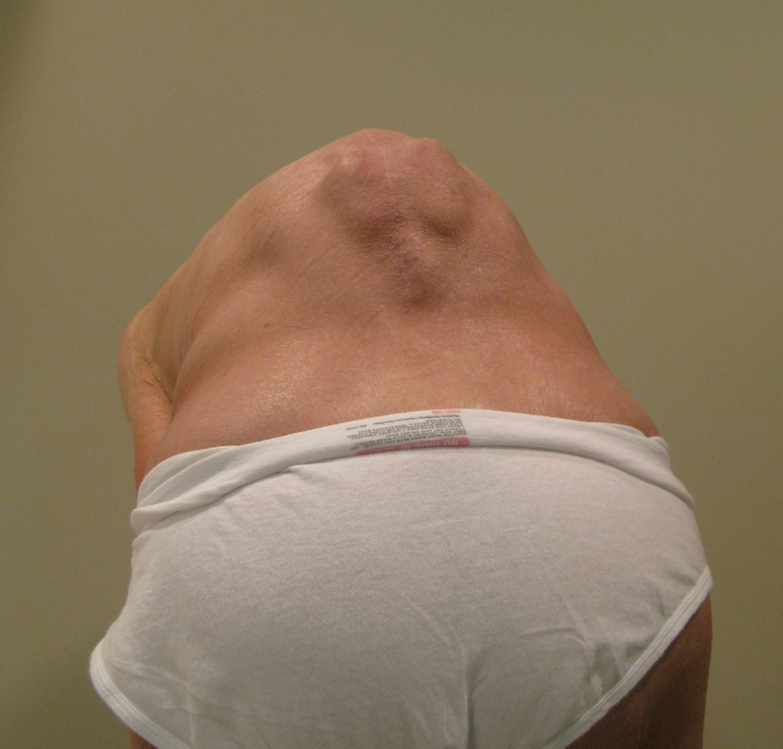

Slide 22
Case Presentation # 3
82 F c/o Imbalance, LBP
2009 L2 compression Fx, treated with A/PSF
Treatment?

Slide 23
Vertebral Column Resection (VCR)
Originally described as ant/post procedure (Bradford)
Now, posterior-only approach (Lenke, Suk)
No fixed-angle wedge for osteotomy closure
Arc of correction is anterior to spine
Greater correction than a PSO, typically 40°–50°
Ideal osteotomy for a sharp angular kyphosis (T₂–L₁)
Typically closed over anteriorly placed cage packed with bone graft
Pre-op
Post-op: T4 VCR

Slide 24
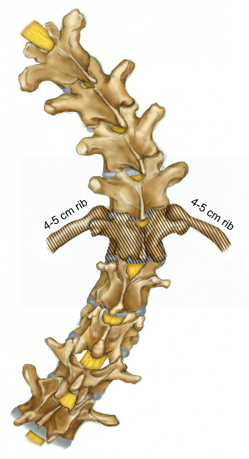
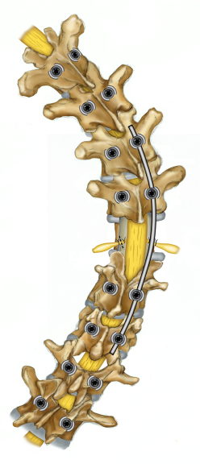
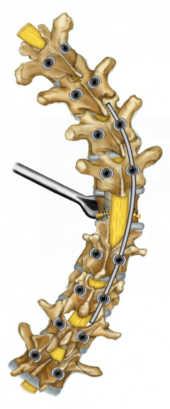
COSTOTRANSVERSECTOMY
LAM & TEMP ROD
VB EXPOSURE

Slide 25
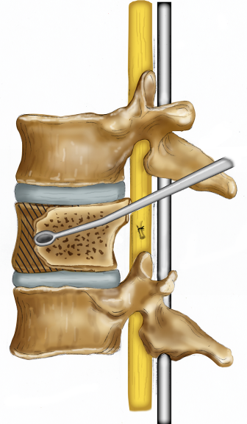
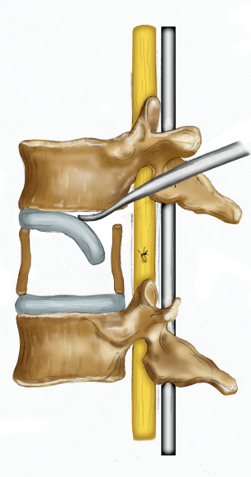
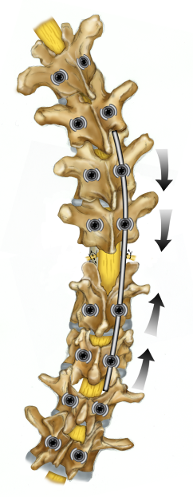
COMPRESSION CLOSURE
VB REMOVAL
DISCECTOMY

Slide 26
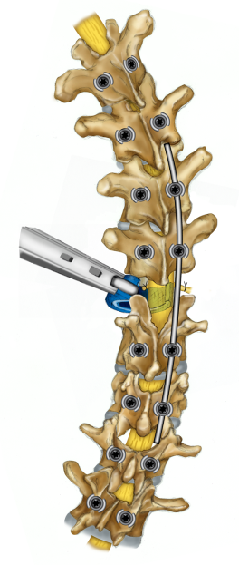
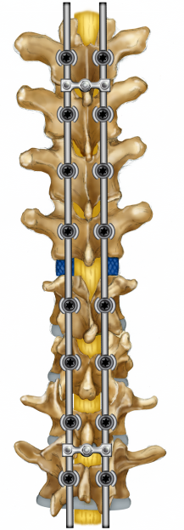
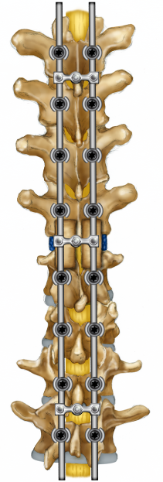
CAGE INSERTION
FINAL CORRECTION
RIB BRIDGE GRAFT

Slide 27
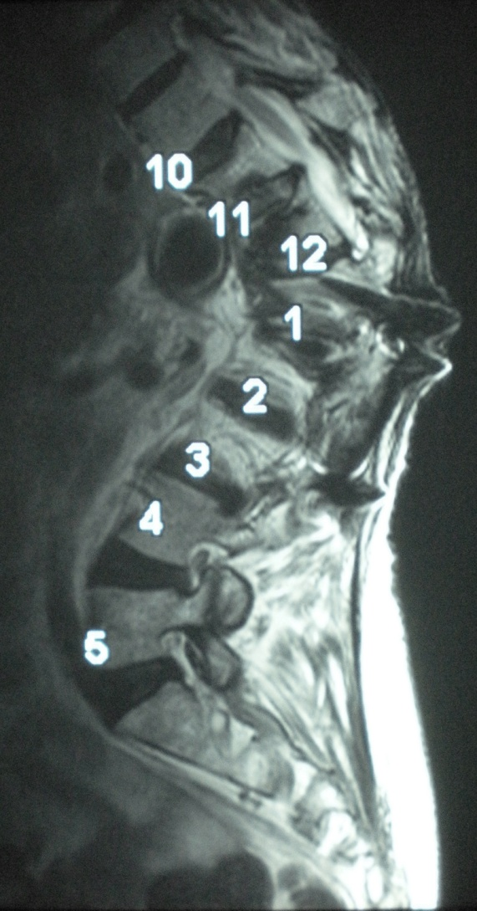
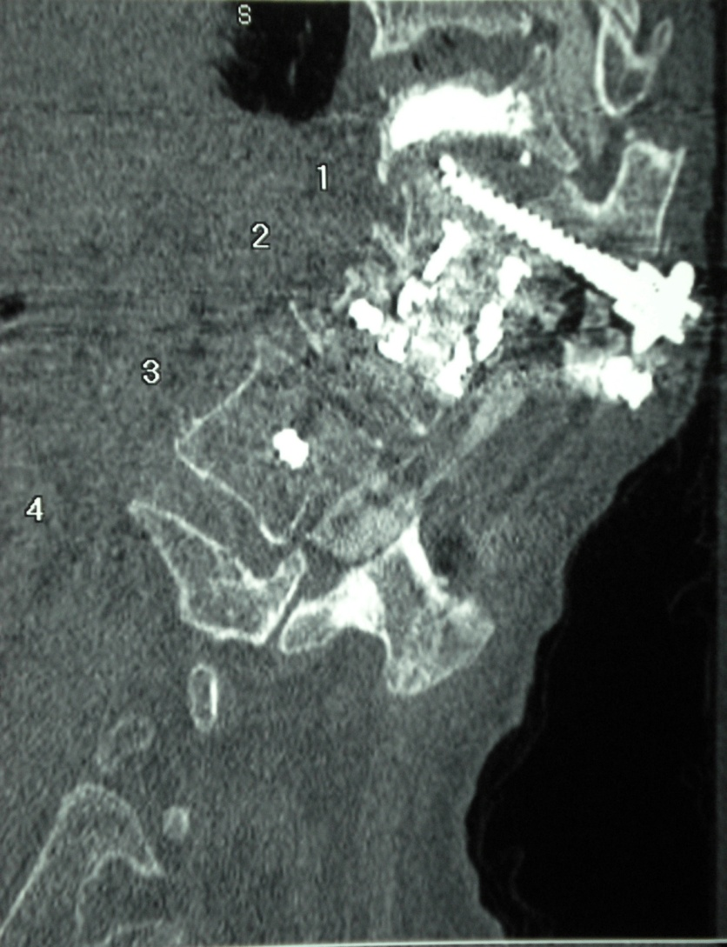
Case Presentation # 3
82 F c/o Imbalance, LBP
L2 compression Fx, treated with A/PSF
L1 instrumentation failure
Treatment? VCR
Levels of fixation?

Slide 28
Distal fusion level
Long fusions stopping at L5 have inferior results
69% had degeneration by 5 years
67% with degeneration had positive sagittal imbalance
Kuhns et al. Spine. 2007
Pelvic fixation
Adds substantial OR time and blood loss
Elderly, frail patient is not ideal candidate
L4 fixation
2 levels enough?

Slide 29
T6-L4 PSF, L1 VCR, Infralaminar hook at L4

Slide 30
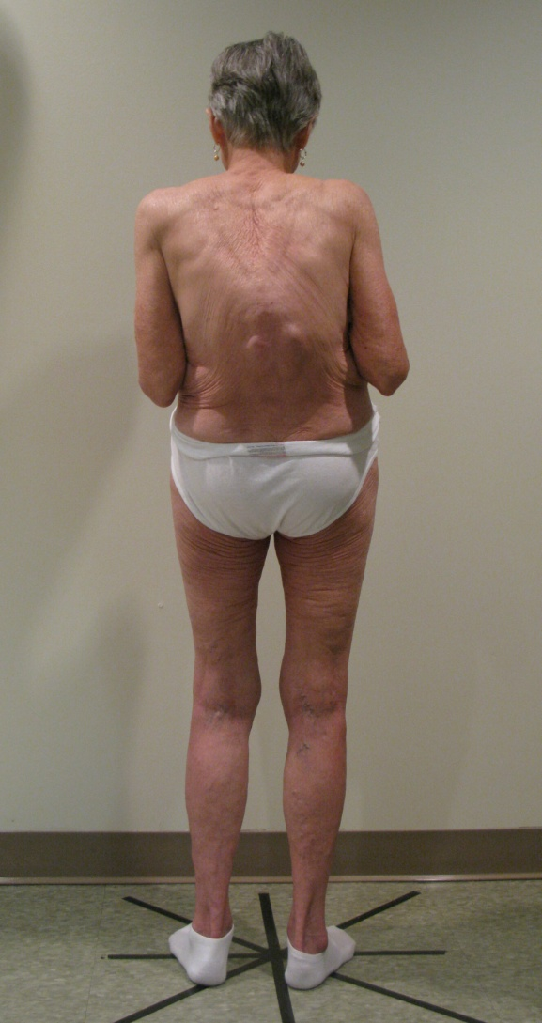
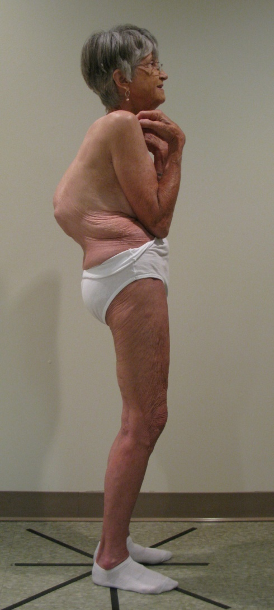

Slide 31
Why Not Always Use Hooks?
 | N % | Dislodged Instrument | Pseudo | Prominent Implant | Infection | Crankshaft | Other | Total
Hooks | 389 | 9 (2.3)** | 6/2* (2.1) | 3 (0.8) | 4 (1.0) | 2 (0.5) | 1 (0.3) | 25 (6.4)**
Hybrid | 423 | 7 (1.7) | 10/1* (2.6) | 0 (0) | 6 (1.4) | 0 (0) | 1 (0.2) | 24 (5.7)**
Screws | 295 | 0 (0) | 2 (0.7) | 2 (0.7) | 1 (0.3) | 0 (0) | 2 (0.7) | 7 (2.4)
ASF/PSF | 321 | 1 (0.3) | 3 (0.9) | 2 (0.6) | 2 (0.6) | 0 (0) | 0 (0) | 8 (2.5)
Total | 1428 | 17 | 21 | 7 | 13 | 2 | 4 | 64 (4.5)
**statistically significant chi-squared analysis vs. screws (p<0.05)
Kuklo TR, Lenke LG, et al. Spine 2007

Slide 32
Summary
Screws offer superior biomechanics in deformity
Hooks are excellent alternatives when cases of aberrant anatomy or revision make screw placement unacceptably risky
Hooks and Hybrid constructs have less PJK issues due to decreased fixation stiffness
Infralaminar hooks may be utilized to save fixation levels

Slide 33
Thank You!
Michael S. Chang, MD

