Slide 1
Key measurements for understanding spinal deformity
1
Greg Mundis, MD
San Diego Center for Spinal Disorders
February 16, 2013
CA#11014A

Slide 2
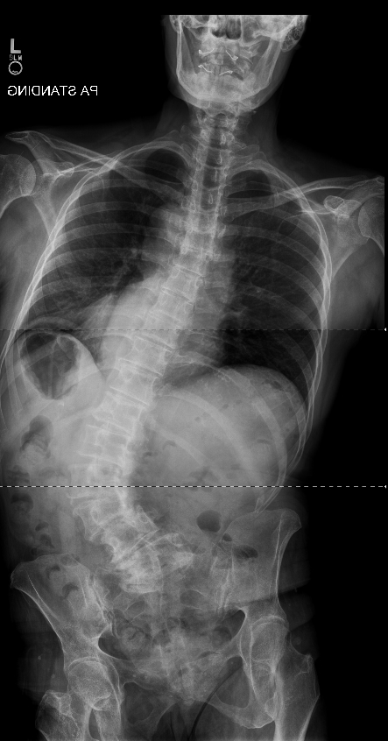
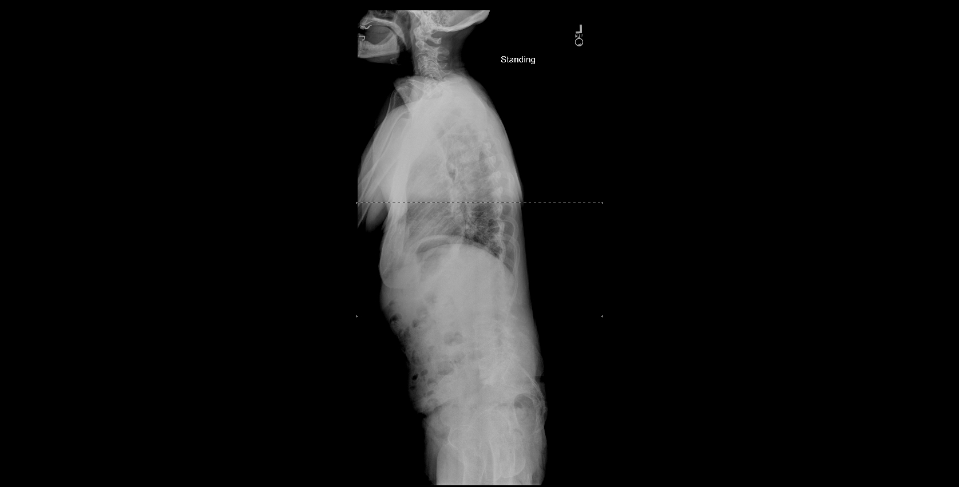
FELLOWS?
L1-L4: 63
L4 tilt: 28
CB: 73 mm rt
SVA: 111 mm
PI: 50
LL: 18
PT: 11
SS: 35

Slide 3
ALIGNMENT OBJECTIVES
C7
T1
SVA
T1 Tilt
PT
PI
Proportional:
LL=PI +/- 10⁰
<5cm
<0⁰
<20⁰
Notes:
3

Slide 4
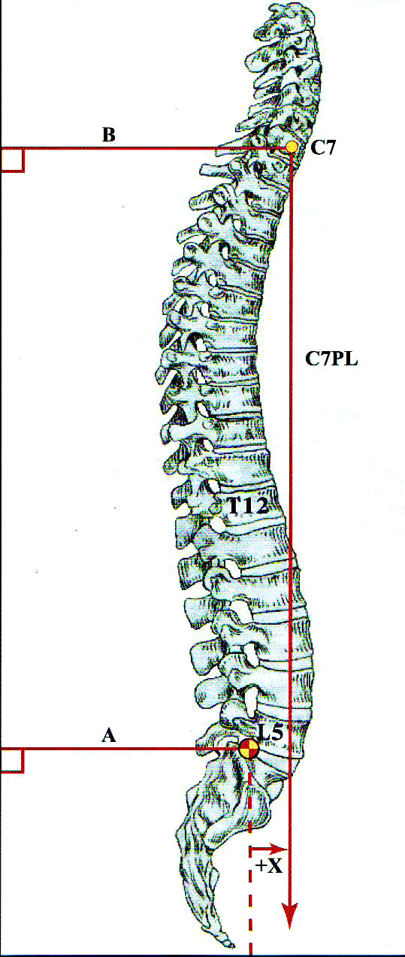
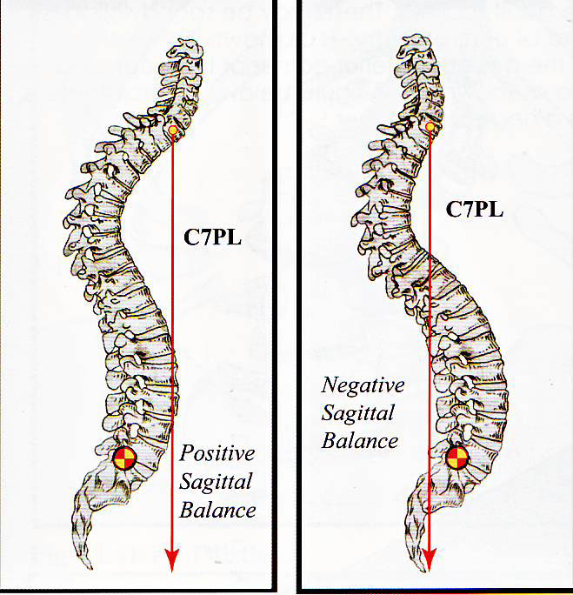
SAGITTAL IMBALANCE

Slide 5
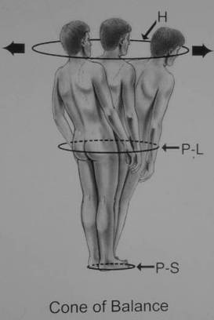
Why is Alignment Important?
Poor alignment = disability
Must compensate for anatomic deformation
Mechanical disadvantage challenges balance mechanisms
Deviation from stable zone = Increase Muscular / energy use
Jean Dubousset
CA#11014A
B.A.

Slide 6
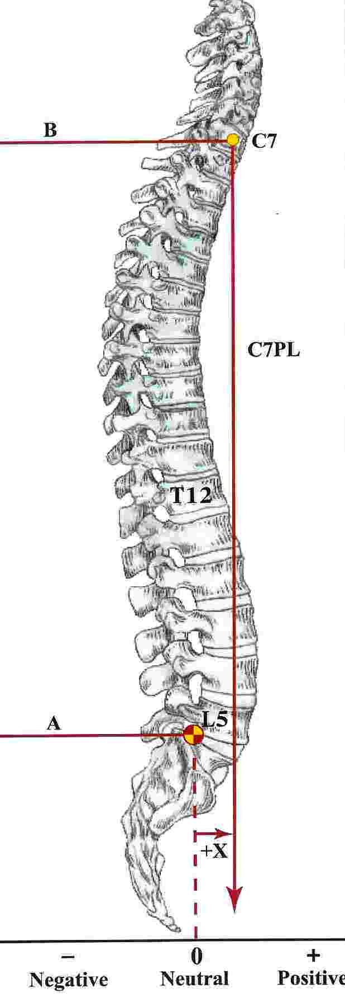
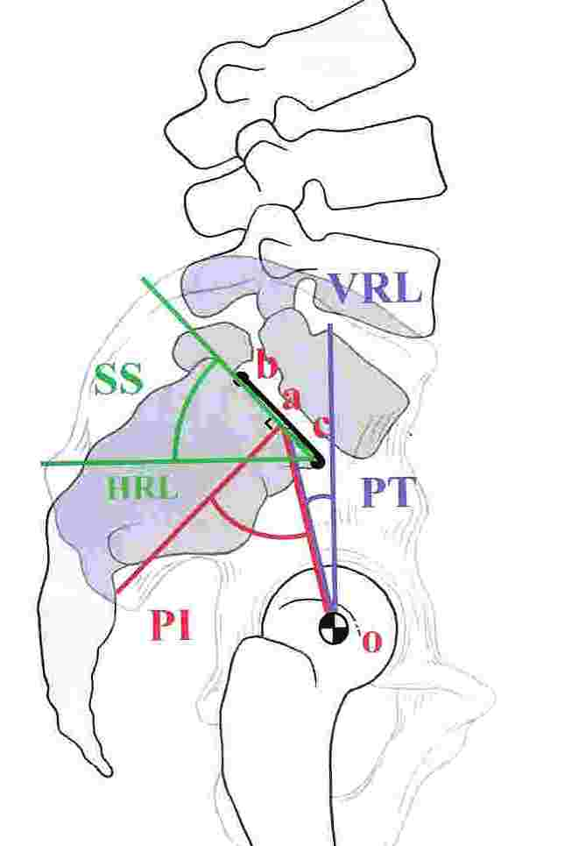
Normal Sagittal Balance
  LS Lordosis 30 degrees > thoracic kyphosis
  2/3 of lordosis L4-S1
  L3-3 o’clock, L4-4 o’clock, L5-5 o’clock
  Sagittal Vertical Axis C7-S1
CA#11014A
B.A.

Slide 7
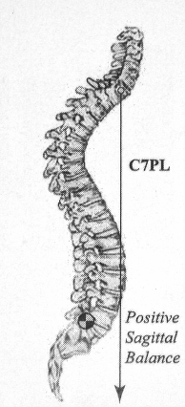
Loss of Global Alignment
Glassman, Bridwell, Dimar, Horton, Berven, Schwab. SPINE 2005
Plumbline Shift Anteriorly
=> Increasing disability
    SF-12, SRS-29, ODI (p<0.001)
=> Lumbar kyphosis marked disability
SRS-29, ODI (p<0.05)
CA#11014A
B.A.

Slide 8
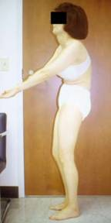
Criteria
Normal=
  C7PL within 2 cm of post-superior sacral promintory
Sagittal Imbalance= C7PL > 5cm anterior

Slide 9
Impact of Sagittal imbalance
Spine ’05:
  Bridwell, Glassman, Berven
    298 adult deformity pts
      →positive sag bal most highly correlated with adverse health outcomes
Spine ’05:
  Bridwell, Glassman, Berven, Schwab
    Retrospective review of 752 pts
    As C7pl increase, all measures of health status declines
    Patients with relative lumbar kyphosis did much worse than those with normal LL

Slide 10
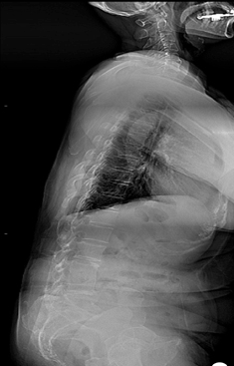
Sagittal Imbalance
CLINICALLY:
  Can be very disabling

Slide 11

Sagittal Imbalance
CLINICALLY:
  Can be very disabling
  Early fatigue

Slide 12
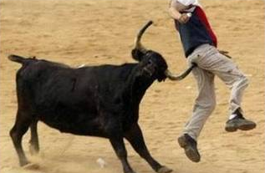
Sagittal Imbalance
CLINICALLY:
  Can be very disabling
  Early fatigue
  Pain

Slide 13
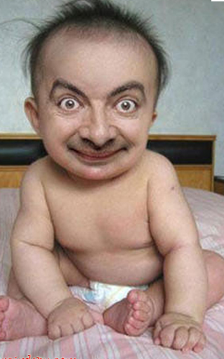
Sagittal Imbalance
CLINICALLY:
  Can be very disabling
  Early fatigue
  Pain
  Poor cosmesis
Dr. KLINEBERG AT 6 MONTHS

Slide 14

Sagittal Imbalance
CLINICALLY:
  Can be very disabling
  Early fatigue
  Pain
  Poor cosmesis
  Functional limitations

Slide 15
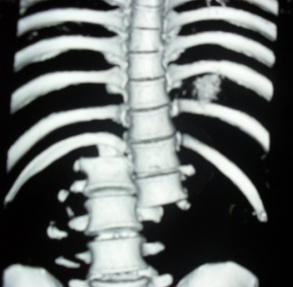
Sagittal Imbalance
CLINICALLY:
  Can be very disabling
  Early fatigue
  Pain
  Poor cosmesis
  Functional limitations
  Mechanical back pain

Slide 16
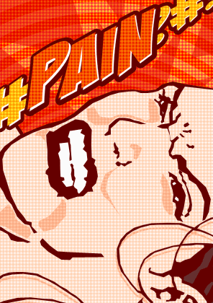
Sagittal Imbalance
CLINICALLY:
  Can be very disabling
  Early fatigue
  Pain
  Poor cosmesis
  Functional limitations
  Mechanical back pain
  Neurologic symptoms from compression

Slide 17
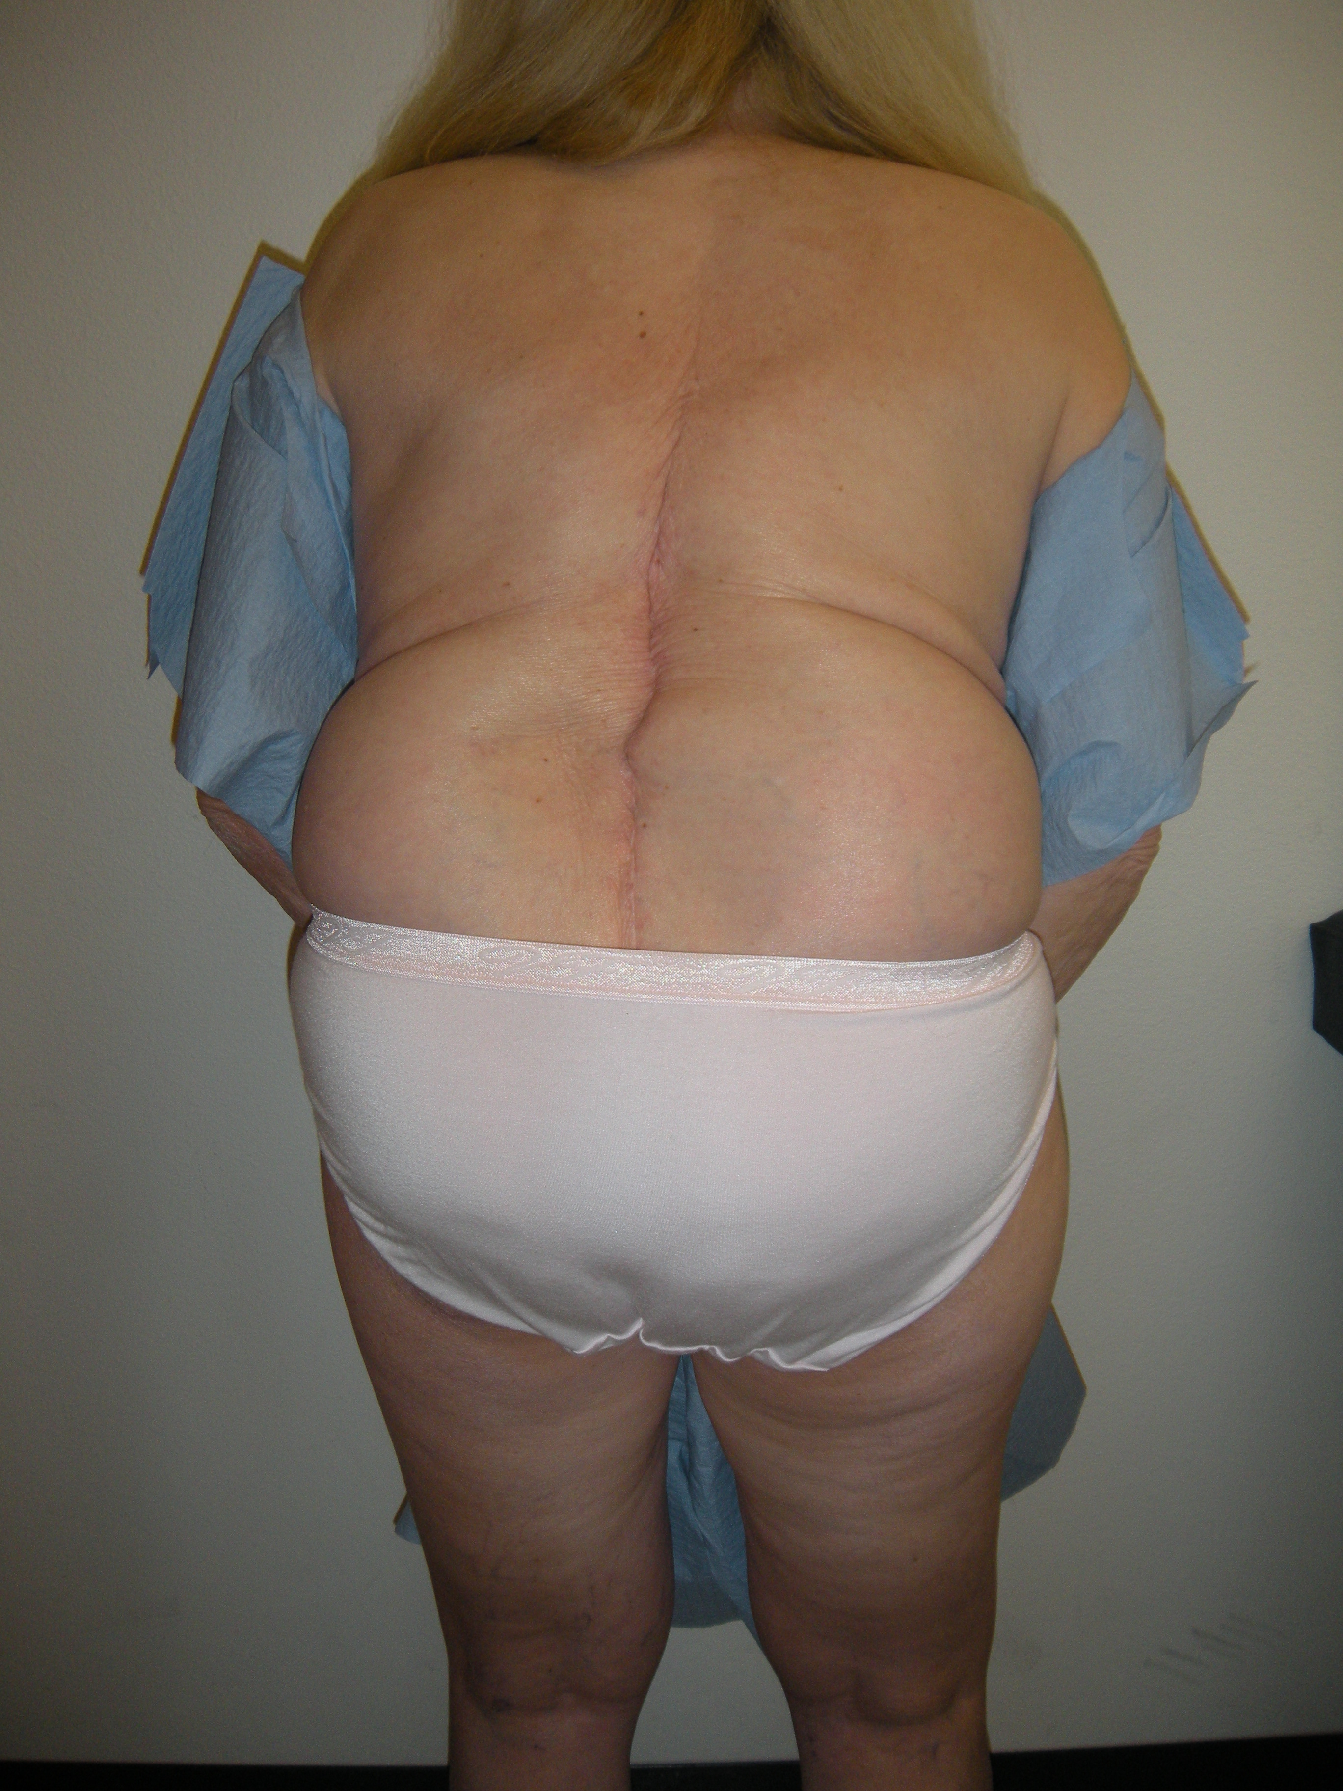
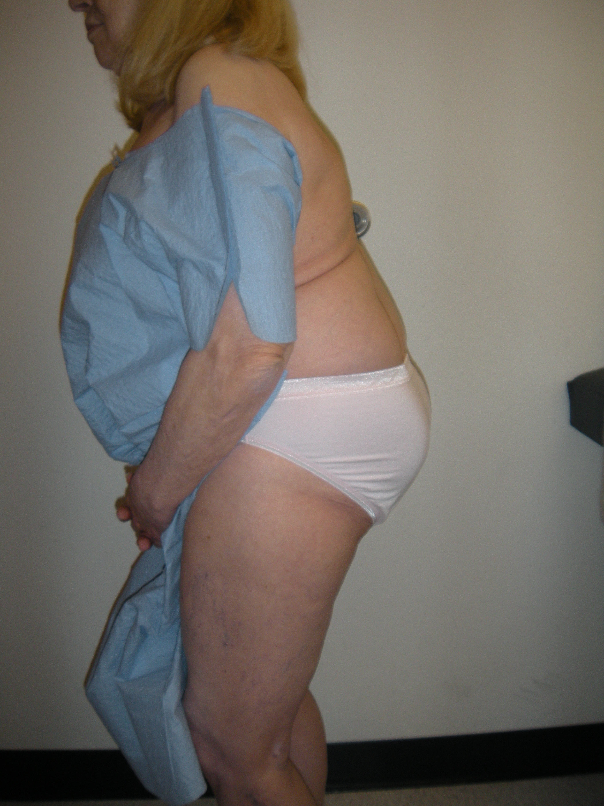
ADULT CLINICAL

Slide 18
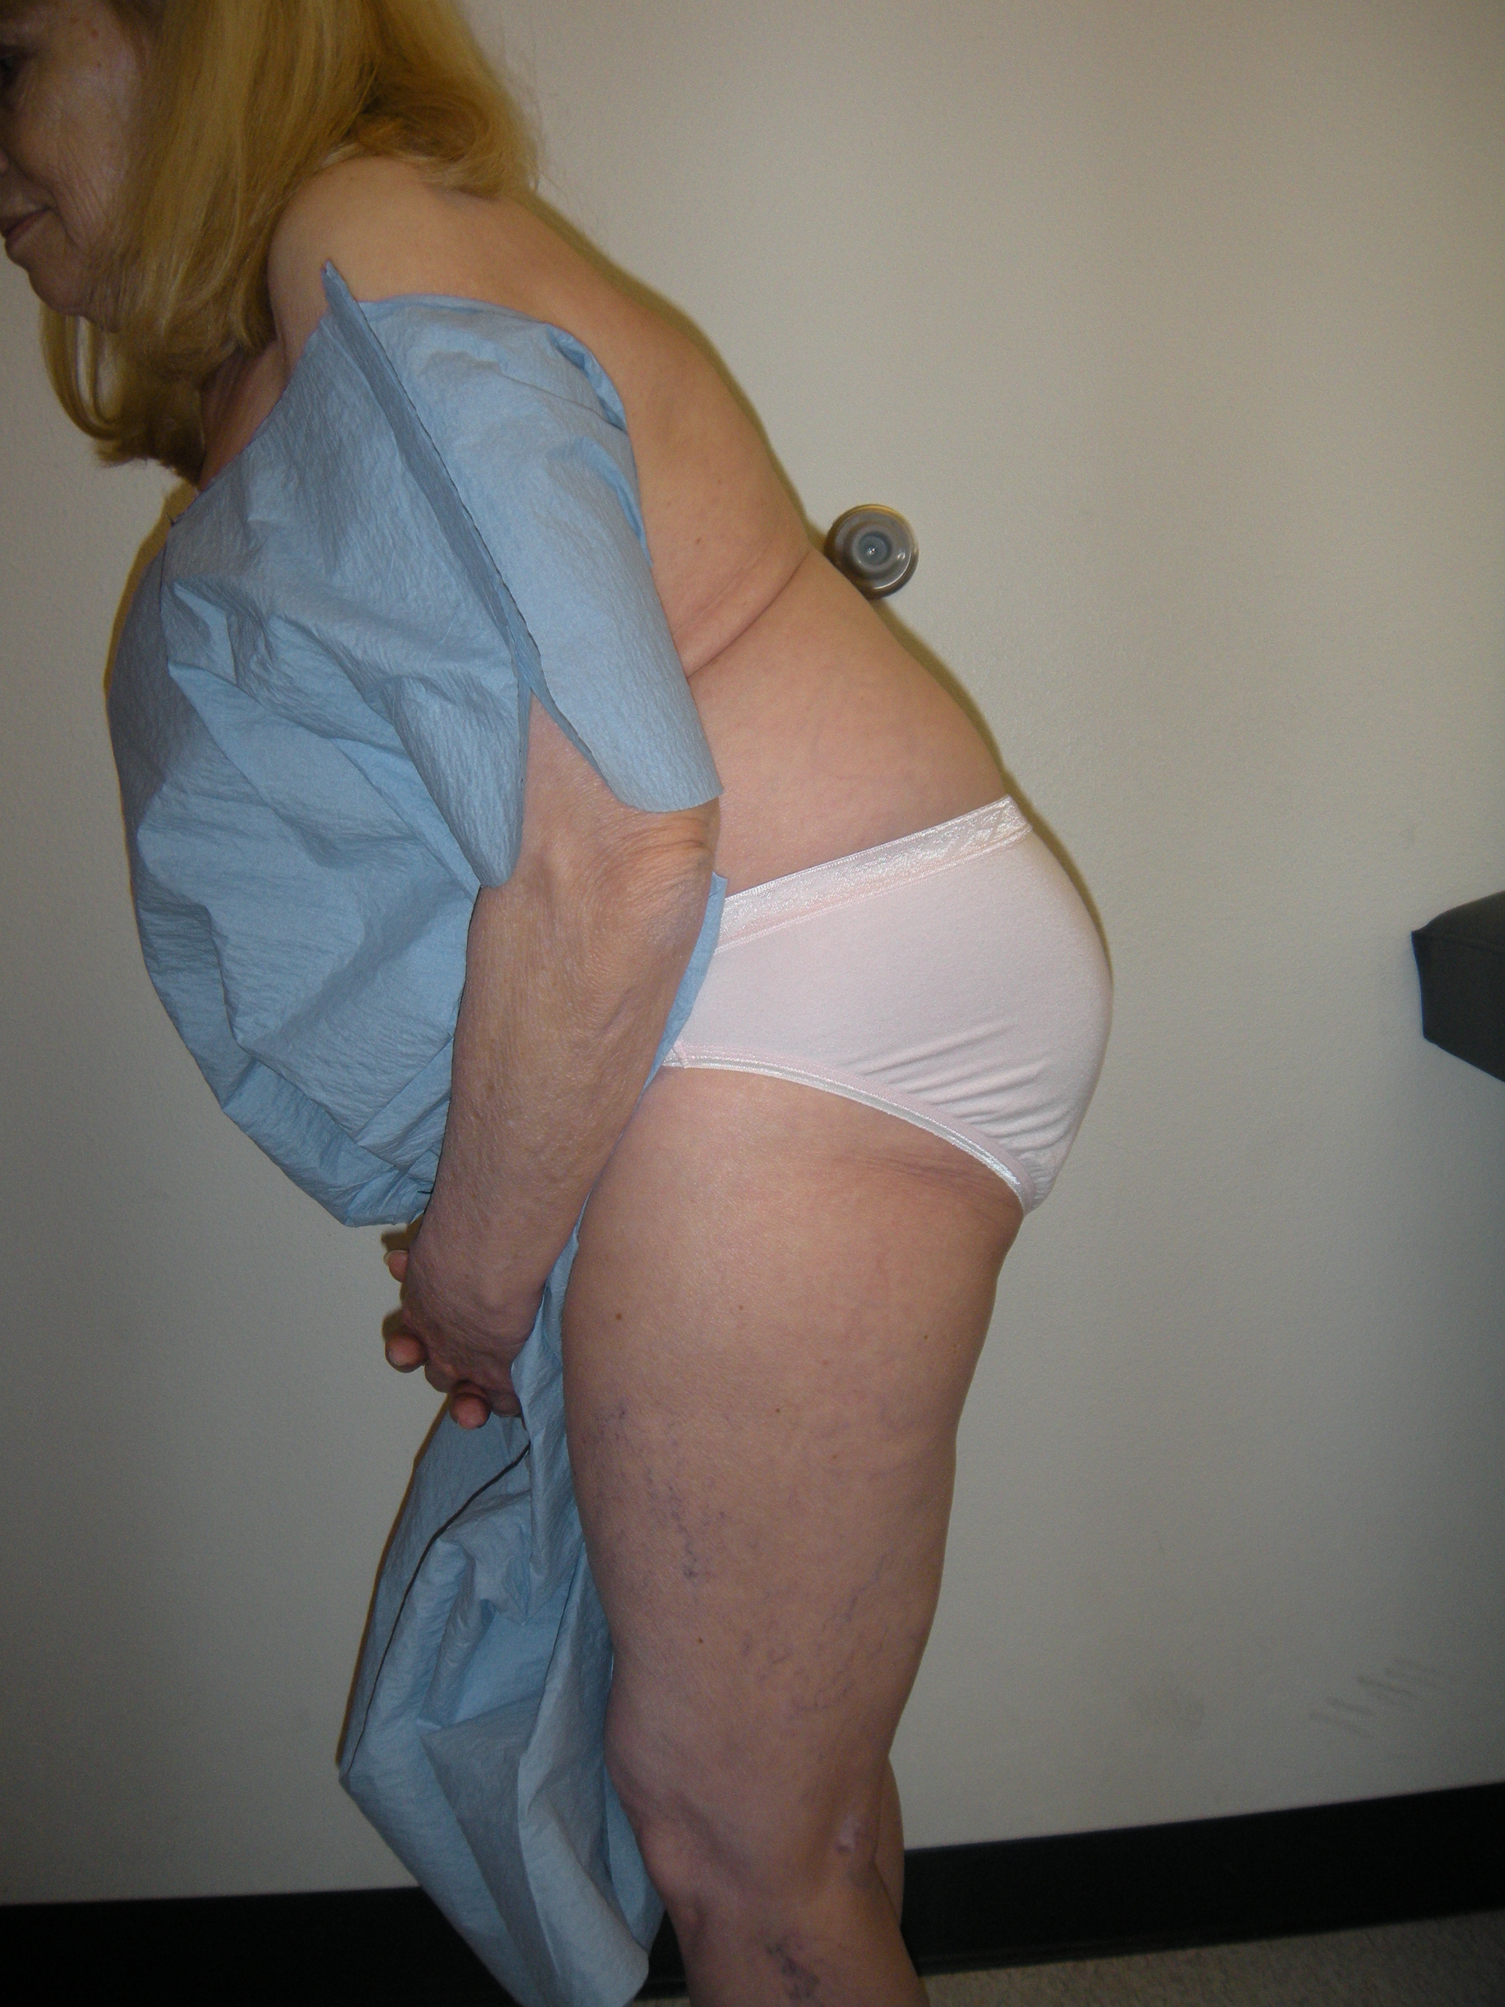
ADULT CLINICAL

Slide 19
THE PARAMETERS
Lumbar Lordosis (LL)
Pelvic Incidence (PI)
Pelvic Tilt (PT)
Truncal Inclination (T1 Tilt)
Sacral Slope (SS)
Sagittal Vertical Axis (SVA)

Slide 20
LORDOSIS
Loss of lumbar lordosis is especially poorly tolerated and has direct effect on disability

Slide 21
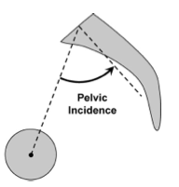
THE PARAMETERS
Lumbar Lordosis (LL)
Pelvic Incidence (PI)
Pelvic Tilt (PT)
Truncal Inclination (T1 Tilt)
Sacral Slope (SS)
Sagittal Vertical Axis (SVA)
CA#11014A

Slide 22

PELVIC INCIDENCE
Morphological parameter
Not Affected by patient position
No Variation over time in adult population

Slide 23
PELVIC INCIDENCE
Morphological parameter
Not Affected by patient position
No Variation over time in adult population

Slide 24


Pelvic Incidence and Lordosis
Large PI
Horizontal Sacrum
Marked, long lordosis
Small PI
Vertical Sacrum
Flat Lordosis
Pragmatic Estimate:
LL = PI +/- 10deg

Slide 25
THE PARAMETERS
Lumbar Lordosis (LL)
Pelvic Incidence (PI)
Pelvic Tilt (PT)
Truncal Inclination (T1 Tilt)
Sacral Slope (SS)
Sagittal Vertical Axis (SVA)
CA#11014A

Slide 26
Pelvic Tilt
Positional parameter
Compensatory Mechanisms
Affected by patient position

Slide 27
Pelvic Tilt
Positional parameter
Compensatory Mechanisms
Affected by patient position

Slide 28
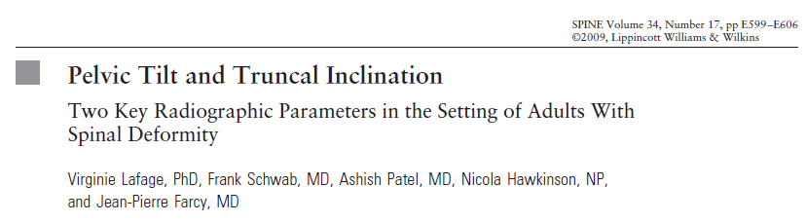
Importance of the Pelvis in Sagittal Plane Outcomes
CA#11014A

Slide 29
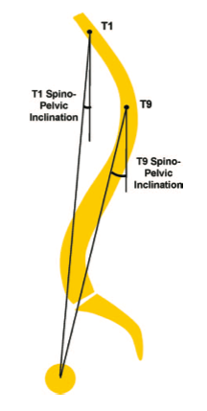
THE PARAMETERS
Lumbar Lordosis (LL)
Pelvic Incidence (PI)
Pelvic Tilt (PT)
Truncal Inclination (T1 Tilt)
Sacral Slope (SS)
Sagittal Vertical Axis (SVA)
CA#11014A

Slide 30
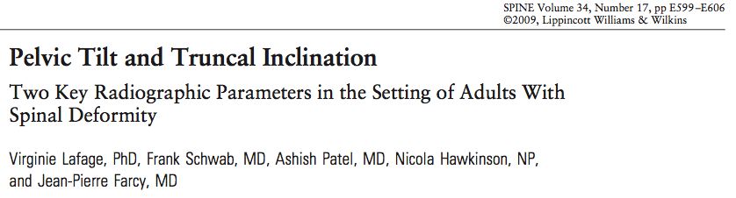
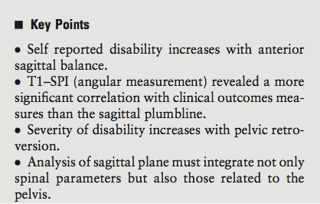
CA#11014A

Slide 31
THE PARAMETERS
Lumbar Lordosis (LL)
Pelvic Incidence (PI)
Pelvic Tilt (PT)
Truncal Inclination (T1 Tilt)
Sacral Slope (SS)
Sagittal Vertical Axis (SVA)
CA#11014A

Slide 32
SACRAL SLOPE
THE EQUATION:
SS+PT=PI

Slide 33
SACRAL SLOPE
THE EQUATION:
SS+PT=PI

Slide 34
THE PARAMETERS
Lumbar Lordosis (LL)
Pelvic Incidence (PI)
Pelvic Tilt (PT)
Truncal Inclination (T1 Tilt)
Sacral Slope (SS)
Sagittal Vertical Axis (SVA)
CA#11014A

Slide 35
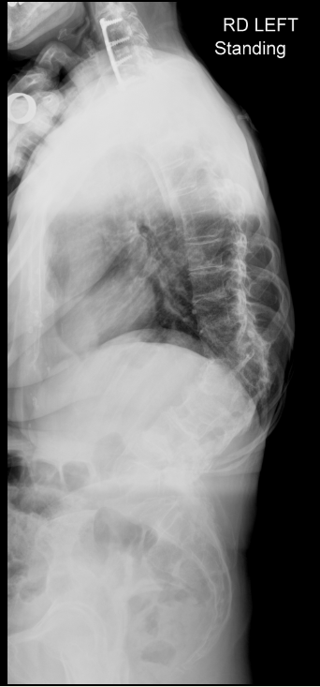
SVA
C7 centroid
POSTERIOR SUPERIOR S1 endplate
CA#11014A

Slide 36
ALIGNMENT OBJECTIVES
C7
T1
SVA
T1 Tilt
PT
PI
Proportional:
LL=PI +/- 10⁰
<5cm
<0⁰
<20⁰
Notes:
36

Slide 37


Combined Assessment of Pelvic Tilt,
Pelvic Incidence/Lumbar Lordosis Mismatch and Sagittal Vertical Axis Predicts Disability in Adult Spinal Deformity
A Prospective Analysis
Frank Schwab, Shay Bess, Benjamin Blondel, Richard Hostin,
Christopher Shaffrey, Justin Smith, Oheneba Boachie-Adjei, Douglas Burton, Behrooz Akbarnia, Gregory Mundis, Christopher Ames, Khaled Kebaish, Robert Hart, Virginie Lafage
CA#11014A
37

Slide 38
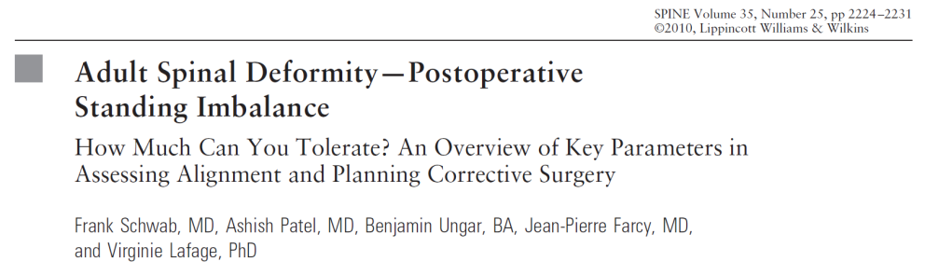
Clinically Relevant x-ray parameters
Alignment Objectives *
  SVA < 5cm
  PT < 25
  PI – LL < 10
Heterogeneous study designs
  Prospective multi-centric (SVA)
  Prospective mono-centric (PT)
  Retrospective multi-centric (LL-PI)
Notes:
38

Slide 39
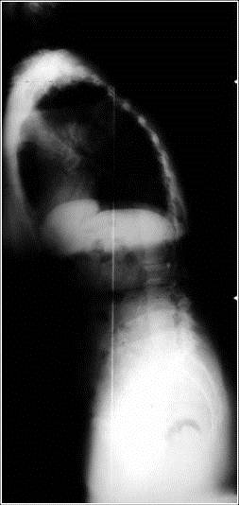
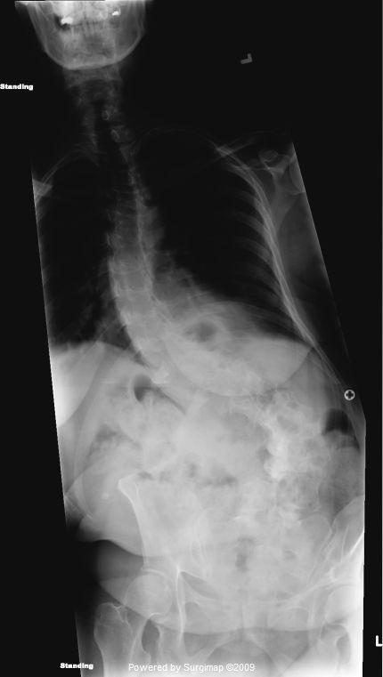
OBJECTIVE
Multi-center prospective study
Establish radiographic drivers of disability
Investigate their value in predicting disability
CA#11014A

Slide 40
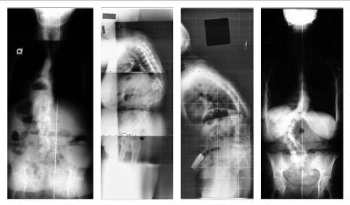
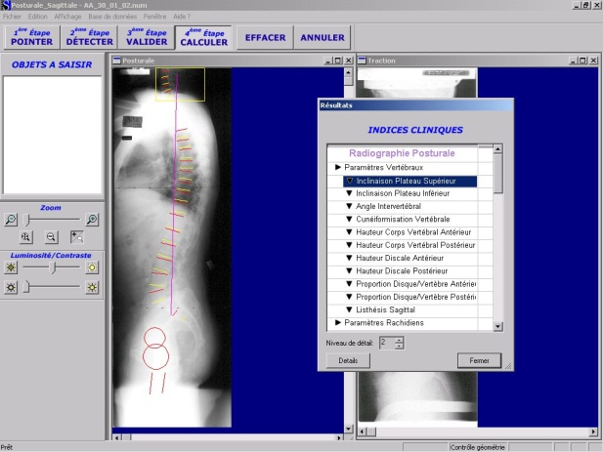
Study Design and data collection
Multi-center prospective study: Surgical vs Non-Operative patients
Inclusion Criteria
  Age >18yo
  Radiographic ASD
    Cobb > 20 °
    SVA > 5cm
    PT > 25 °
    Kyphosis > 60°
Evaluation Criteria
  Demographics
  Full Spine coronal and sagittal
    SpineView Analysis
  Baseline HRQOL
    ODI, SF36, SRS22r

Slide 41
Statistical Analysis
Surgical Patients = OP; Non-operative patients = NON
Comparison OP vs NON
  Unpaired t-test
    Demographic
    Radiographic measurements
    HRQOL scores
Correlation Analysis
  Pearson Coefficient
    HRQOL vs Radiographic
Prediction of Severe Disability
  Multi-linear models
    ODI > 40
Risk Analysis
  Relative risk analysis
    Within x-ray parameters
Difference in Baseline profiles
X-ray parameters drivers of disability
Predictive ability of x-ray parameters
Clinical relevance

Slide 42
Demographic & HRQOL
Enrollment Period: Oct. 08 to Dec. 10
492 ASD Patients
  70M: 422F
  51.9 years (SD 16.8y)
  178 OP : 314 NON
OP vs. NON
  OP older (55 vs. 50, p=0.002)
  More disable
    Total scores
    All ODI/SRS domains
* SRS x 10

Slide 43
3 most highly correlated parameters
Coronal and Sagittal plane
 |  | PT | SVA | PI-LL
OP | ODI | .377 | .458 | .425
 | SRS | -.411 | -.357 | -.416
 | PCS | -.350 | -.399 | -.482
 | MCS | -.226 | ns | -.230
NON | ODI | .338 | .36 | .402
 | SRS | -.204 | -.215 | -.270
 | PCS | -.319 | -.351 | -.409
 | MCS | ns | ns | ns
.458
OP: better correlations
  -0.35 to -0.482 (OP)
  -0.20 to -0.409 (NON)
‘Best” Parameters
  PI - LL
  OP / NON
-.416
-.482
-.230
-.402
-.270
-.409
OP Patients
  More deformity

Slide 44
Prediction of Disability
Multi-linear models
  ODI = 0.2106 * PT + 13.719
  ODI = 1.5563 * SVA - 16.293
  ODI = 0.4379 * PI-LL - 6.0827
Thresholds for severe disability (ODI>40)
  SVA > 47mm
  PT > 22°
  PI – LL > 11 °
  Patients with x-ray parameters below thresholds are more likely to receive conservative treatment

Slide 45
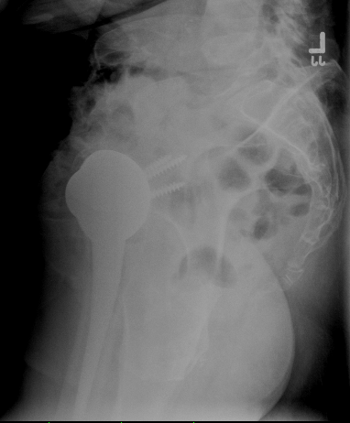
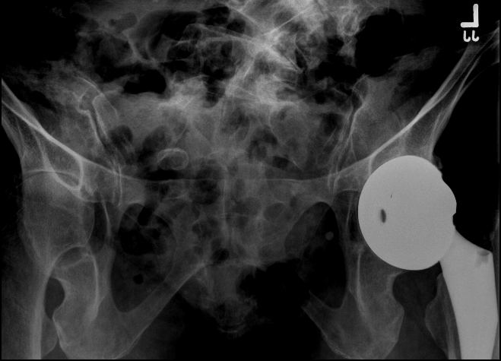
FELLOW???
Recurrent Anterior Dislocator
CA#11014A

Slide 46
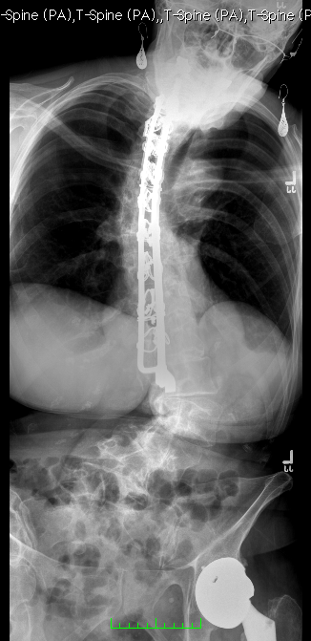
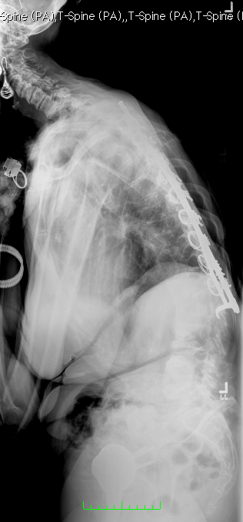
LEFT TRUNCAL SHIFT 6 cm
C2 SVA: 22 cm
C7 SVA: 18 cm
PT: 41
PI: 80
LL: 8

Slide 47
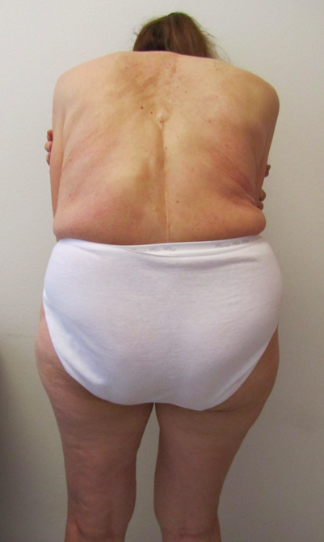
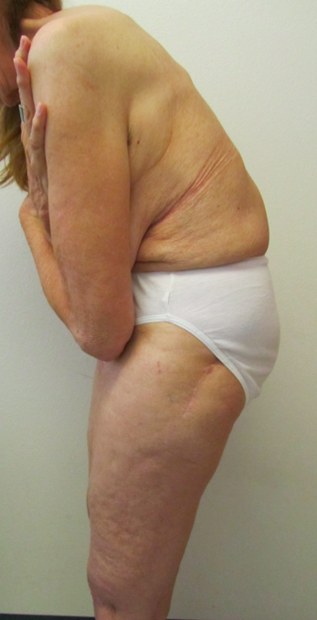

Slide 48
ALIGNMENT OBJECTIVES
C7
T1
SVA
T1 Tilt
PT
PI
Proportional:
LL=PI +/- 10⁰
<5cm
<0⁰
<20⁰
Notes:
48

Slide 49
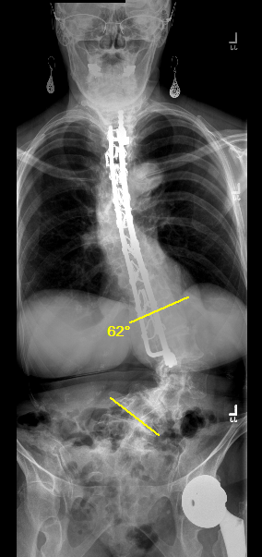
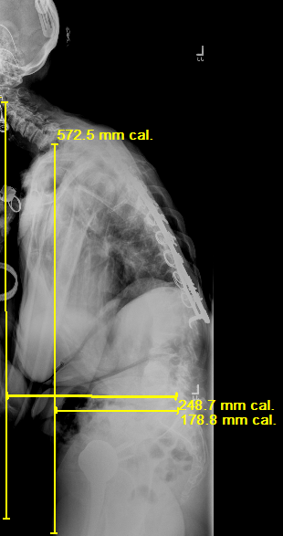
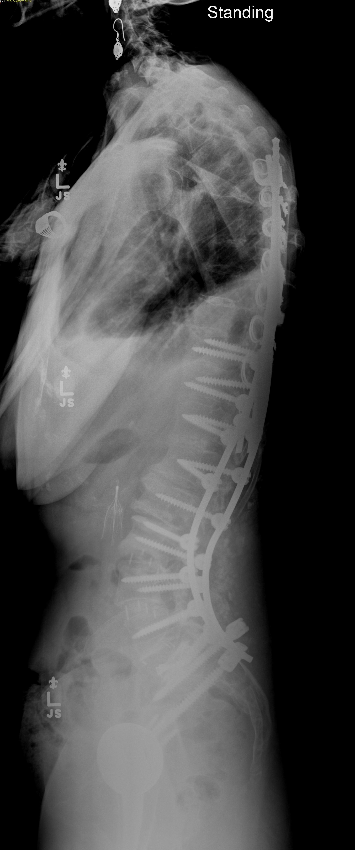
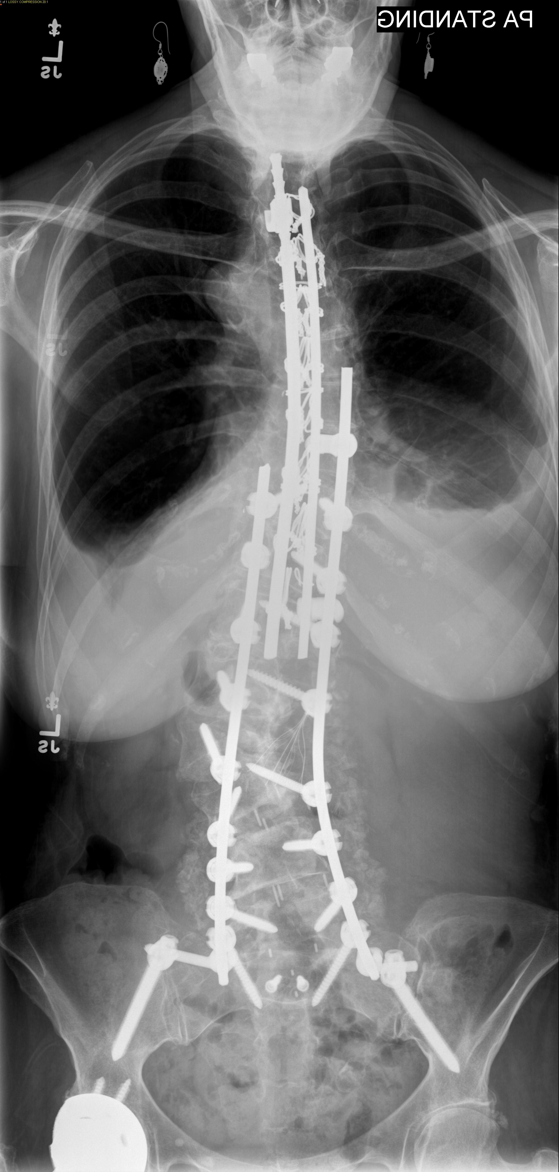

Slide 50
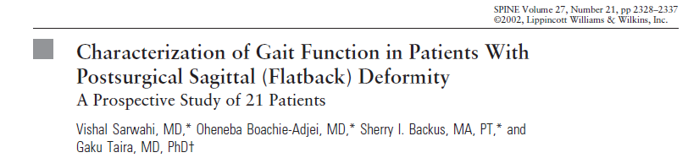
Sagittal Imbalance and Gait
Sagittal Imbalance results in abnormal gait
  External Rotation of Hip
  Internal Rotation of Knee
  Short stride
  Accelerated arthritis?
Normal gait requires forward flexion of pelvis
If high PT is maintaining SVA this forward tilt may decompensate pt

Slide 51


Changes in Thoracic Kyphosis Negatively Impact Sagittal Alignment Following Lumbar Pedicle Subtraction Osteotomy
Virginie Lafage PhD, Eric Klineberg MD, Frank Schwab MD, Behrooz Akbarnia MD, Christopher Ames MD, Oheneba Boachie-Adjei MD, Douglas Burton MD, Robert Hart MD, Richard Hostin MD, Christopher Shaffrey MD, Kirkham Wood MD, Shay Bess MD.
International Spine Study Group
SRS 2010 Kyoto

Slide 52
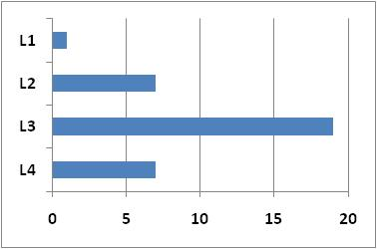
Results – Entire group
Patients
  34 lumbar PSO
  24F:10M
  Age: 54.4 years (SD = 12)
  BMI: 25.5 kg/m² (SD = 5.2)
  26 revision
Surgery
  Most common PSO Site: L3
  Focal resection: 26° (SD = 9)
  Levels fused: 6.4
Radiographic Changes
  LL: 17° to 48° p<0.001
  TK: 22° to 35° p<0.001
  T1SPI: 5° to -3° p<0.001
  SVA: 14 to 4cm p<0.001
  PT: 33° to 25° p<0.001
PSO site
CA#11014A

Slide 53
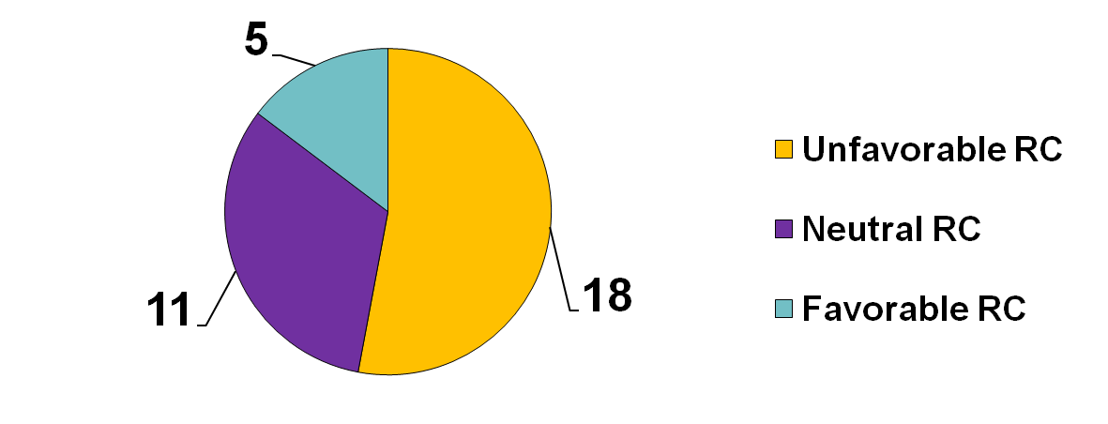
Group distribution
Neutral RC
  change in thoracic kyphosis less than 5°
Favorable RC
  increase in thoracic kyphosis countered
    excessive negative SVA
    excessive decrease of PT
Unfavorable RC
  increase in thoracic kyphosis ‘led’ to
    post-operative SVA > 4cm
    post-operative PT>20°

Slide 54
Analysis of “unfavorable” RC
Pre-operative parameters
Demographic
  Older 59 y vs. 49 years p=0.01
Larger Pre-op imbalance
  Worse SVA 17.5 vs 10.3cm p=0.002
  Worse T1SPI 7° vs. 2° p=0.004
  Pelvic retroversion 36° vs. 28° p=0.024
  Loss of lordosis 11° vs. 24° p=0.04
Morphology
  Larger PI 61° vs. 54° p=0.04
PI : LL mismatch
Significant difference in terms of patient pre-operative profiles

Slide 55
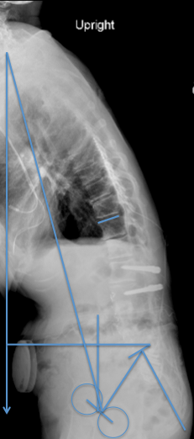
PUTTING IT ALL TOGETHER
PLANNING is crucial to minimize post operative failure
FULL LENGTH FILMS are the only way to assess preoperative global sagittal alignment

Slide 56
THANK YOU

