Slide 1
Oral Boards Functional Neurosurgery Cases

Slide 2
Presentation
38yo woman c/o right arm pain x 3 yrs after minor injury to her wrist while at work
Pain initially in wrist and hand, now extends up arm into shoulder and neck
Has undergone physical therapy without improvement
Can no longer do many tasks with right arm due to pain

Slide 3
Exam
Her exam is notable for decreased ROM in right arm and hand, mostly due to pain, but cannot fully close right hand
Sensation slightly decreased C5-8 regions, dysesthetic
Inspection and comparison of her hands reveals the right hand is swollen, but cold, with less forearm hair, as compared to the left
She states she rarely needs to trim her right fingernails

Slide 4
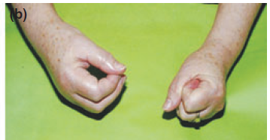
Exam: affected right hand
From: European Journal of Neurology 2010, 17: 649–660

Slide 5
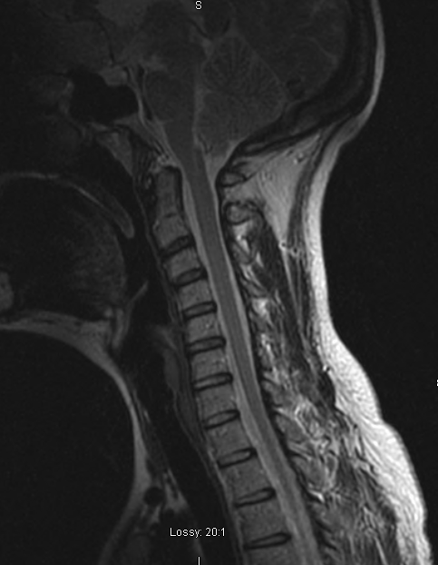

Slide 6
Presentation
44 year old woman who, 8 years prior, initially experienced episodes of severe, intermittent sharp, electrical pain in her right jaw.
The pain is precipitated by wind, brushing her teeth, and talking.
Her pain went into remission for periods of months at a time, but would recur more severely

Slide 7
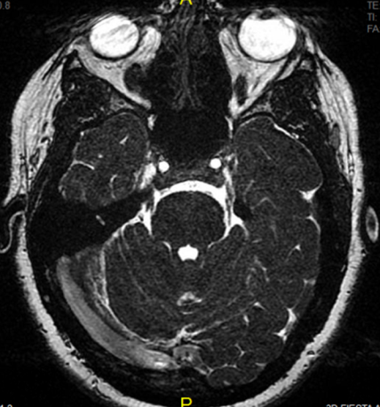
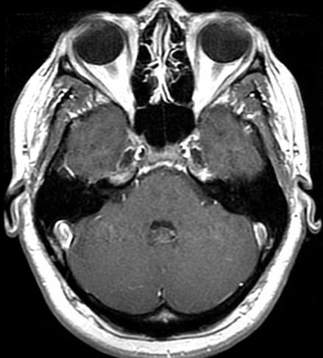

Slide 8
Presentation
70yo man with resting tremor, slowness and stiffness of movements
PMHx Parkinson’s disease, symptoms treated with dopamine replacement, but tremor poorly responsive
Complains dopamine replacement not as effective as before and stops working suddenly

Slide 9
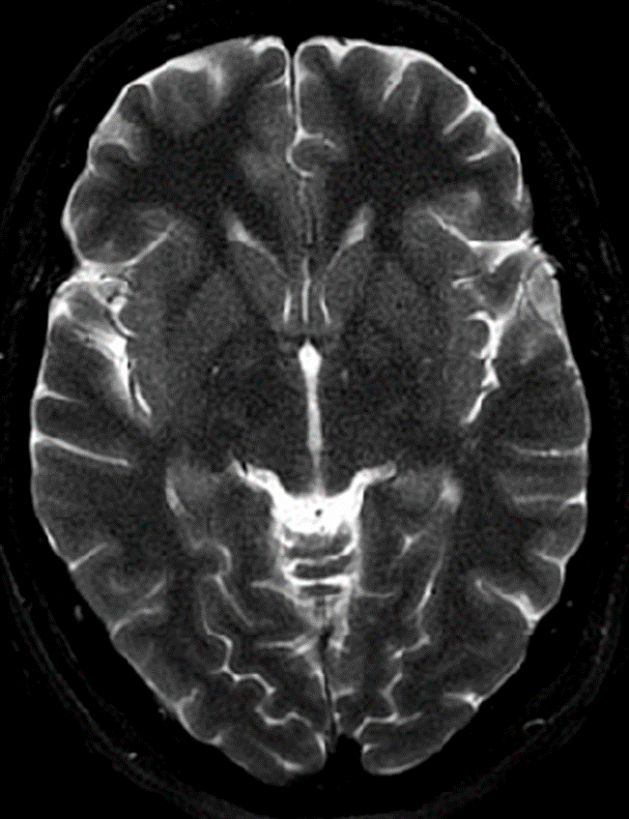
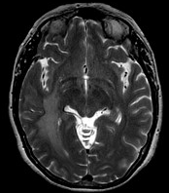

Slide 10
Presentation
47yo man presents to ED after episode of a strange smell followed by inability to speak.
His wife states he was smacking his lips and picking at his shirt, but wouldn’t answer her questions

Slide 11
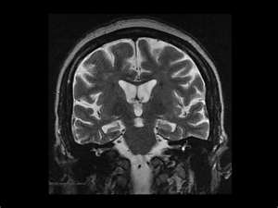

Slide 12
Details to remember

Slide 13
CRPS: Criteria
symptoms
physical signs
At least 1 symptom in at least 3 of 4 categories:
  Sensory: Hyperesthesia or allodynia
  Vasomotor: Temperature asymmetry, skin color changes, skin color asymmetry
  Sudomotor/edema: Edema, sweating changes, or sweating asymmetry
  Motor/trophic: Decreased range of motion, motor dysfunction (eg, weakness, tremor, dystonia), or trophic changes (eg, hair, nail, skin)
At least 1 sign in at least 2 categories:
  Sensory: Evidence of hyperalgesia (to pinprick), allodynia (to light touch, temperature sensation, deep somatic pressure, or joint movement)
  Vasomotor: Evidence of temperature asymmetry (>1°C), skin color changes or asymmetry
  Sudomotor/edema: Evidence of edema, sweating changes, or sweating asymmetry
  Motor/trophic: Evidence of decreased range of motion, motor dysfunction (eg, weakness, tremor, dystonia), or trophic changes (eg, hair, nail, skin)
Signs must be present at some point, but do not all need to be present simultaneously
Signs and symptoms must be regional, not in a dermatome or specific nerve distribution
No other diagnosis can better explains the signs and symptoms

Slide 14
CRPS: Initial treatment
First-line therapy is physical therapy to increase range of motion and desensitize pain
Mirror therapy most effective in early stages
Corticosteroids have long-term benefit in pain relief
Neuropathic pain medications (e.g. tricyclics)

Slide 15
CRPS: Surgical Treatment:
Sympathectomy
Spinal cord stimulation
  Percutaneous stellate ganglion (anterior to C6 transverse process) block: trial before ablative procedure.
  Lumbar sympathectomy for lower extremity
  The primary indication for sympathectomy remains hyperhidrosis (rule out diabetes, hyperthyroidism, menopause, pheochromocytoma)
Decreased pain score and increased QOL maintained at 2 years
Probably better outcome with shorter disease duration & increased pre-operative functional status
Can resolve sudomotor changes

Slide 16
Risks of spinal cord stimulation
Bleeding: can cause epidural hematoma requiring laminectomy & evacuation
Cord compression with paddle electrode: get thoracic MRI pre-op (? Stenosis)
Infection: most often at IPG site, usually ~5%, can be low virulence, biofilm
CSF leak
Device failure
Requires pre-implant trial and neuropsychology evaluation

Slide 17
TN: Initial Treatment
MRI brain to rule out multiple sclerosis or mass lesion (15%)
Carbamazepine (Tegretol; 200 to 1,200 mg per day) is effective for controlling pain in patients with classic trigeminal neuralgia. (Level A recommendation)
Oxcarbazepine (Trileptal; 600 to 1,800 mg per day) is probably effective for treating pain in patients with classic trigeminal neuralgia. (Level B recommendation)
Gabapentin, pregabalin, lamotrigine, Dilantin, clonazepam, and baclofen have also been used, insufficient data
IV phenytoin (250mg bolus) has been used to abort an acute attack

Slide 18
TN: Neurosurgical treatment
Open
Microvasular decompression
Lowest long-term recurrence rate
Percutaneous
Radiofrequency rhizotomy: Highest branch selectivity, highest risk of anesthesia dolorosa
Non-invasive
Gamma Knife: Longer latency to pain relief
~20% develop new facial numbness or tingling
Glycerol rhizotomy: Requires patient sitting upright
Balloon compression: Lowest risk to corneal reflex
0.5% chance of anesthesia dolorosa

Slide 19
Microvascular decompression
Suboccipital cranectomy just medial and inferior to asterion
Extend opening to transverse-sigmoid junction and open dura
Follow tentorial-petrous junction to brainstem and nerve
Dissect any vessels free, place Teflon sponge, can be vein instead of artery
If no vessels found, still pad nerve, may “comb” nerve to damage C-fibers
Risks:
  Bleeding, particularly from petrosal vein, better to coagulate and divide vein; bailout of tearing vein – oxycel and bone wax pledget to pack bony opening
  Hearing loss: monitor ABRs, pause and release retraction if they decrease
  “ear fullness”: prevent by waxing mastoid air cells
  Opening supra-tentorially rather than pfossa – prevent by starting craniotomy lateral and inferior to asterion
Approach also used to treat AICA compression of CN VII for hemifacial spasm

Slide 20
Percutaneous treatment of TN
  All three techniques:
    Utilize the same approach through the cheek to the foramen ovale
    Cannulation of foramen typically met with masseter and pterygoid contraction
    Can cause hypotension and bradycardia (trigeminal depressor response)
    Provide >90% initial pain relief; decreased long-term relieve vs. MVD
  Balloon compression:
    Generally performed under general anesthesia
    Requires inflation of balloon into pear shape across the foramen
    Has highest rate of trigeminal depressor response
    Relatively spares small fibers that carry corneal relex

Slide 21
Percutaneous treatment of TN
  Glycerol Rhizotomy
    Patient head is elevated to sitting and contrast injected to confirm location
    Patient to remain sitting upright after the procedure
  Radiofrequency Rhizotomy:
    Requires awake cooperative patient
    Greatest nerve root selectivity
    Longer durability correlated with higher degree of post-procedure numbness

Slide 22
Parkinson’s Disease: Medical treatment
L-dopa is mainstay
Patients develop motor fluctuation, unpredictable on-off, on dyskinesias, off dystonia

Slide 23
Parkinson’s Disease: Surgical treatment
>5 yr history of PD (to exclude PSP, CBD, other degenerative causes)
At least 30% response to levodopa
No or minimal non L-Dopa responsive axial symptoms (bradykinesia, rigidity), or is tremor dominant
Motor fluctuations
No or minimal cognitive issues, no major psychiatric illness
With the exception of tremor, DBS in PD (Gpi or STN) does not typically improve non L-Dopa responsive symptoms such as ON freezing of gait, postural instability, dysarthria, dysphagia, cognitive decline, sialorrhea.

Slide 24
Parkinson’s Disease: Surgical treatment
Deep Brain stimulation
  Reversible
  Allow bilateral treatment (bilateral lesions side effects too high)
  Do not slow progression of disease
  STN and GPI equivalent for motor symptoms
Pallidotomy: for unilateral predominant PD
Thalamotomy: for unilateral ET or tremor in PD
Gamma Knife thalamotomy: unilateral ET, no physiologic control, delayed imiprovement

Slide 25
Essential Tremor: Treatment
Propranolol and Primidone first line
Tends to improve with alcohol
50% have family history, can also have head or voice tremor
Rule out other causes of tremor

Slide 26
Stimulation-induced effects: STN
(Leg Medial within STN) Coord: 12 lat, 3 post, 4 inferior
Effect | Structure | Location
Paresthesias | Medial lemniscus | Posterior
Dysarthria | Internal capsule | Lateral
Tonic contractions | Internal capsule | Lateral
Diploplia / blurred vision | CN III | Anteriomedial
Dyskinesias |  | Just right?
No effect at high amplitude |  | Superior / anterior

Slide 27
Stimulation-induced Effects: ViM
(Leg lateral within ViM) 12 lateral (10 from 3rd V), 6 ant to PC, at AC-PC plane
Effect | Structure | Location
Paresthesias | Ventral caudal thalamus | Posterior
Dysarthria (motor) | Internal capsule | Lateral
Dysarthria (sensory) | Ventral caudal thalamus | Posteriomedial
Tonic contractions | Internal capsule | Lateral
No effect at high amplitude |  | Superior / anterior

Slide 28
Stimulation-induced Effects: Gpi
(Leg dorsal-medial within Gpi) Coord 21 lat, 3 ant, 4 inferior
Effect | Structure | Location
Dysarthria | Internal capsule | Posteromedial
Tonic contractions | Internal capsule | Posteromedial
Visual changes | CN II | Deep
No effect at high amplitude |  | Superior / anterior / lateral

Slide 29
Epilepsy
Ask if first seizure, history of head trauma, febrile seizure, metabolic problems, drug/medication use, cancer, family history seizures
Check electrolytes, rule out bleed
Refractory if fails 2 meds plus one combo of meds
Pre-op:
  EMU (EEG and semiology should match MRI findings; up to 20% have PNES)
  neuropsychologic eval (dysfunction should match location)
  usually at least one additional confirmatory test (PET hypometabolism, ictal SPECT increased uptake, MEG dipole)
Anterior temporal lobectomy (3.5cm L, 5 R) & amygdalohippocampectomy: equivalent outcomes to selective AH in experienced hands
Risks: expect superior subquadranopsia; verbal or visual memory impairment, speech deficit if dominant hemisphere, 3rd or 4th CN palsy, stroke from anterior perforators damaged in hippocampal sulcus
If tumor or cavernoma related, consider perilesional tissue may be active

Slide 30
Cancer pain
> 3 months survival: pain pump or SCS may be implanted
< 3 months survival (or poor implant candidate)
  Cordotomy for pain in one limb or unilateral; C1-2 anterior to dentate ligament
    Risks: ipsilateral weakness if lesioned posterior to dendate, urinary incontinence, ondine’s curse (avoid bilateral lesion)
    Can be done open in thoracic spine for LE pain
  Midline myelotomy for bilateral lower extremity pain; open to central canal T10-above conus
    Risks: bladder dysfunction
  Cingulotomy: diffuse pain (rarely used)

Slide 31
Other pain treatments
DREZ: for brachial plexus avulsion
  Lamintotomy, dural opening, identify normal dorsal roots above and below avulsion
  Electrode inserted 2mm deep at 45° angle, 75° for 15 sec, repeat every 1mm
  Can be used for post-amputation phantom pain
  Risks: EDH, CSF leak, ipsilateral weakness

Slide 32
Spasticity
Distinguish from contractures
Maximize baclofen oral therapy first
For patients with insufficient control w baclofen or dose limited by Ses
Get CT myelo to rule out block
Administer intrathecal test dose (50mcg/cc and wait 8-12 hours and re-eval)
T9-12 catheter for LE spasticity
T3-5 catheter for UE spasticity
Warn of baclofen OD or WD symptoms.

