Slide 1
65 yo diabetic man with progressive gait instability over 12 months
Medications: HCTZ and insulin
Examination: Sensory intact
Bilateral iliopsoas 4+/5
Reflexes 4+ throughout

Slide 3
60 yo female with 3 months of headache and unsteadiness
PMH: unremarkable
Medications: none
Examination: Normal except for moderately abnormal tandem gait

Slide 5
60 yo with sudden headache two months prior now resolving
and weakness in left upper extremity
Examination: Speech normal
4/5 left upper extremity

Slide 6
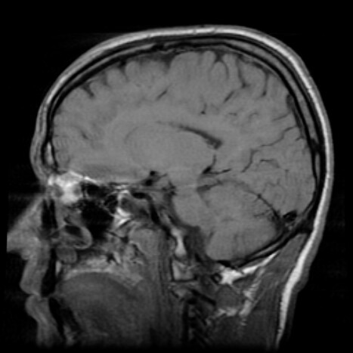
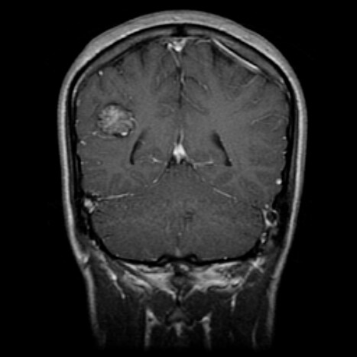
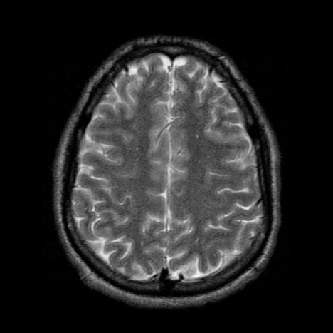
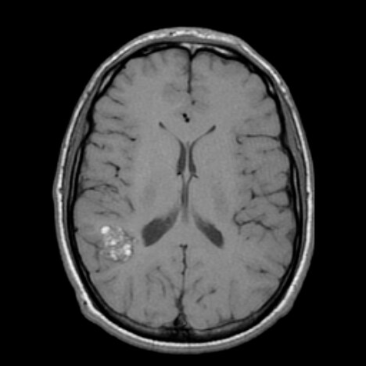
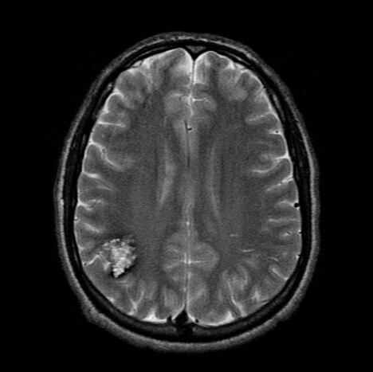
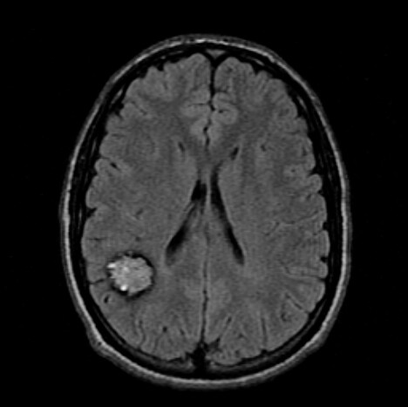

Slide 7
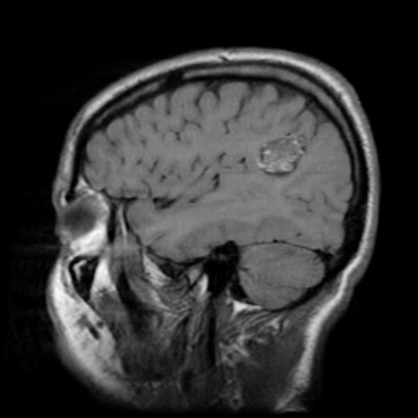
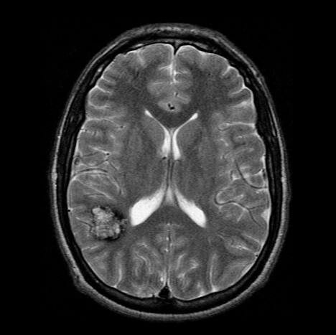

Slide 9
10 yo boy with neck pain and progressive gait instability
over the last 6 months
PMH: Unremarkable
Examination: Sensory and motor normal
Moderate bilateral spasticity in LE

Slide 11
19 yo male with blurry vision and headache for two months
Examination: Parinaud’s syndrome

Slide 14
60 yo male with hypertension and acute visual loss 24 hours prior to admission with symptom resolution over two hours
PMH: HTN, diabetes, smoker
Examination: BP 170/90, P 75 regular
neurologically normal

Slide 15
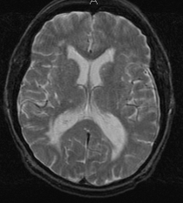

Slide 16
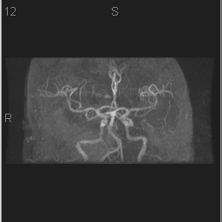

Slide 17
40 yo man with hearing loss
Examination: AD 30 dB loss, 70% speech discrimination
Decreased V3 sensation right
Otherwise normal neurlogically

Slide 19
46 yo asymptomatic male S/P MVA with an incidental MRI finding
Examination: Normal

Slide 20
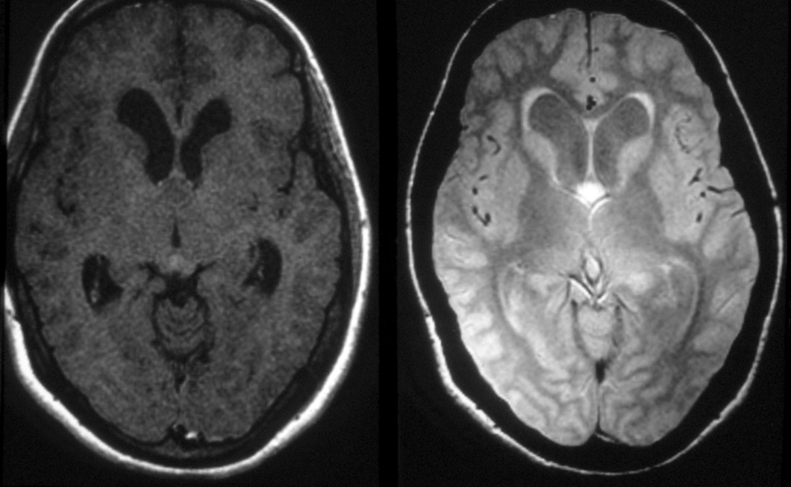

Slide 21
60 yo female with left lower extremity weakness for 2 weeks
PMH: Chronic sinusitis
Examination: Alert, oriented
Left lower extremity 4/5
Left upper and lower extremity hyperreflexia

Slide 24
27 yo woman with headache for two months
PMH: Mild hypertension
Medications: HCTZ and Tylenol PRN
Examination: Neurologically normal

Slide 25
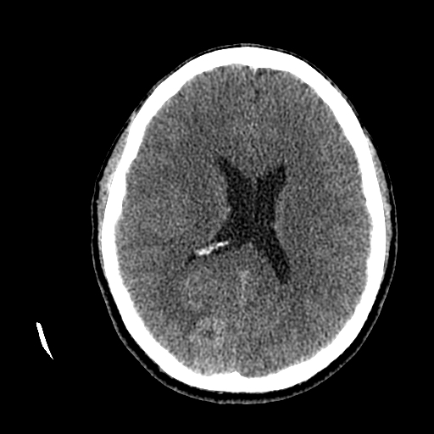

Slide 26
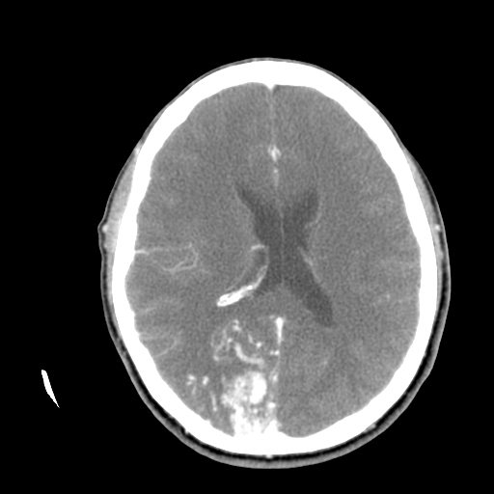

Slide 27
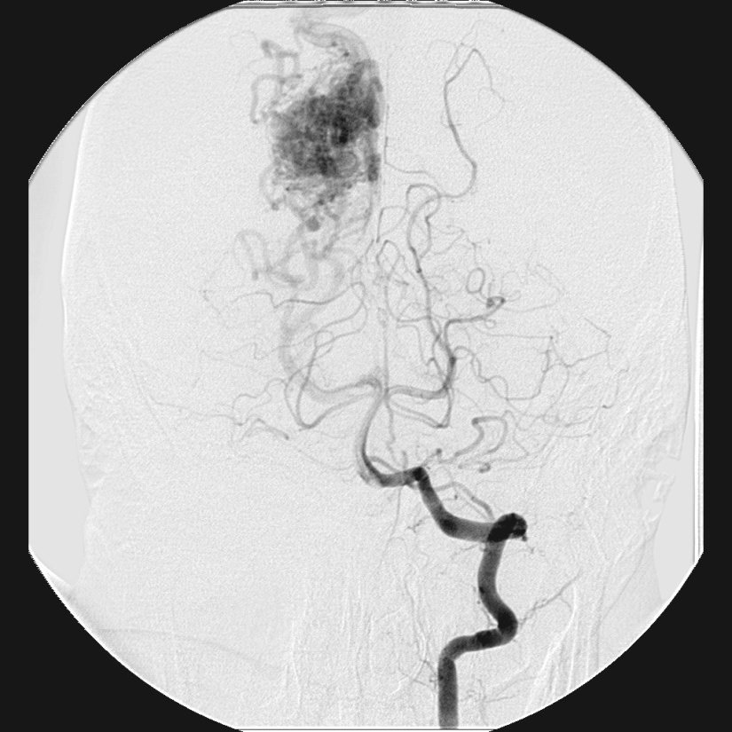
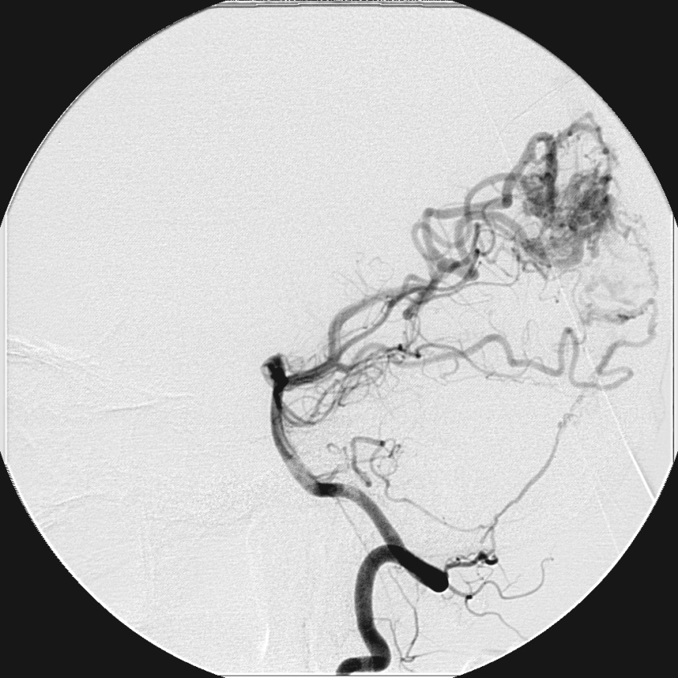
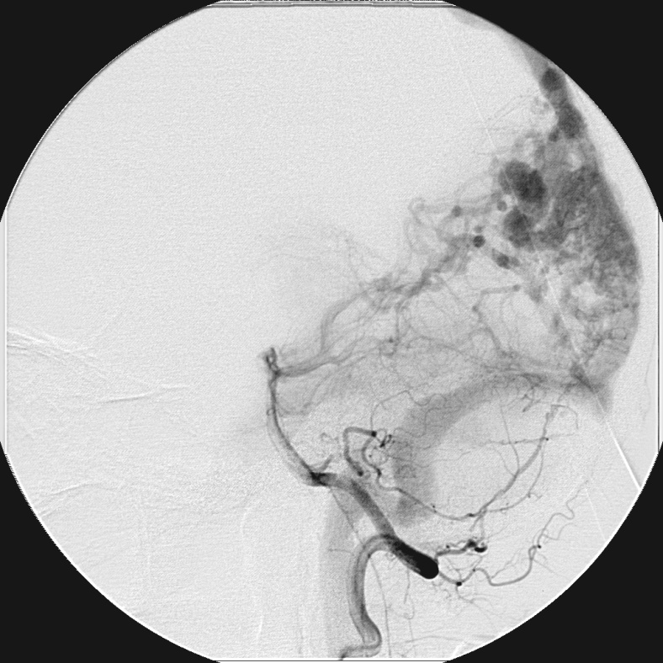

Slide 28
40 yo female with a 3 week history of bilateral paresthesiae
in upper extremities which came on over 24 hours
Examination: Normal except for 4+/5 weakness right iliopsoas
and hypalgesia in the left leg

Slide 29
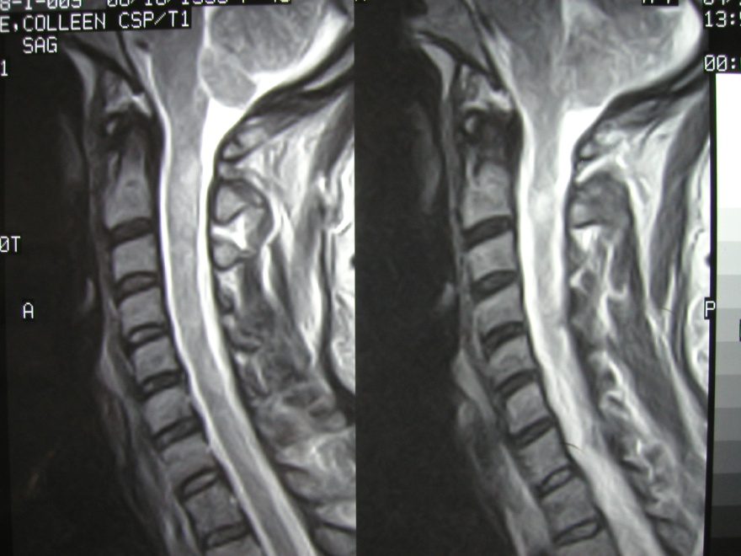
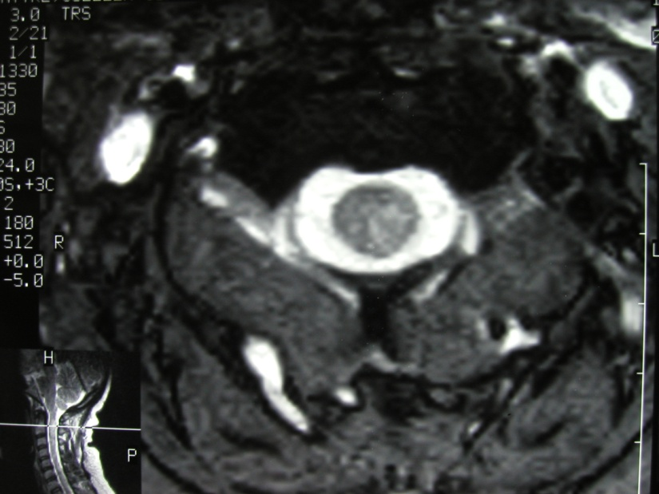

Slide 30
24 yo female with double vision for 4 weeks
PMH: Diabetes
Examination: Right abducens paresis

Slide 31
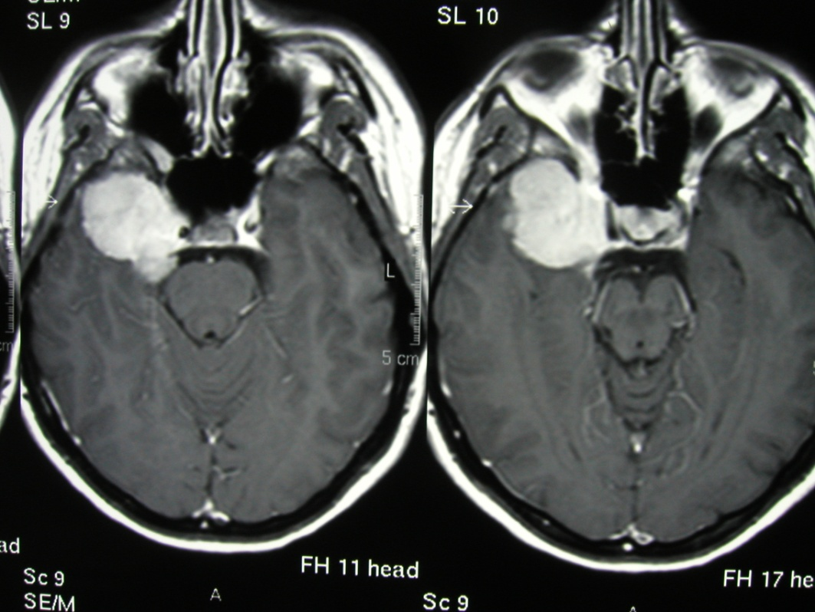
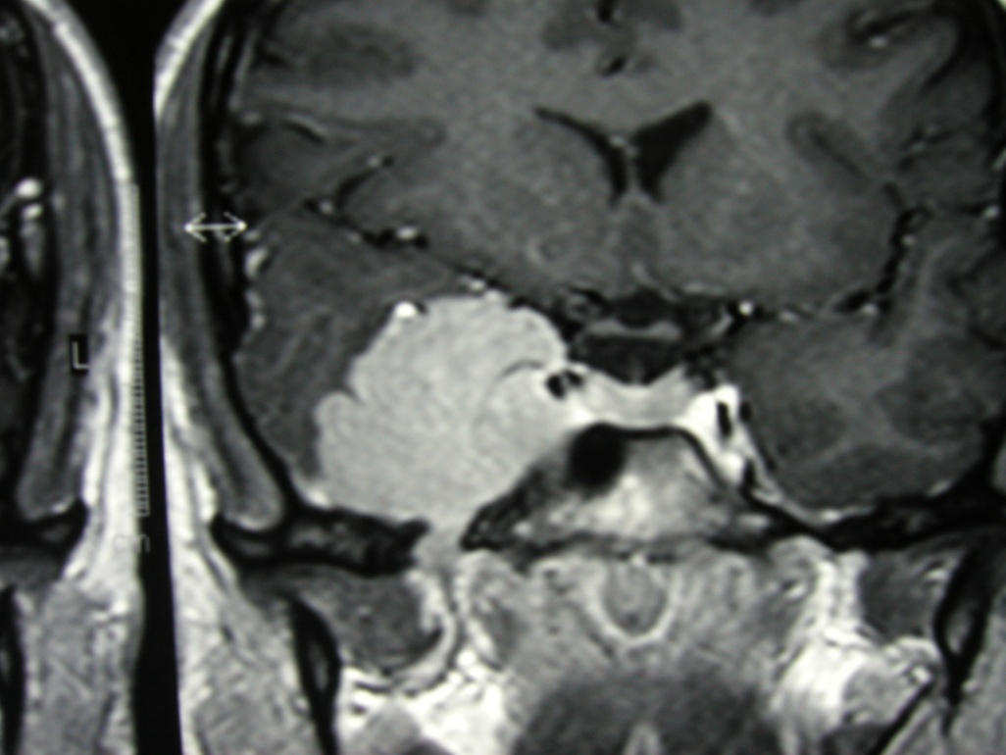

Slide 33
32 yo female with progressive visual loss and amenorrhea
Labs: TSH, FT4 and FSH low
Examination: 20/80 OD, 20200 OS
Asymmetric field loss worse on OS

