Slide 1
40 yo female with sudden headache and imbalance
Examination; left cerebellar signs

Slide 2
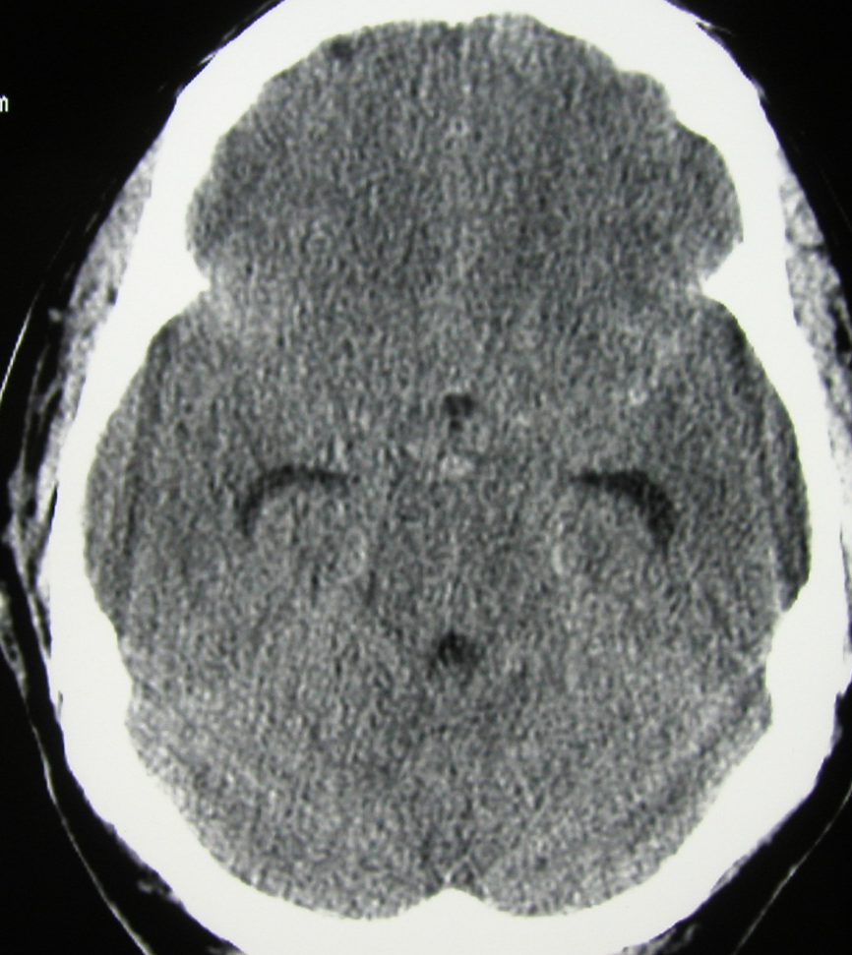
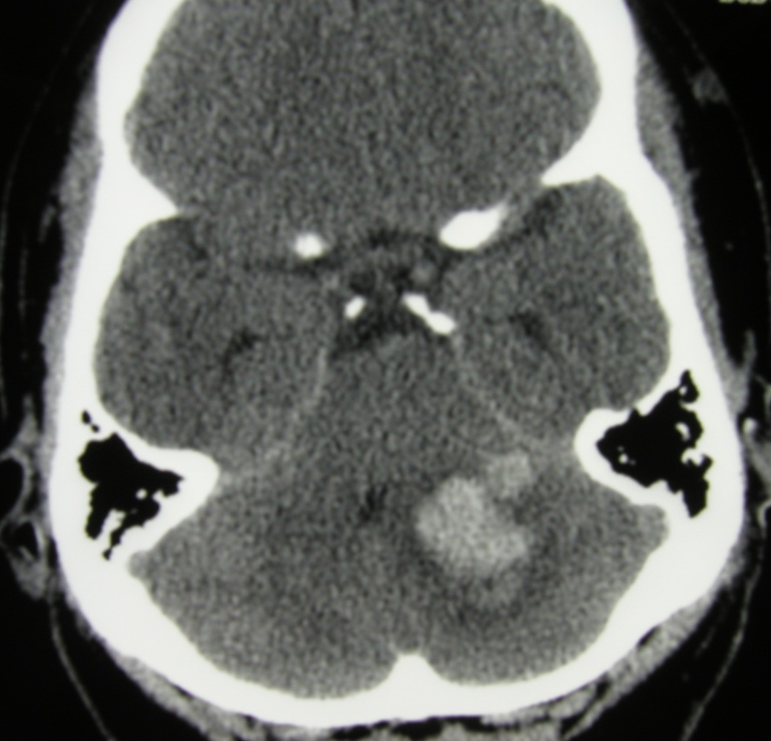
40 yo female with sudden headache and imbalance

Slide 3
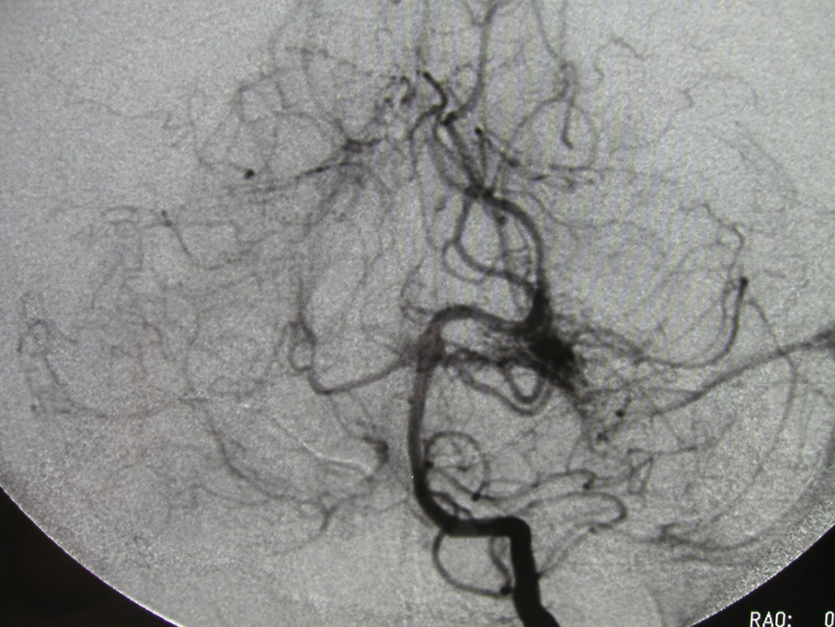
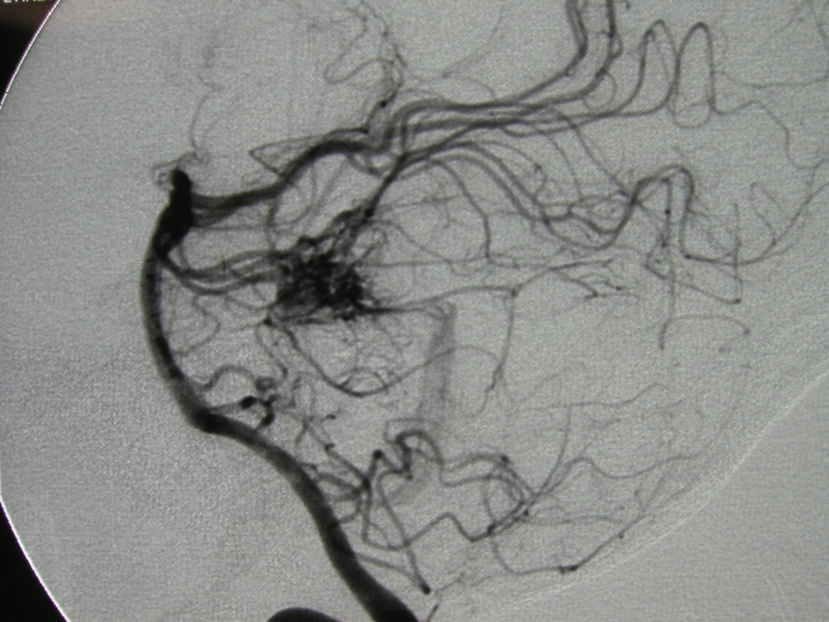
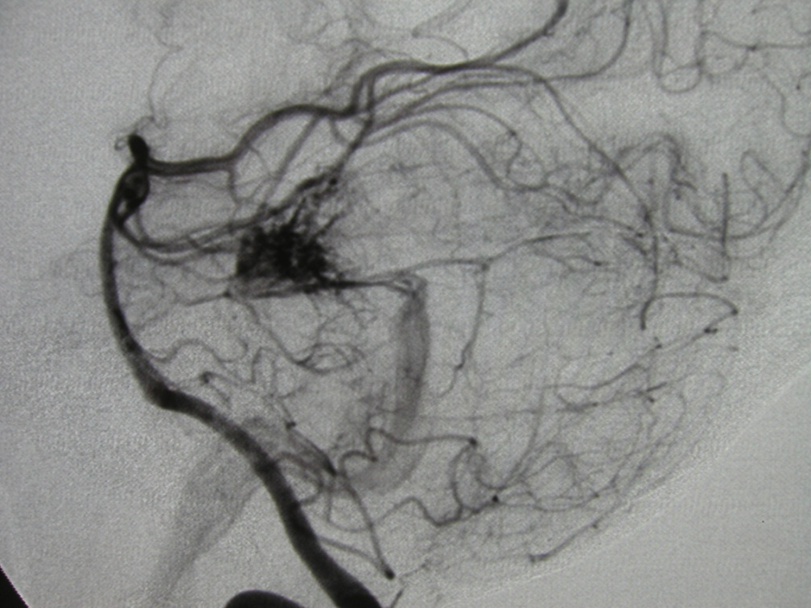

Slide 4
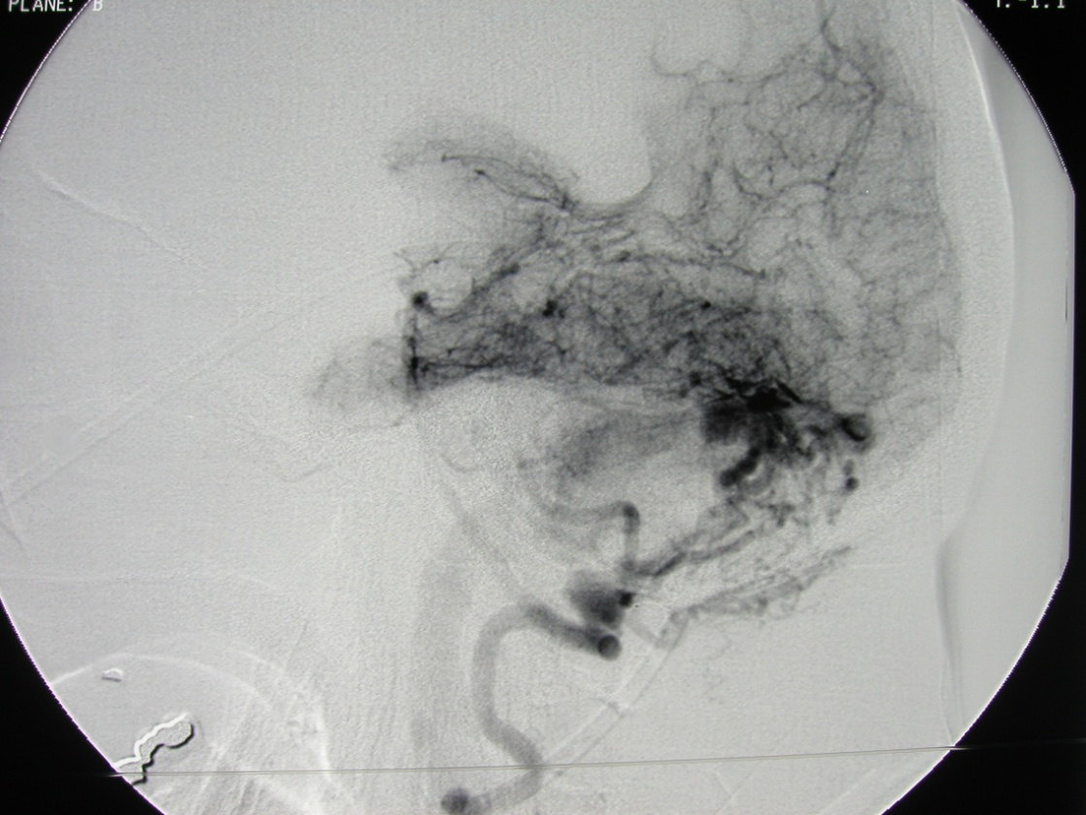
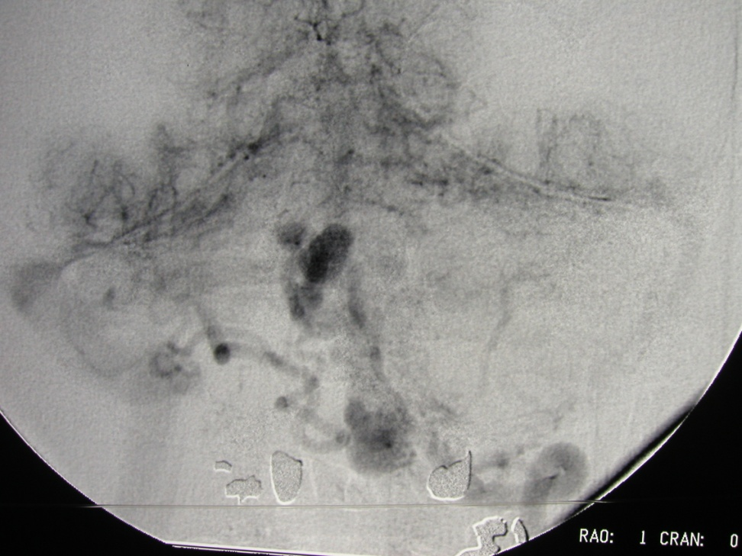

Slide 5
30 yo male with severe left leg pain for 10 days
Examination- neurologically normal
4/5 foot weakness

Slide 6
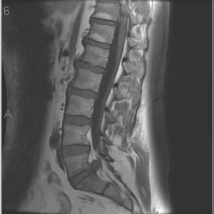
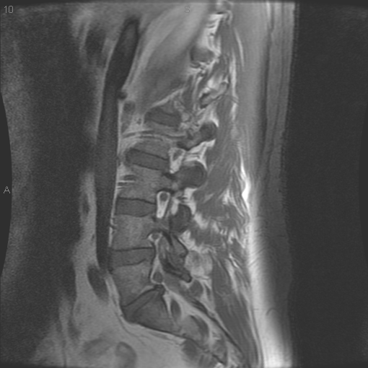
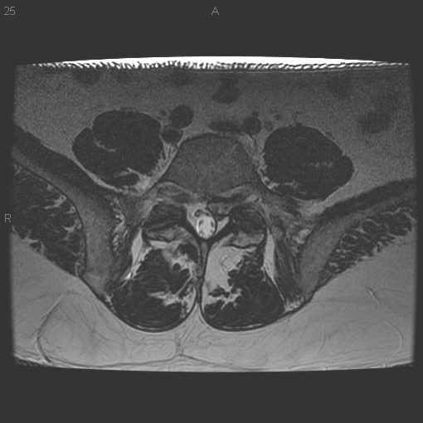
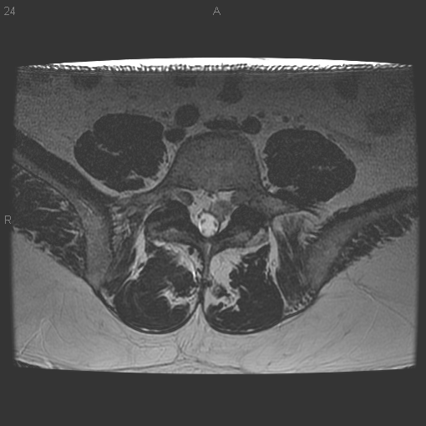

Slide 7
57-year-old with severe left C6 radiculopathy

Slide 8
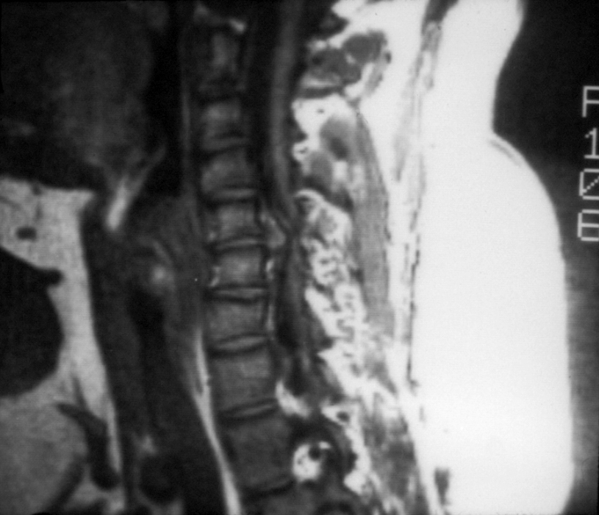
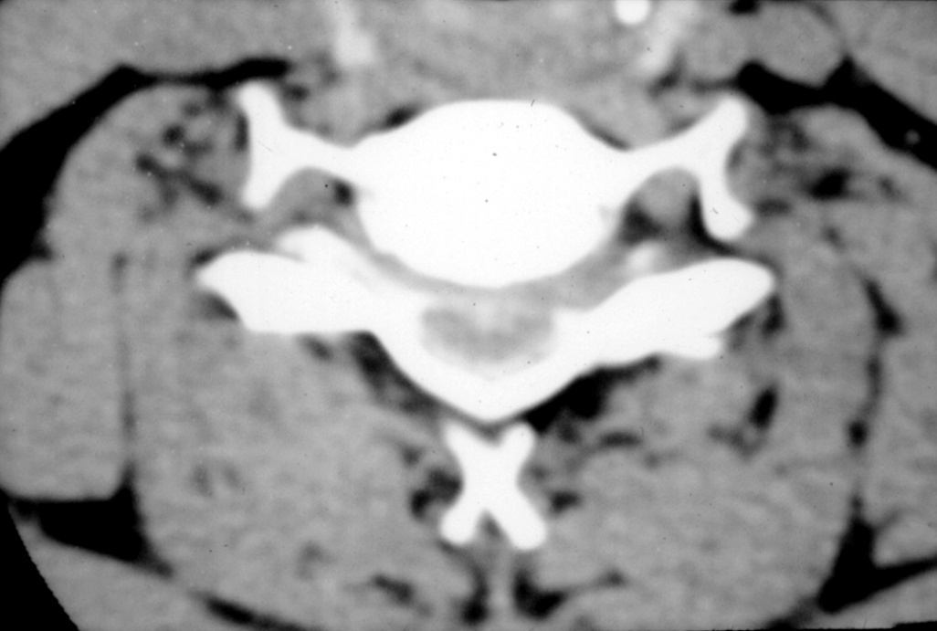
57-year-old with severe left C6 radiculopathy

Slide 9
45-year-old man 1 year after liver transplant with left sided hemiparesis over 1 week

Slide 10
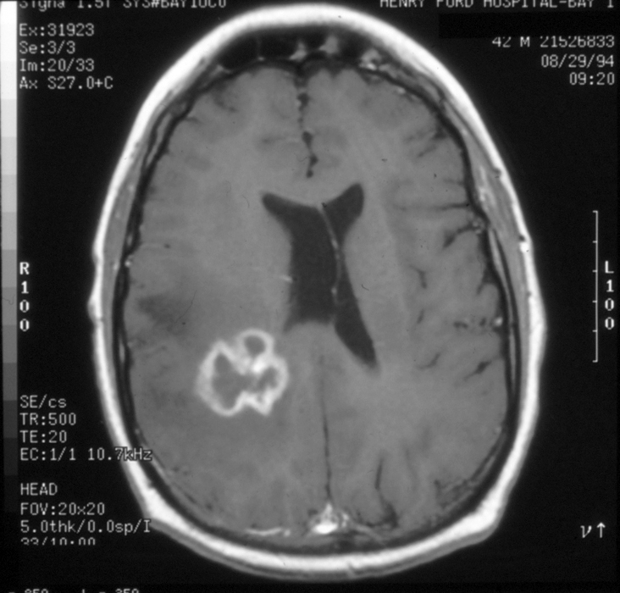
45-year-old man 1 year after liver transplant with left sided hemiparesis over 1 week

Slide 11
35 yo male with headache and blurred vision
Examination – acuity normal OD
bilateral poor accomodation
diminished upgaze
inability to converge

Slide 13
65 yo with renal cancer
Examination - normal

Slide 15
18-year-old with insect bites 10 days PTA, hemoptysis and fever 7 days PTA, lethargy and visual loss 2 days PTA

Slide 16
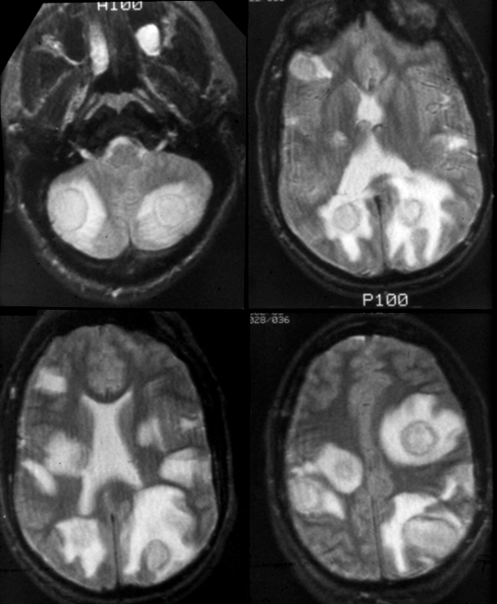
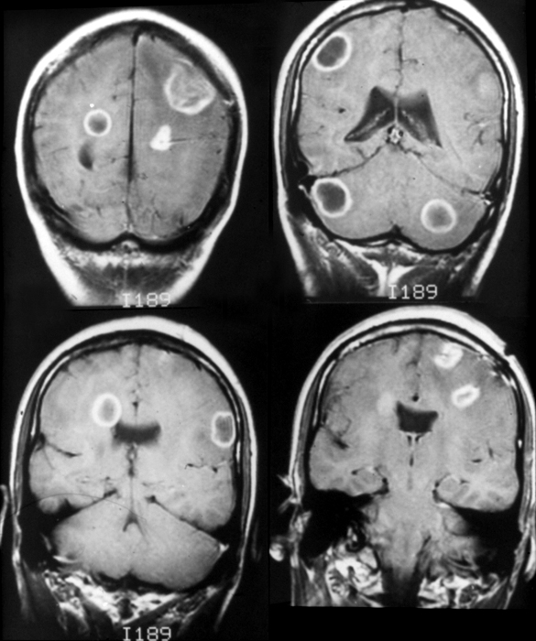
18-year-old with insect bites 10 days PTA, hemoptysis and fever 7 days PTA, lethargy and visual loss 2 days PTA

Slide 17
43-year-old painter from New Orleans with right hand weakness over 2 weeks

Slide 18
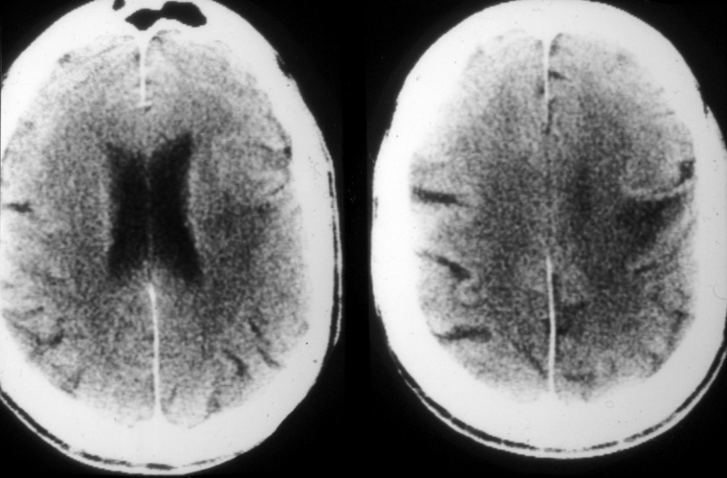
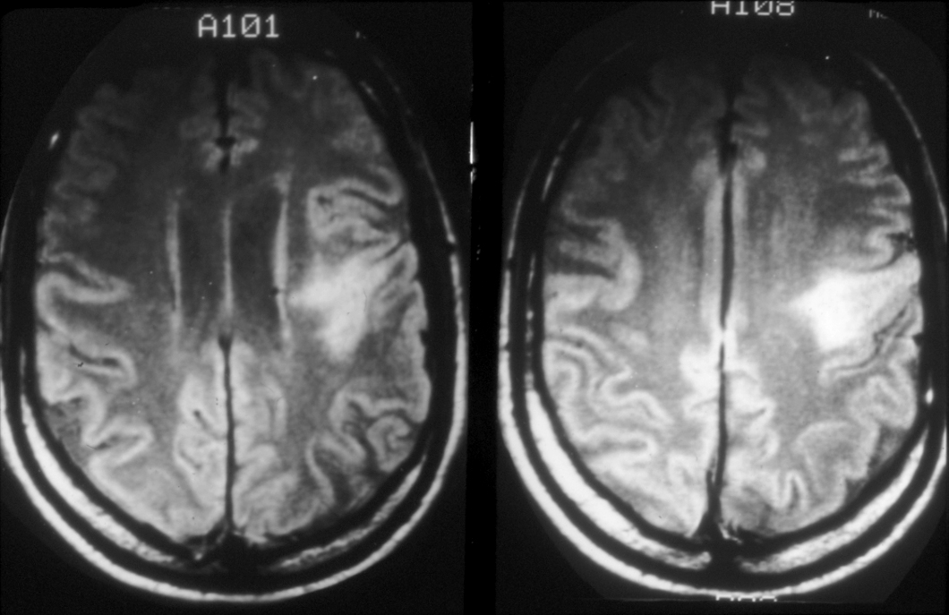
43-year-old painter from New Orleans with right hand weakness over 2 weeks

Slide 19
30 yo male with sudden headache

Slide 20
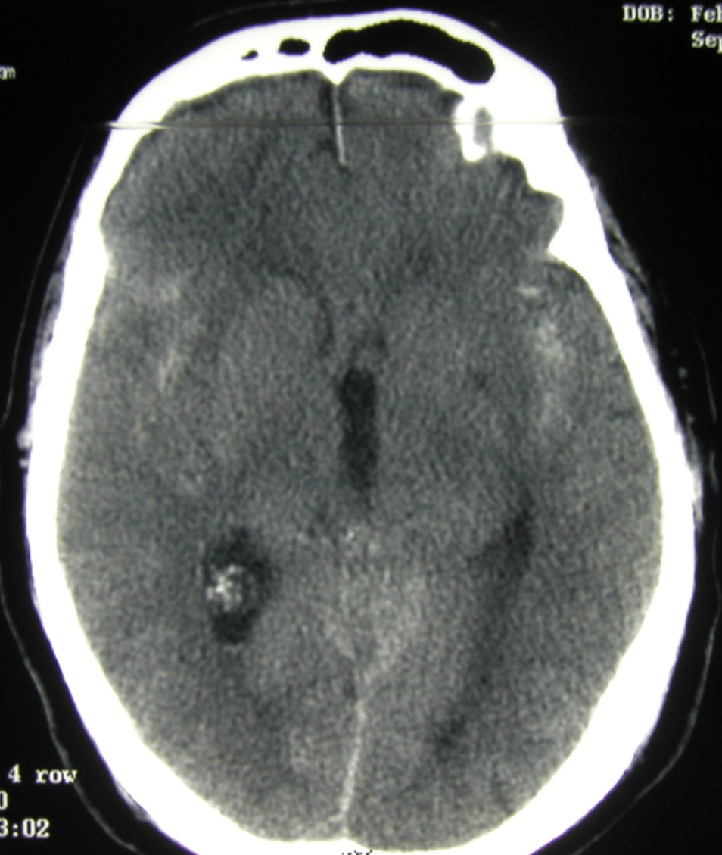
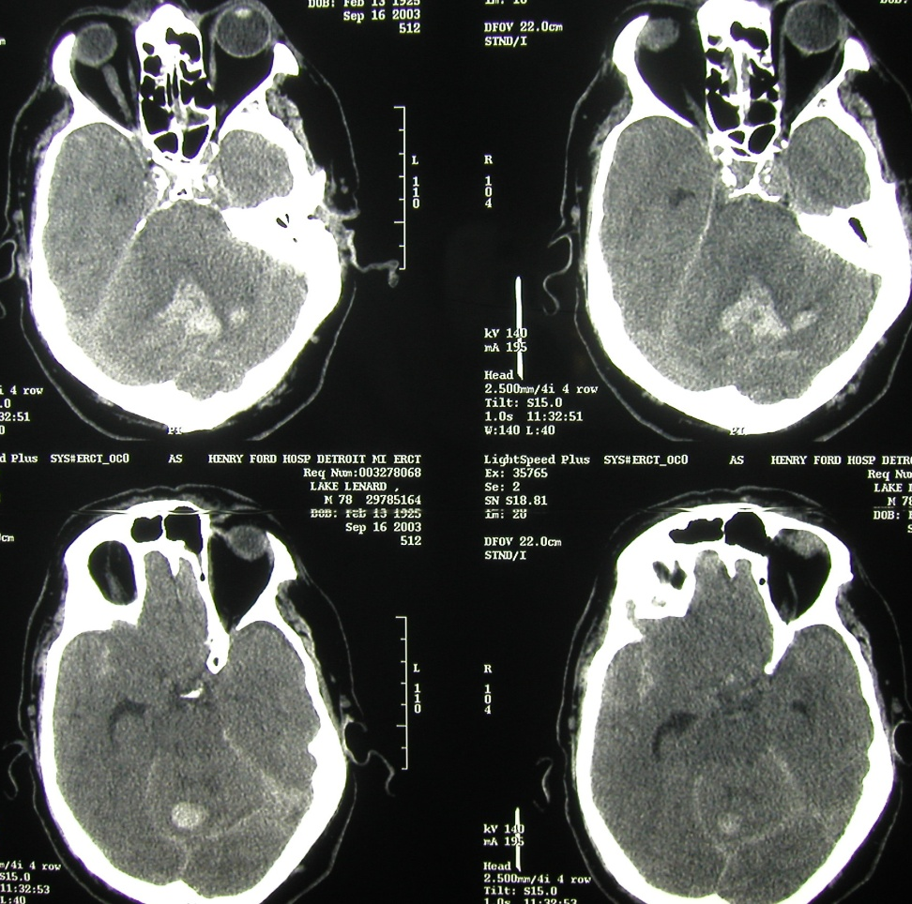
30 yo male with sudden headache

Slide 21
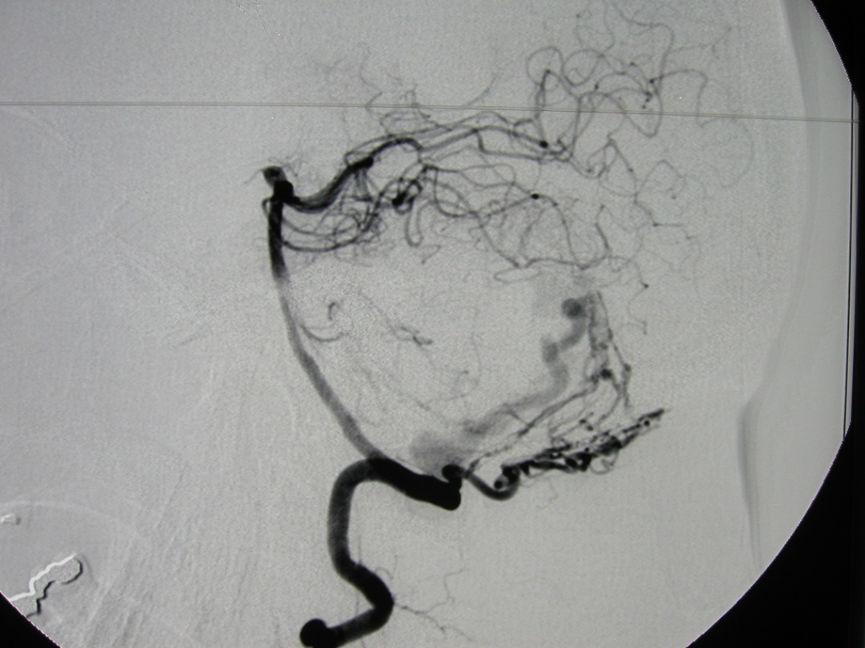
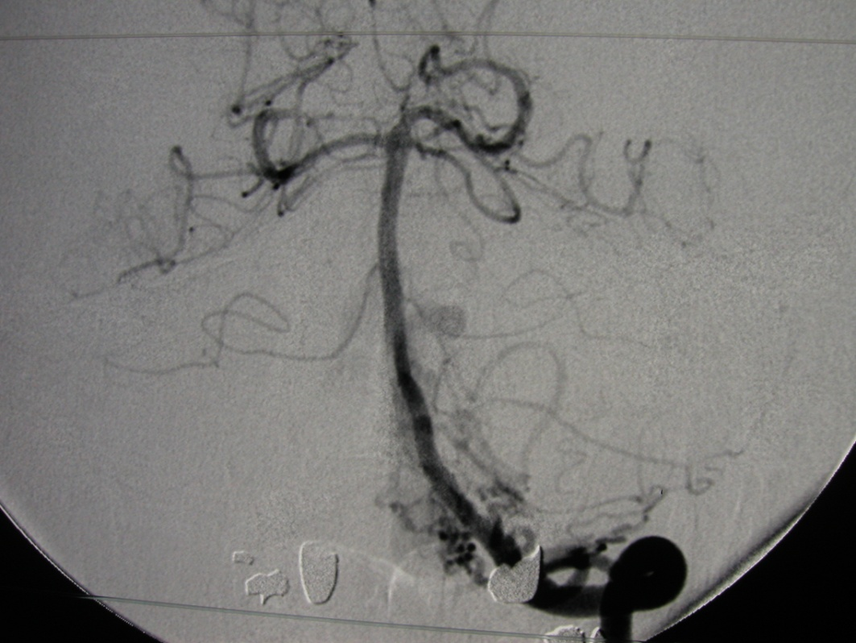
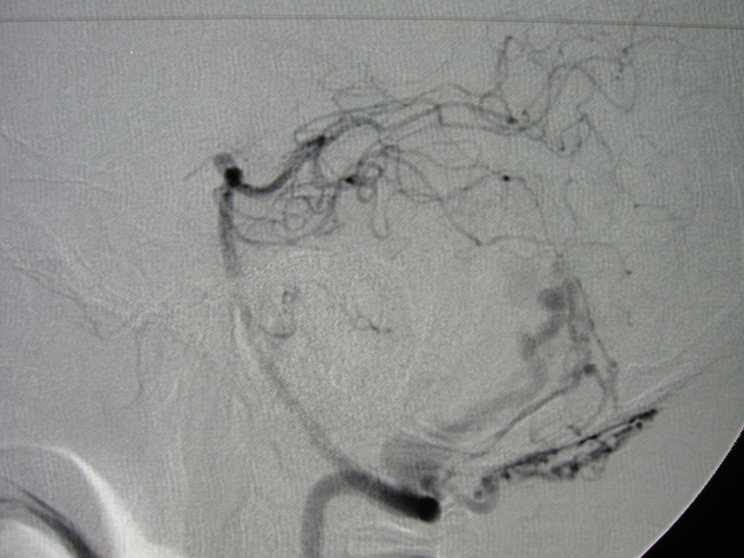
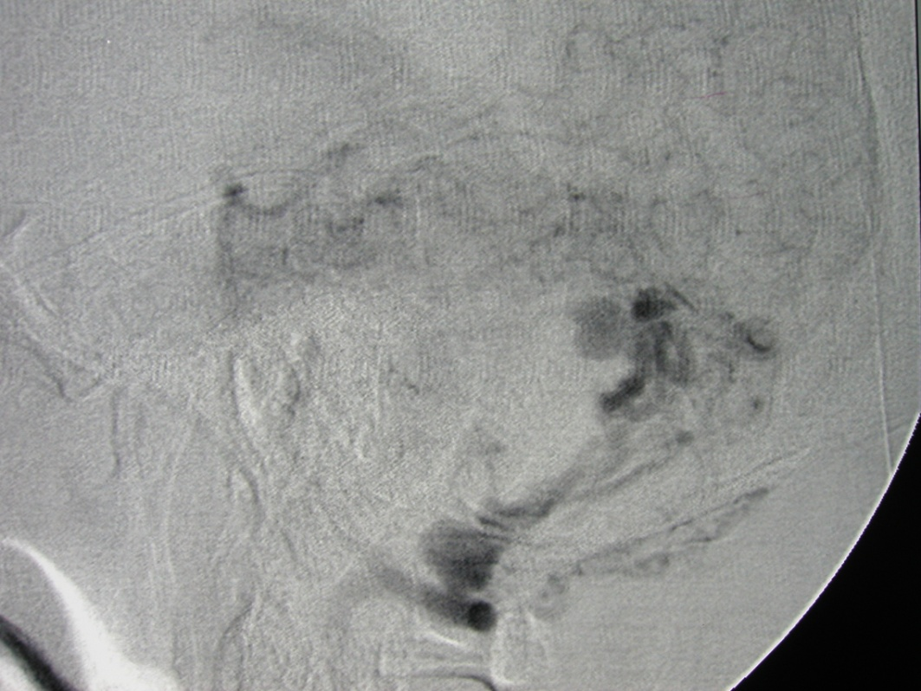

Slide 22
70 yo S/P cervical laminectomy for myelopathy 1 year ago, now has progressive myelopathy

Slide 23
70 yo S/P cervical laminectomy for myelopathy 1 year ago, now has progressive myelopathy

Slide 24
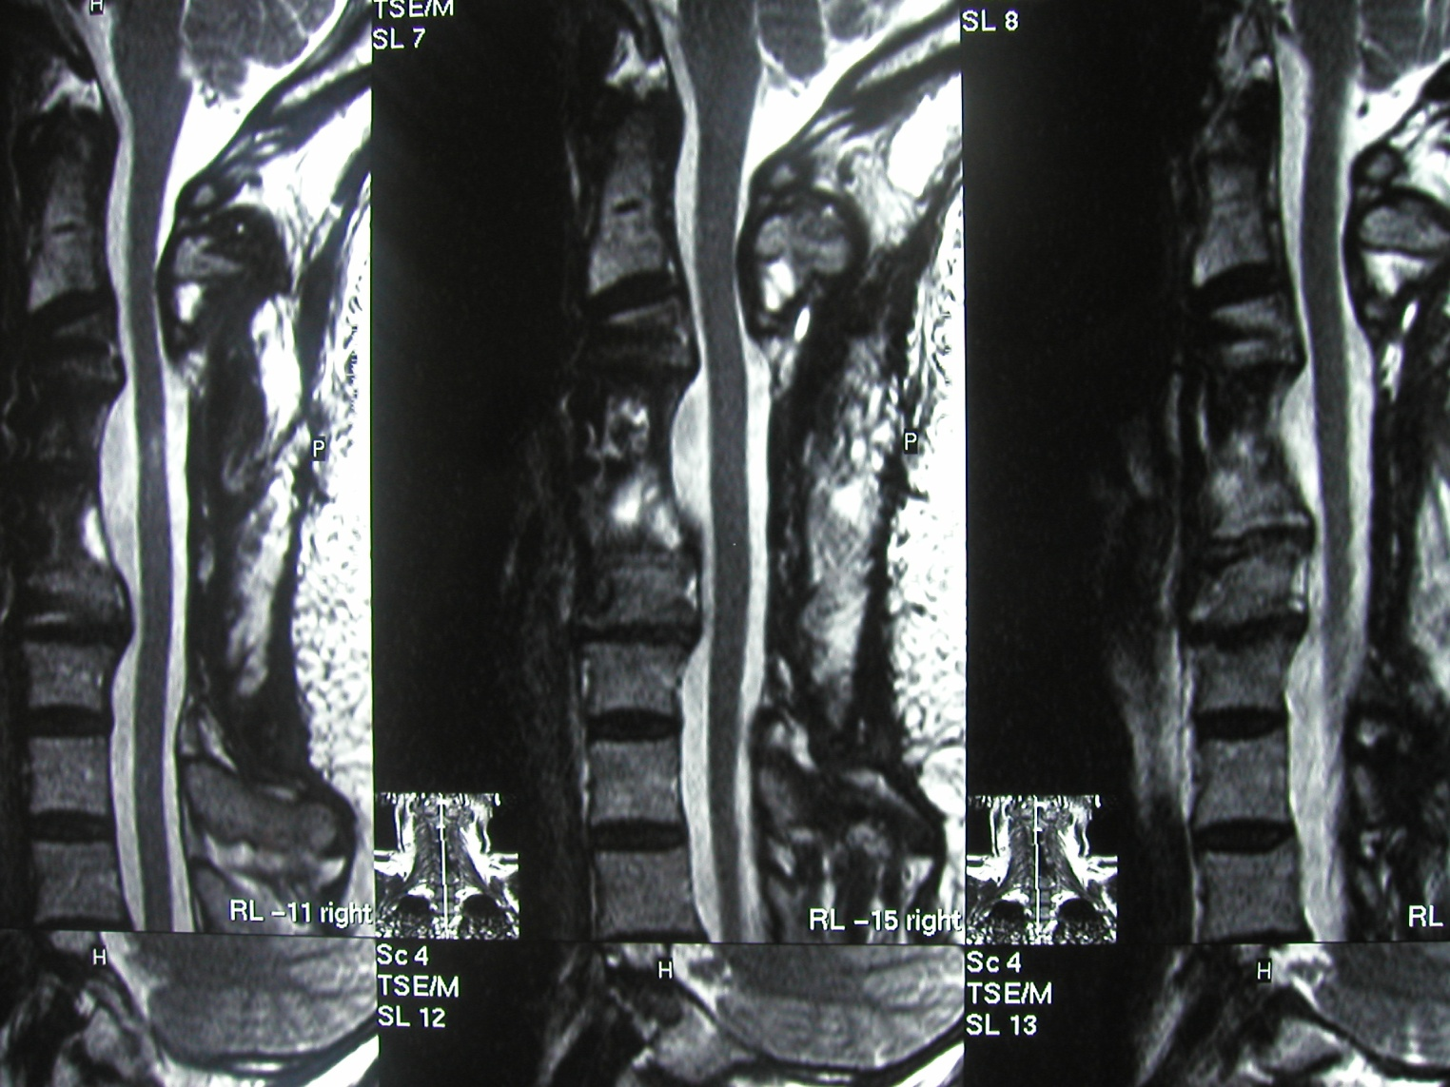

Slide 25
58 yo male with headache and acute visual loss
Examination; bilateral 20/400

Slide 26
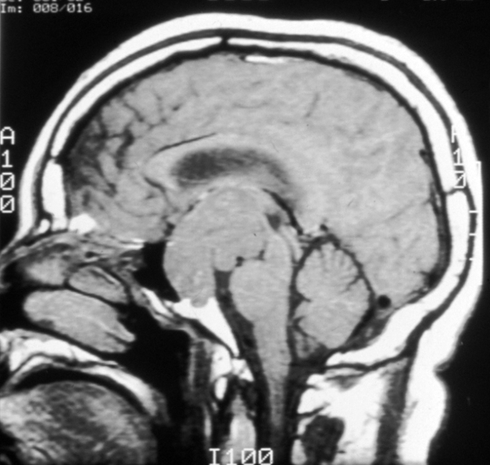
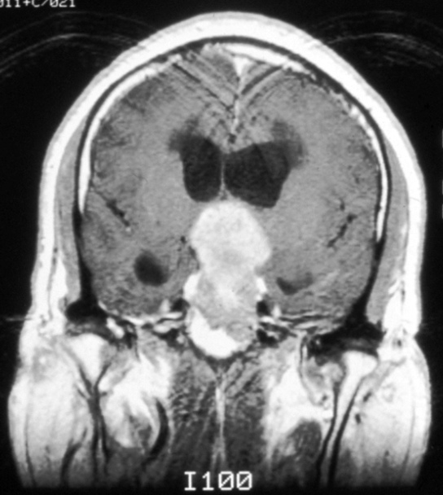
58-year-old man with headaches, sluggishness and acute visual loss

