Slide 1
30 yo male with low back pain and acute footdrop
after being tackled during a football game

Slide 2
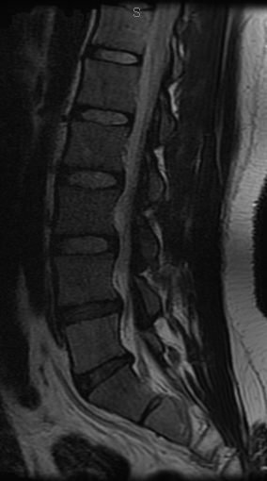
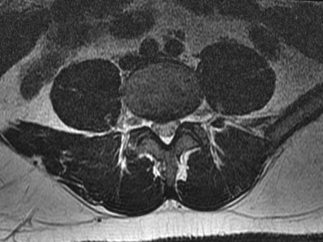

Slide 3
72 yo man with gait difficulty for 6 months and
memory difficulty for 2 months
Examination: some difficulty with short term memory
wide based gait

Slide 4
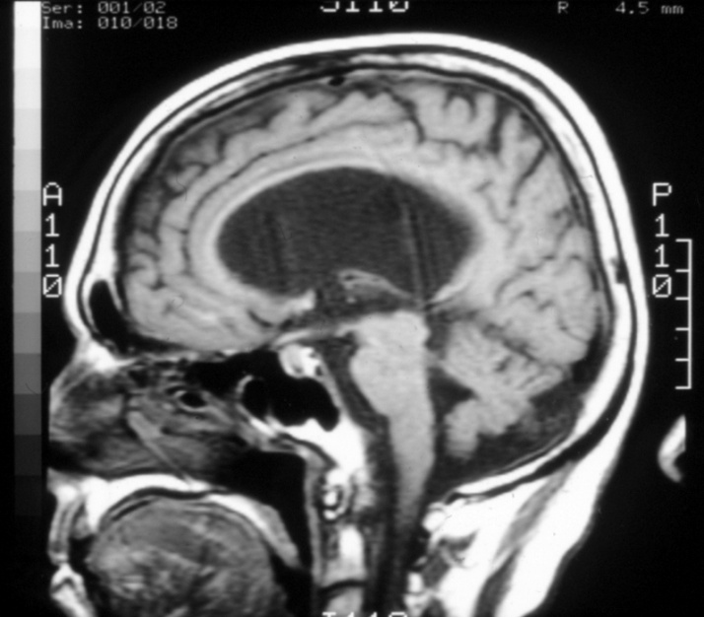
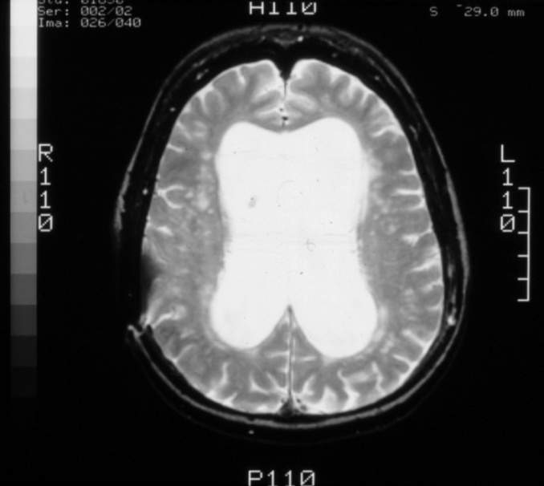

Slide 5
56 year-old with year long memory loss that has worsened over last 3-4 months who complains of gait instability, falls, and urinary incontinence
PMH: Denies trauma to head, LOC, HA, N/V, N/T or seizure, but family states that patient intermittently has difficulty with speech

Slide 6
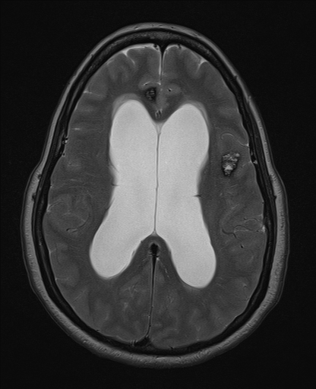
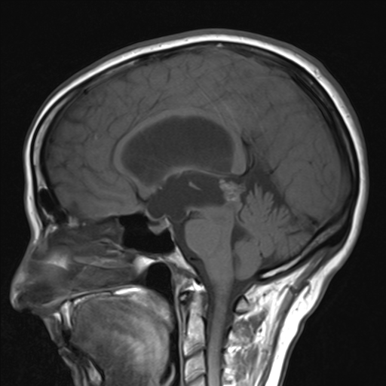
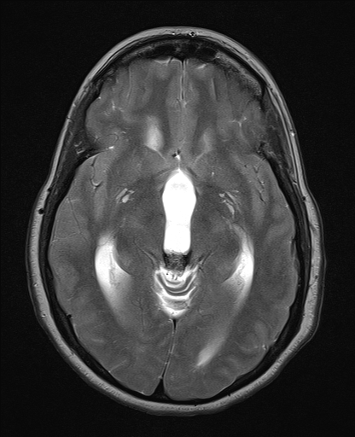

Slide 7
18 yo chinese engineering graduate student with imbalance
Examination; minimal difficulty with tandem gait

Slide 9
65 yo with one week history of speech dificulty

Slide 10
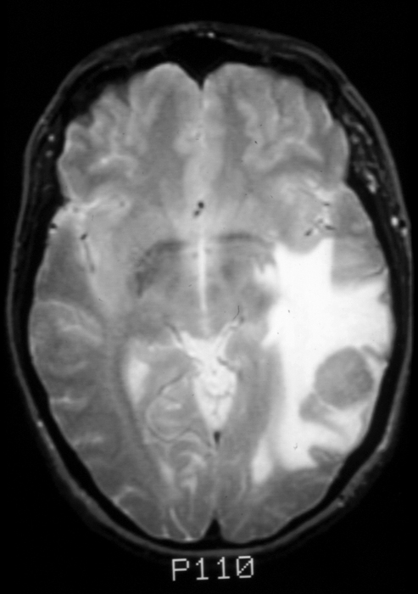
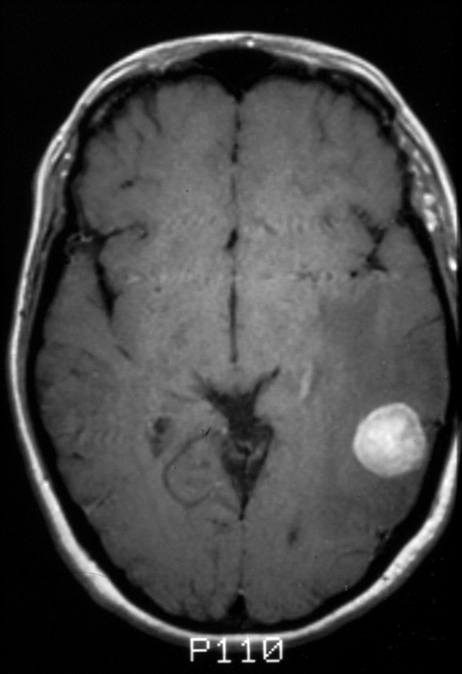
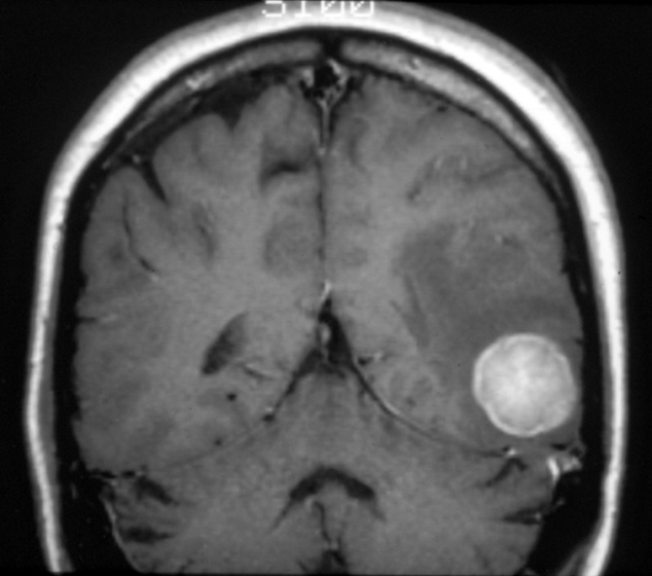
65 yo with one week history of speech dificulty

Slide 11
25 yo man with headaches for two years
Examination; normal

Slide 13
42 yo female with partial wristdrop

Slide 14
65 yo S/P MVA with neck pain and normal examination
Examination: 4/5 bilateral iliopsoas

Slide 16
30 yo female S/P MVA with acute C6 quardiparesis
and GCS 11

Slide 17
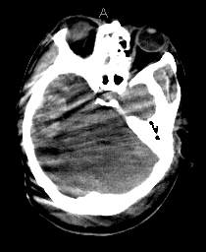
30 yo female S/P MVA with acute C6 quadriparesis
and GCS 11. Post MVA day #3, decreased mental status
and dilated right pupil.

Slide 18
45 yo male with chronic low back pain and
right L5 radiculopathy

Slide 19
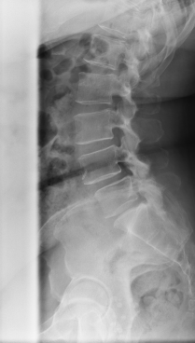
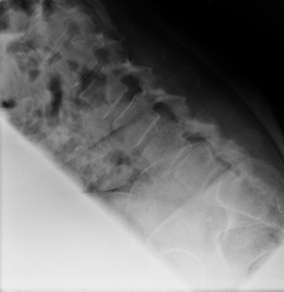
45 yo male with chronic low back pain and
right L5 radiculopathy

Slide 20
50 yo female with lymphoma diagnosed last year
mid-back pain and progressive lower extremity weakness
over two weeks
Examination- BP 130/80, P70
bilateral lower extremity power 3/5

Slide 21
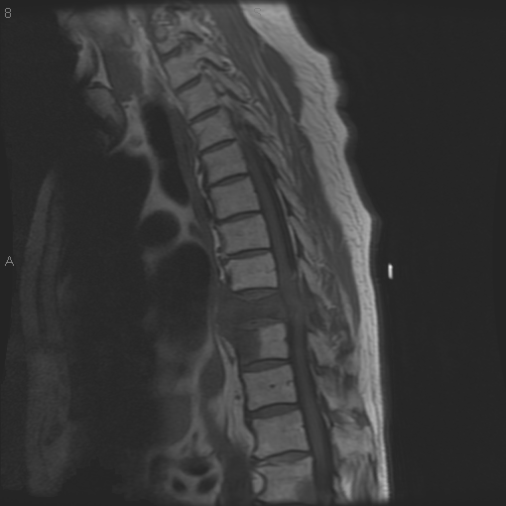
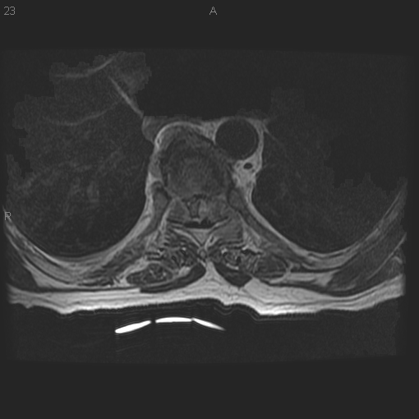

Slide 22
56 year-old with year long memory loss that has worsened over last 3-4 months and gait instability, falls, and urinary incontience.
Patient sent in by PCP after obtaining outside MRI.
Denies trauma to head, LOC, HA, N/V, N/T or seizure, but family states that patient intermittently has difficulty with speech.

Slide 24
32 yo female S/P CHI and abducens paresis

Slide 25
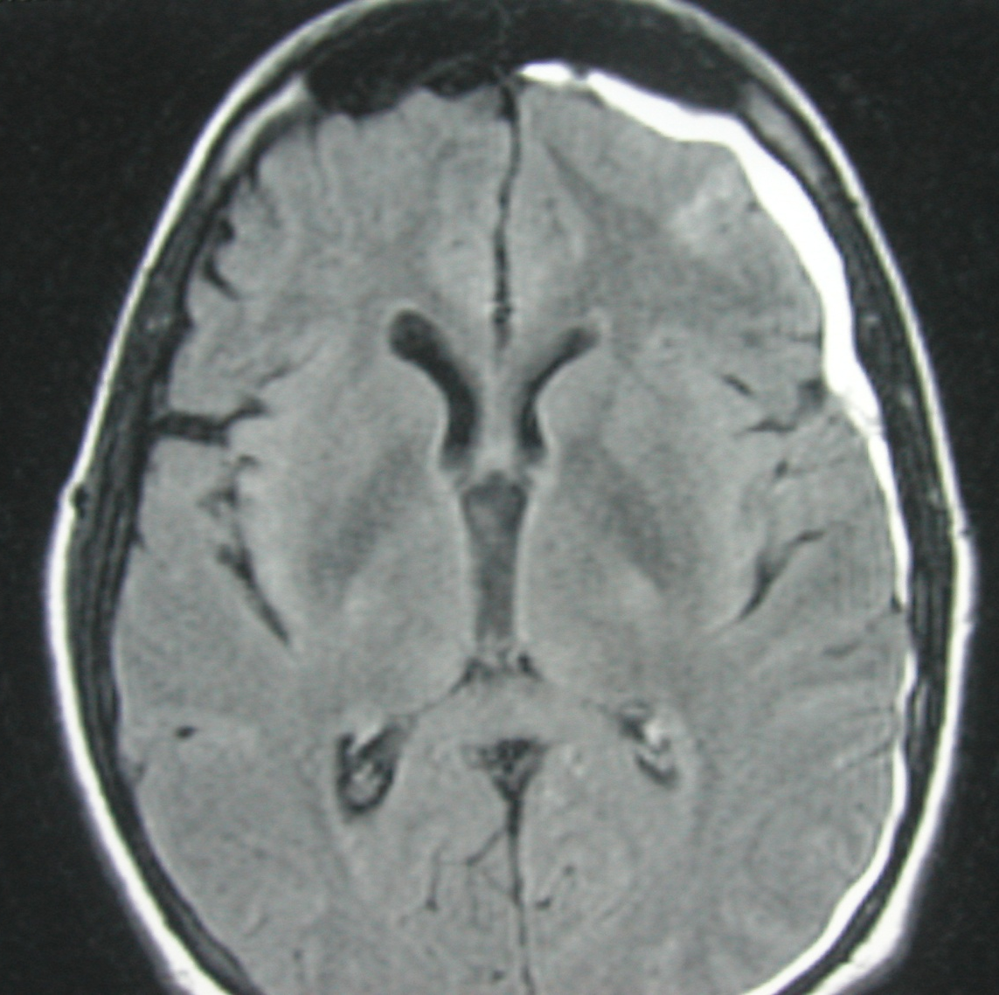
32 yo female S/P CHI and abducens paresis

Slide 26
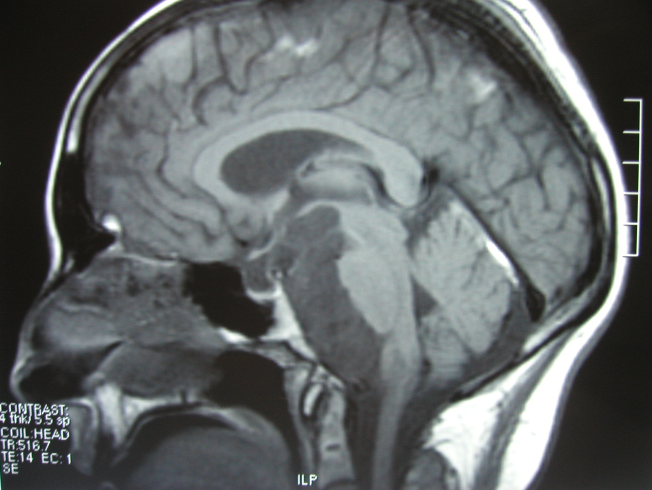
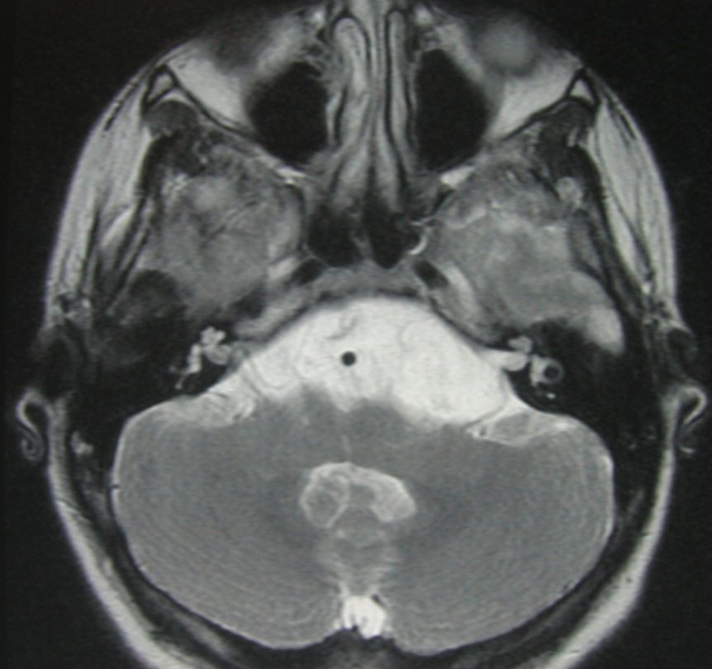

Slide 27
32 yo with acute abducens nerve paresis

Slide 28
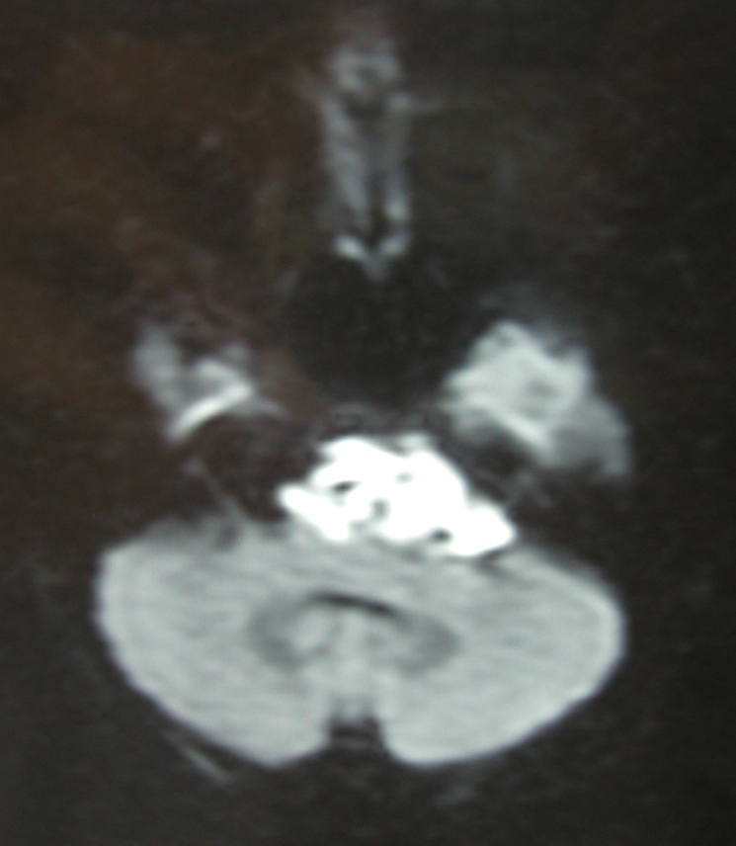
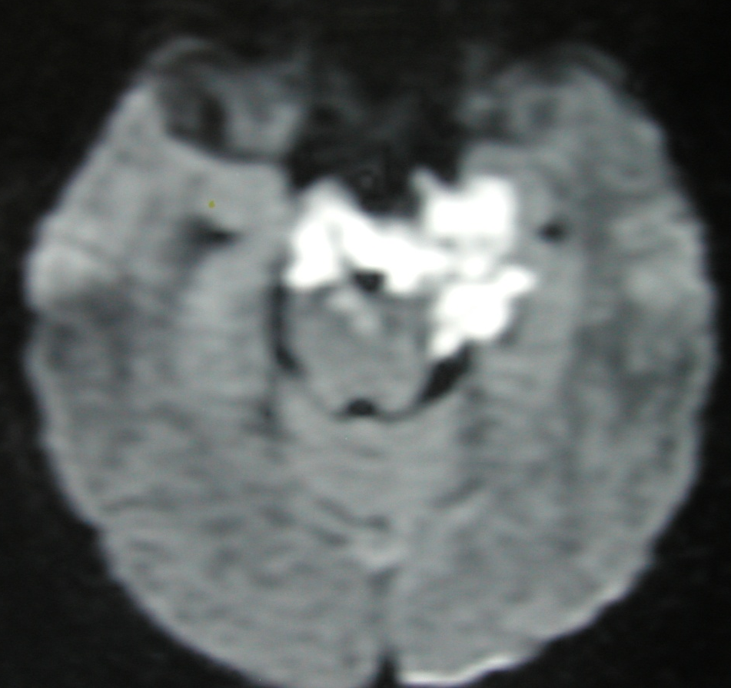

Slide 29
32 yo female with acute abducens paresis

Slide 30
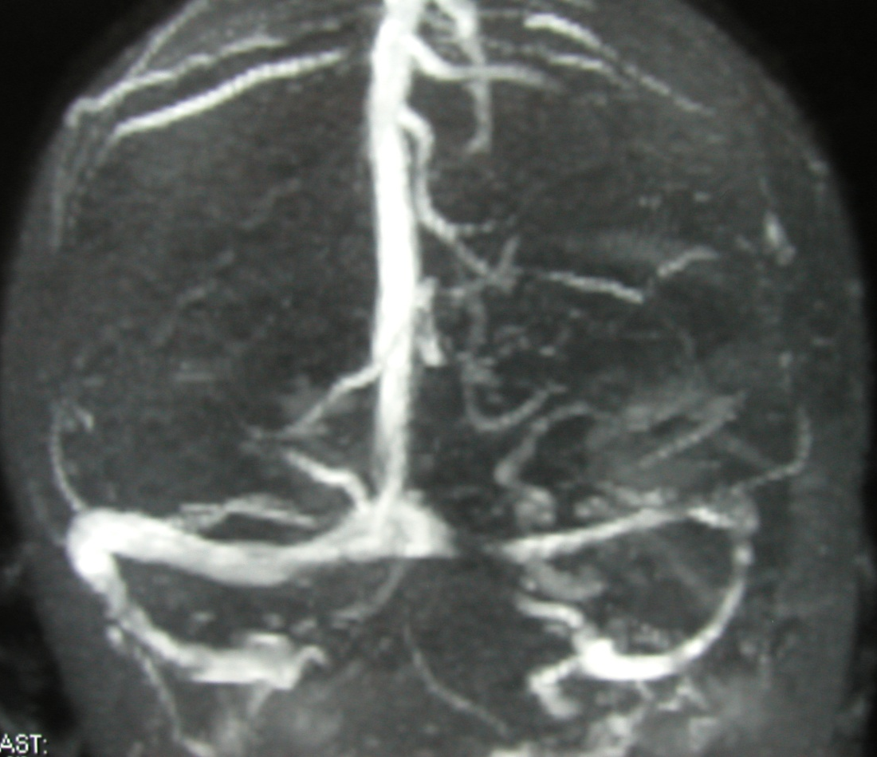
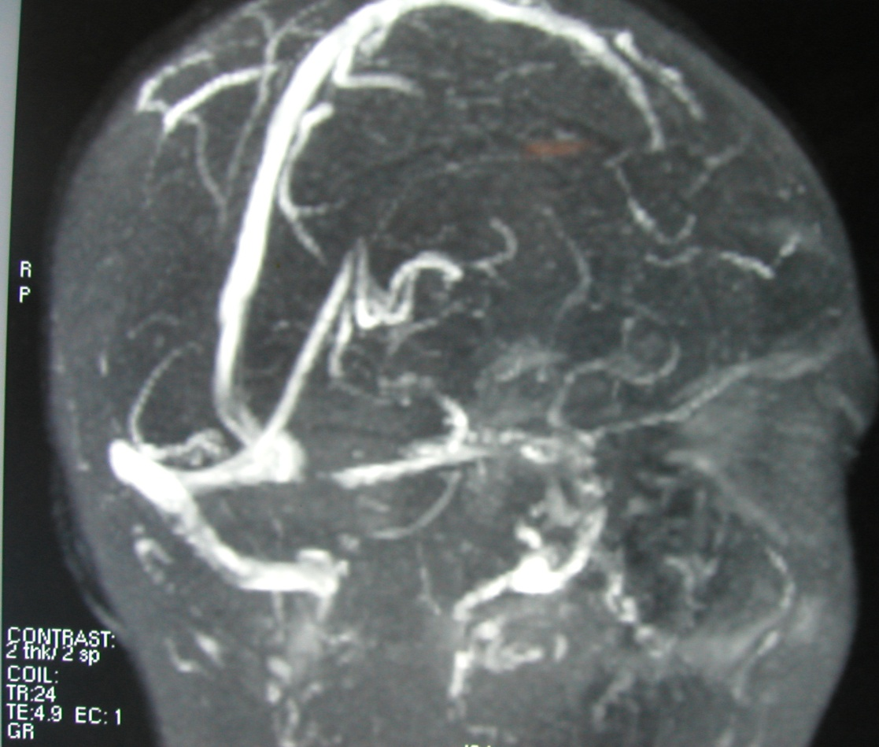

Slide 31
54 yo female with melanoma and progressive
swallowing difficulty
Examination; right vocal cord paralysis

Slide 33
65 yo female with double vision
Examination – left occulmotor paresis

Slide 35
42-year-old woman with left-sided hearing loss
Examination: AS 30Db loss, 70% SD
AD 90Db loss

Slide 36
